Slide 1


Leadership Styles & How to Use Them

Slide 2
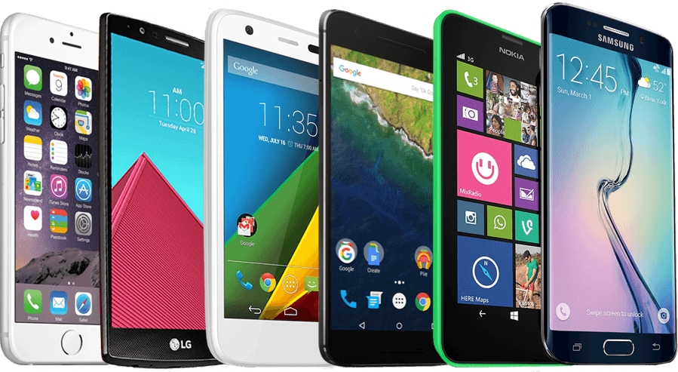


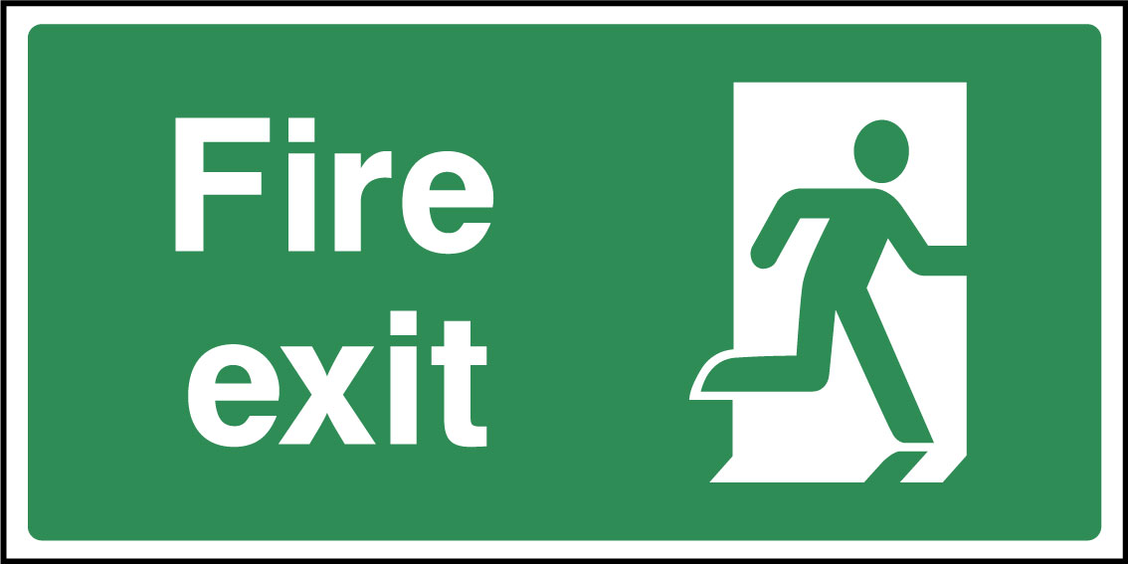
Notes:
PHONES TO SILENT PLEASE
APPRECIATE OFTEN USED FOR TAKING NOTES ETC

Slide 3
Agenda & Flow
Welcome & Introduction
Why This Session?
Leading Vs Managing
Common Leadership Styles
Situational Leadership & Empowering Teams
Close

Slide 4
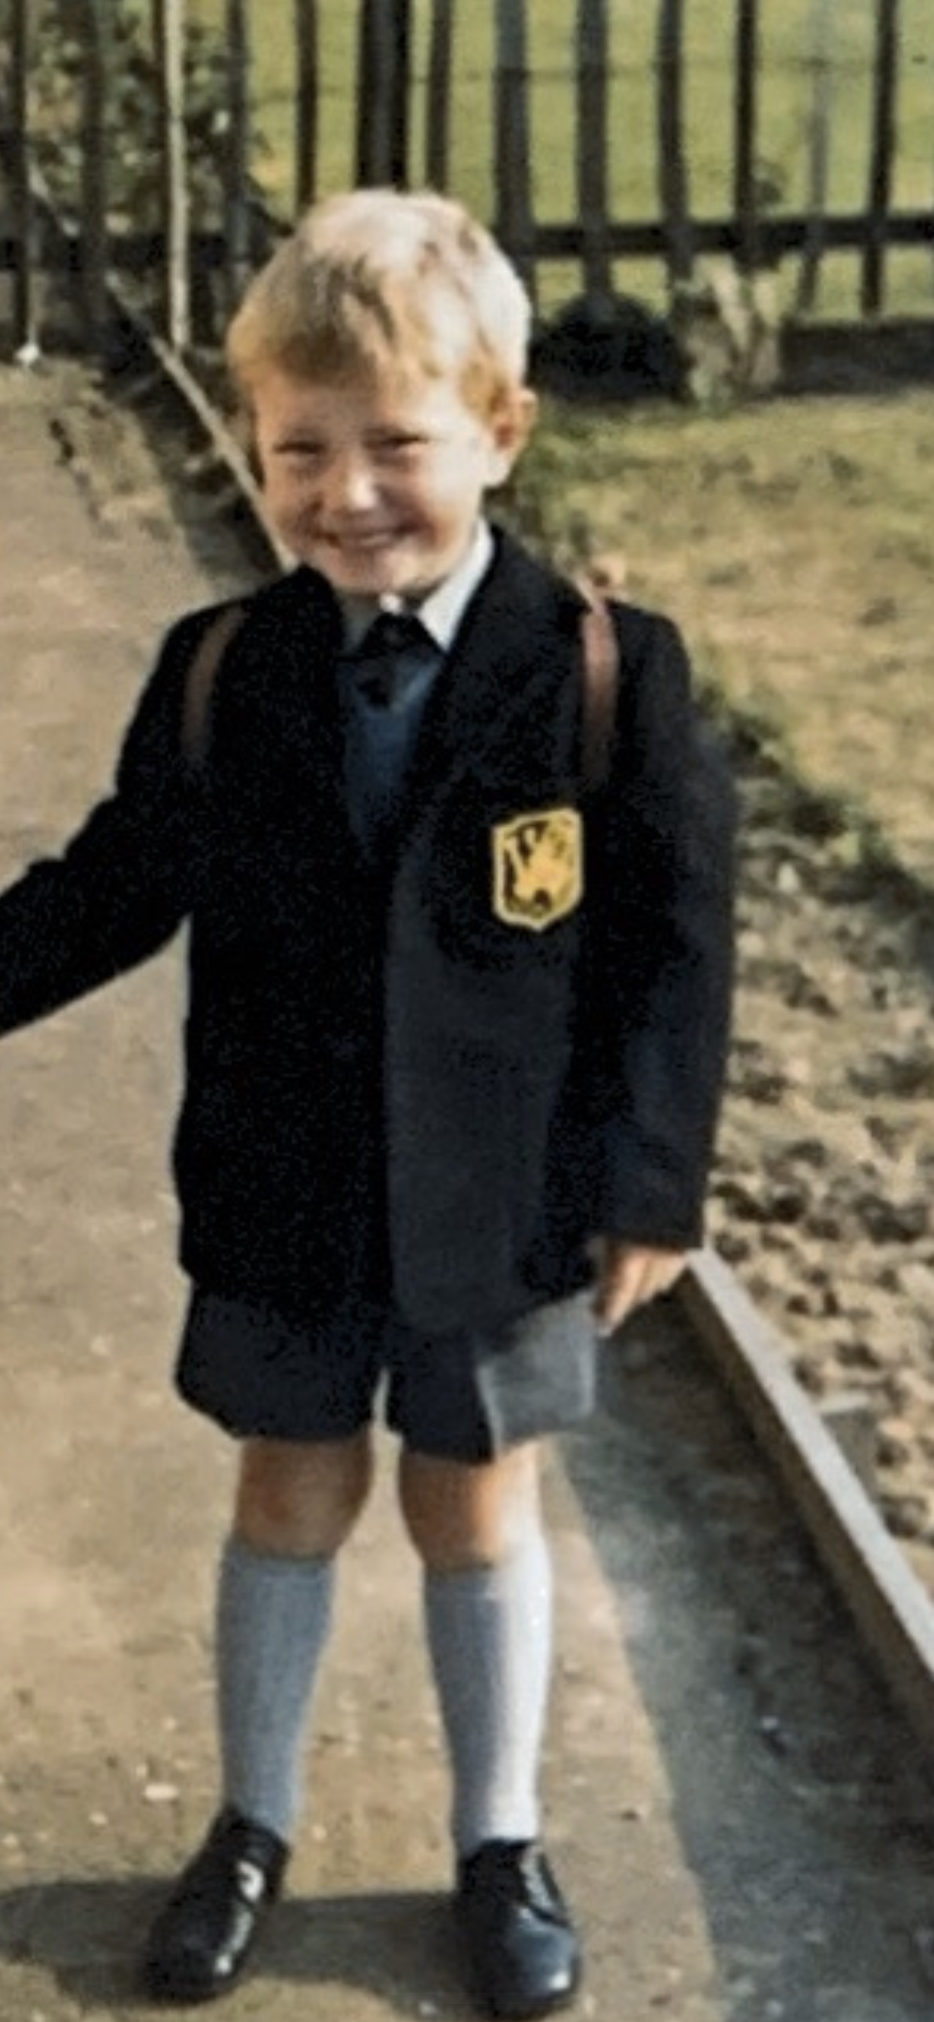
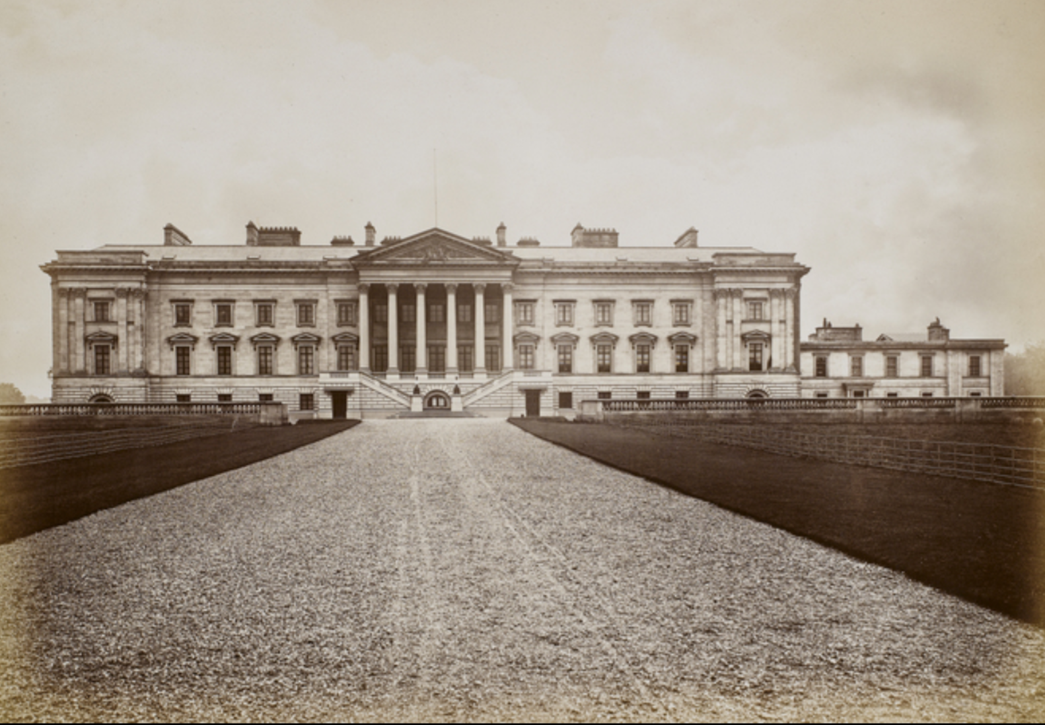
Introduction to me

Slide 5
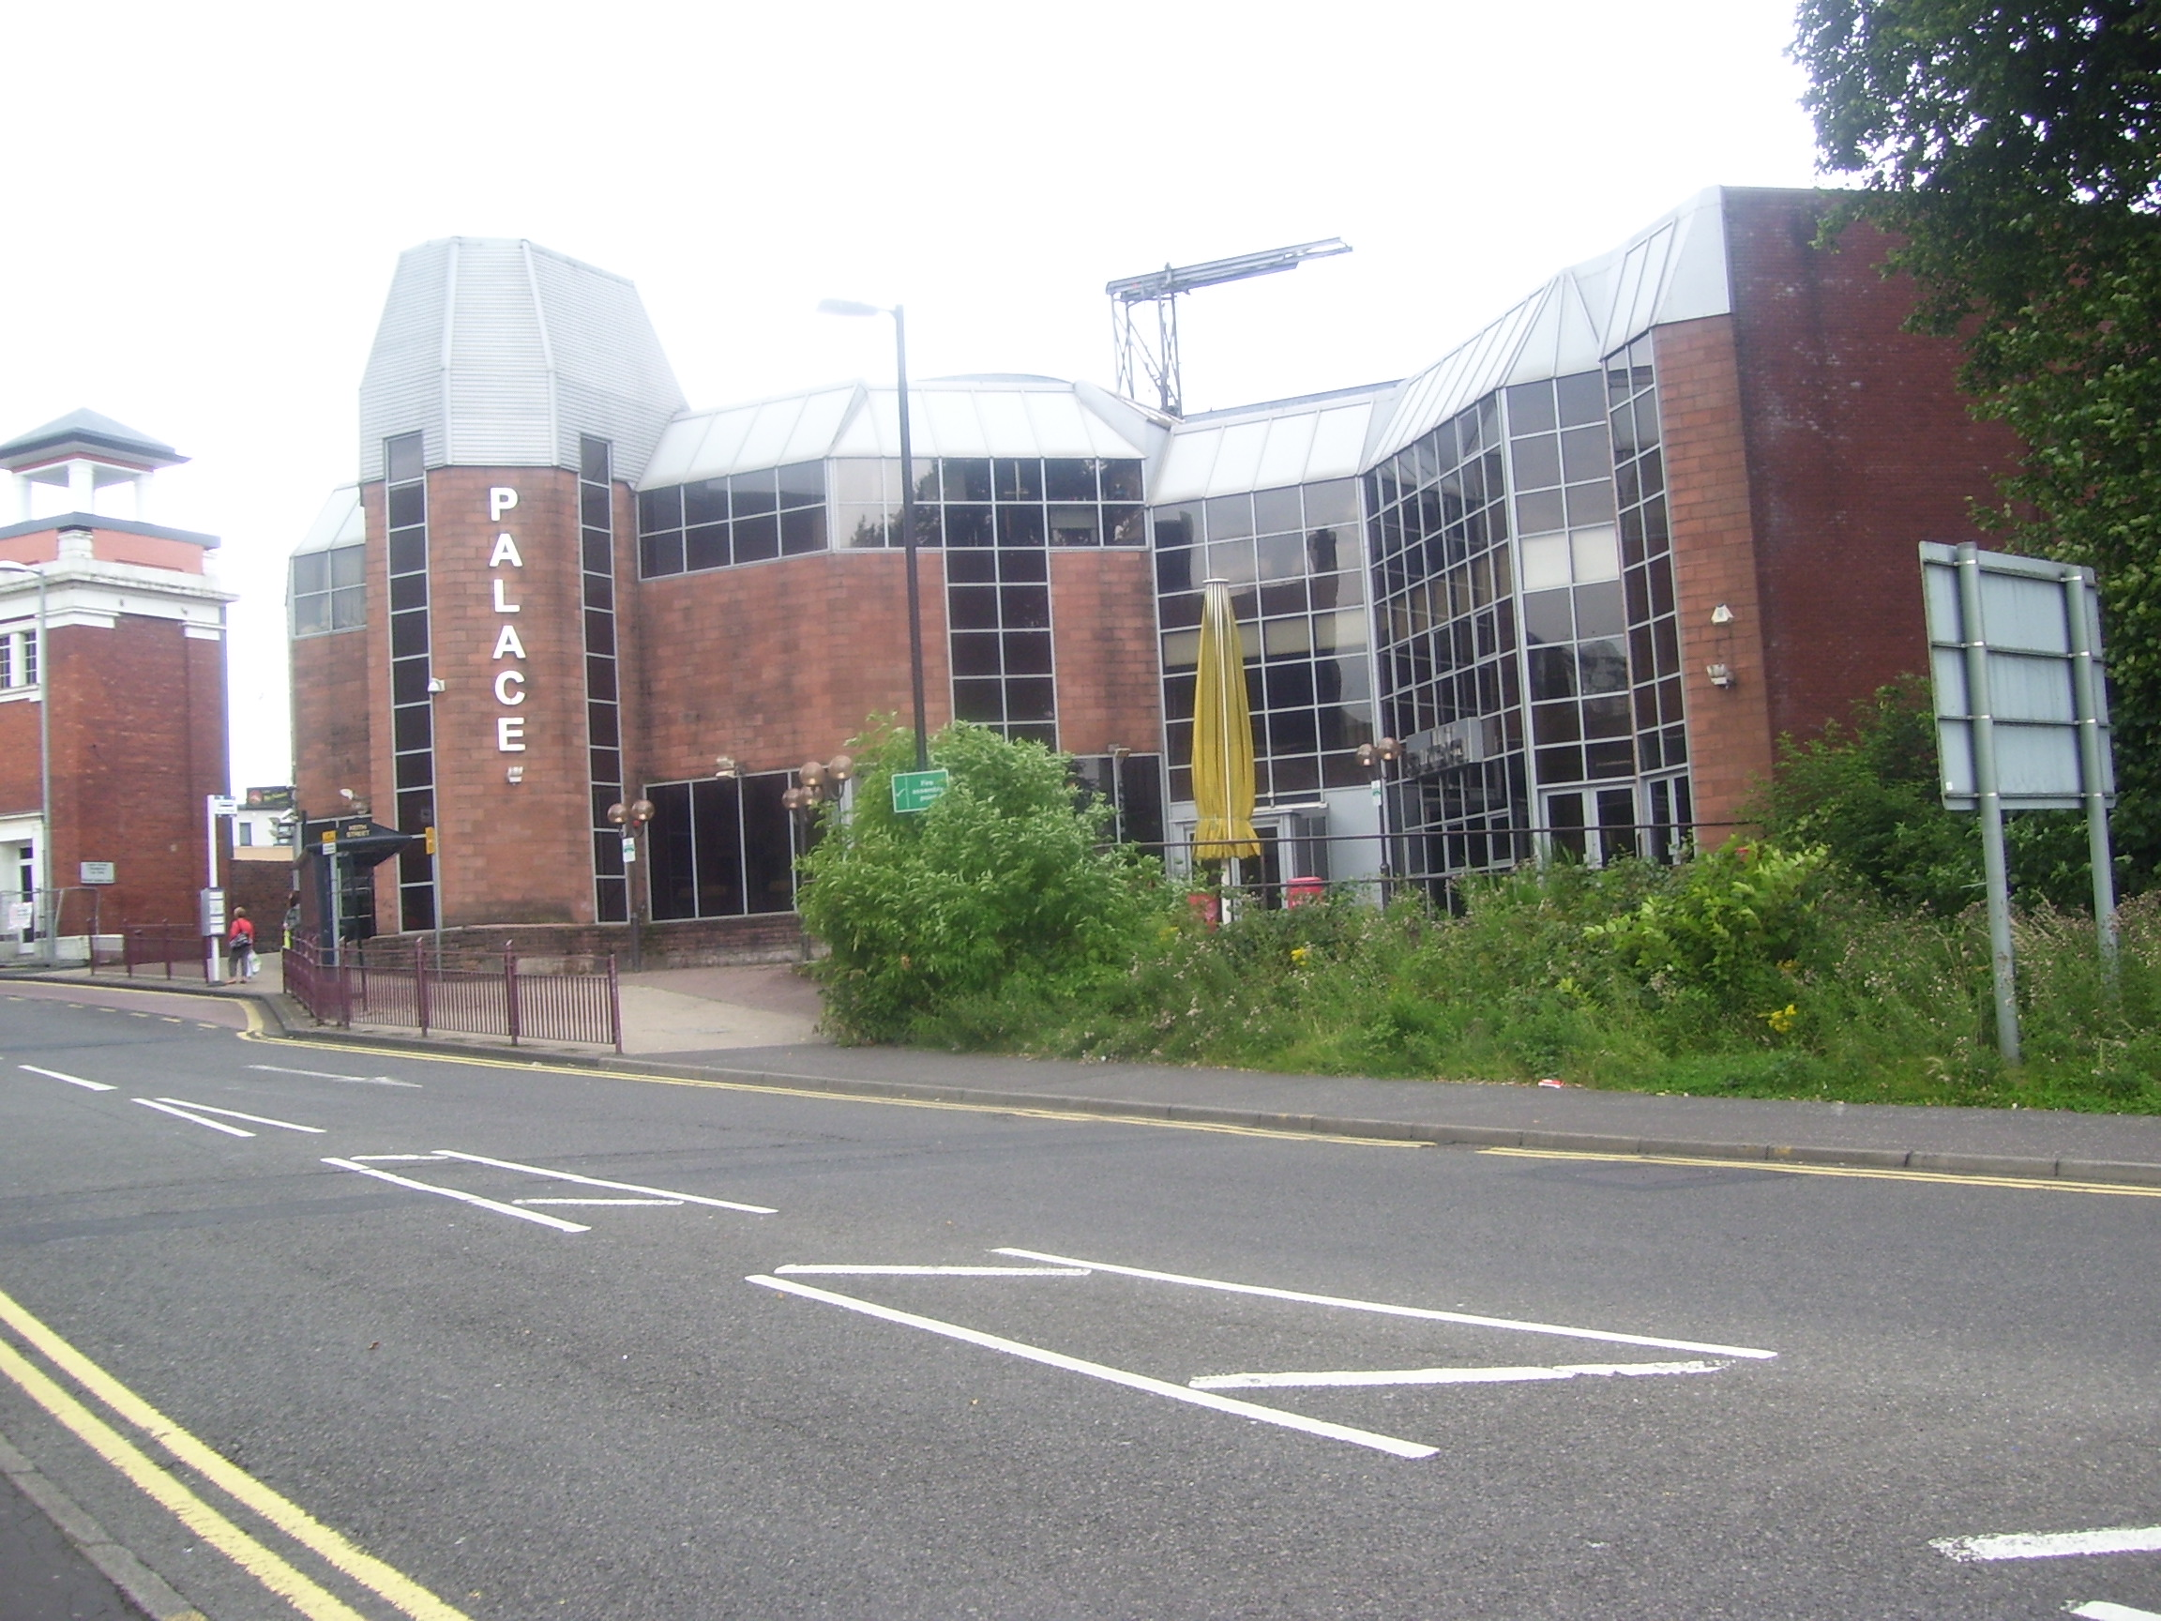
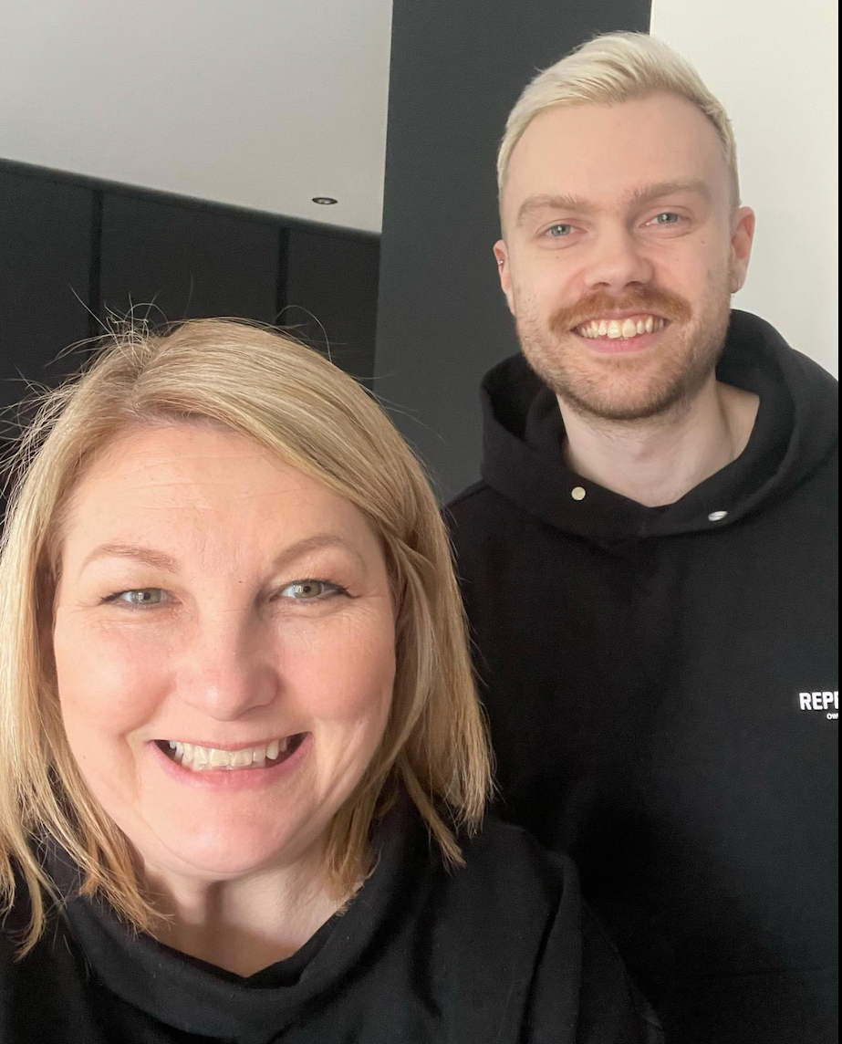
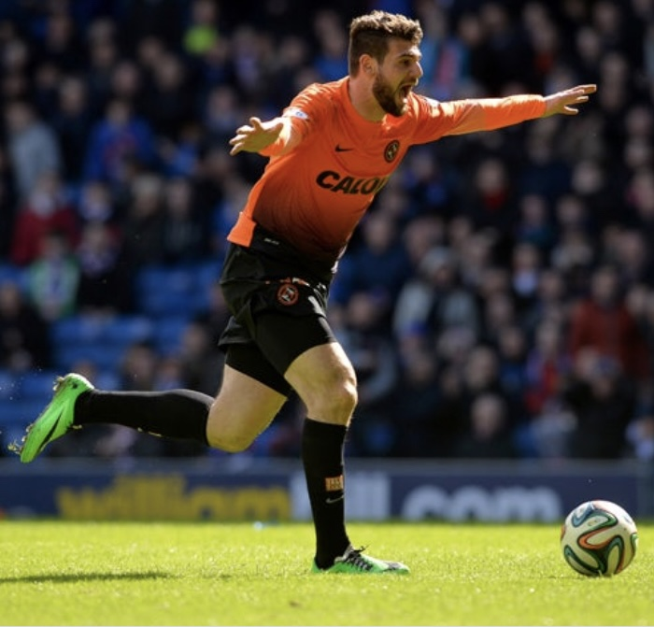
Introduction to me

Slide 6
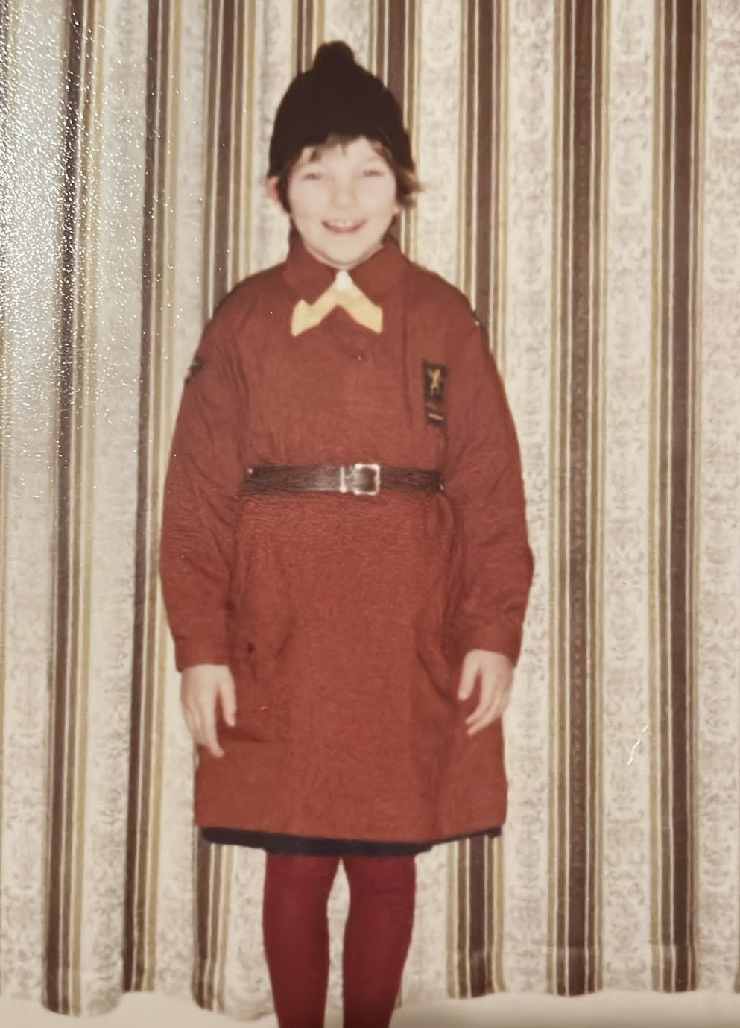
Introduction to me

Slide 7
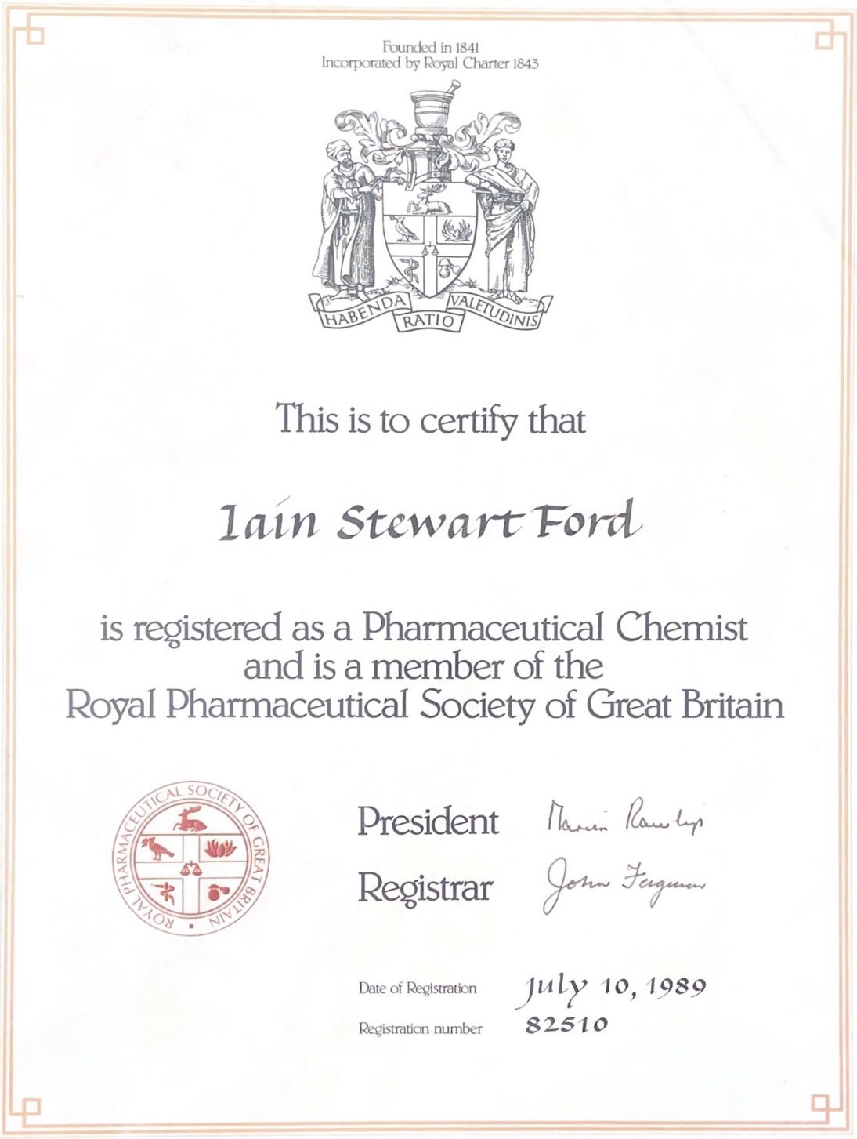
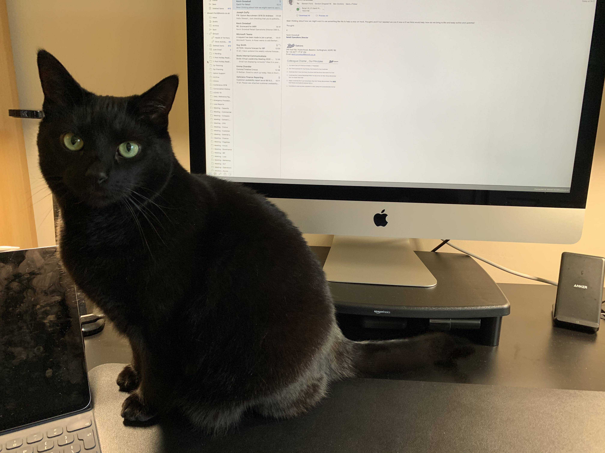
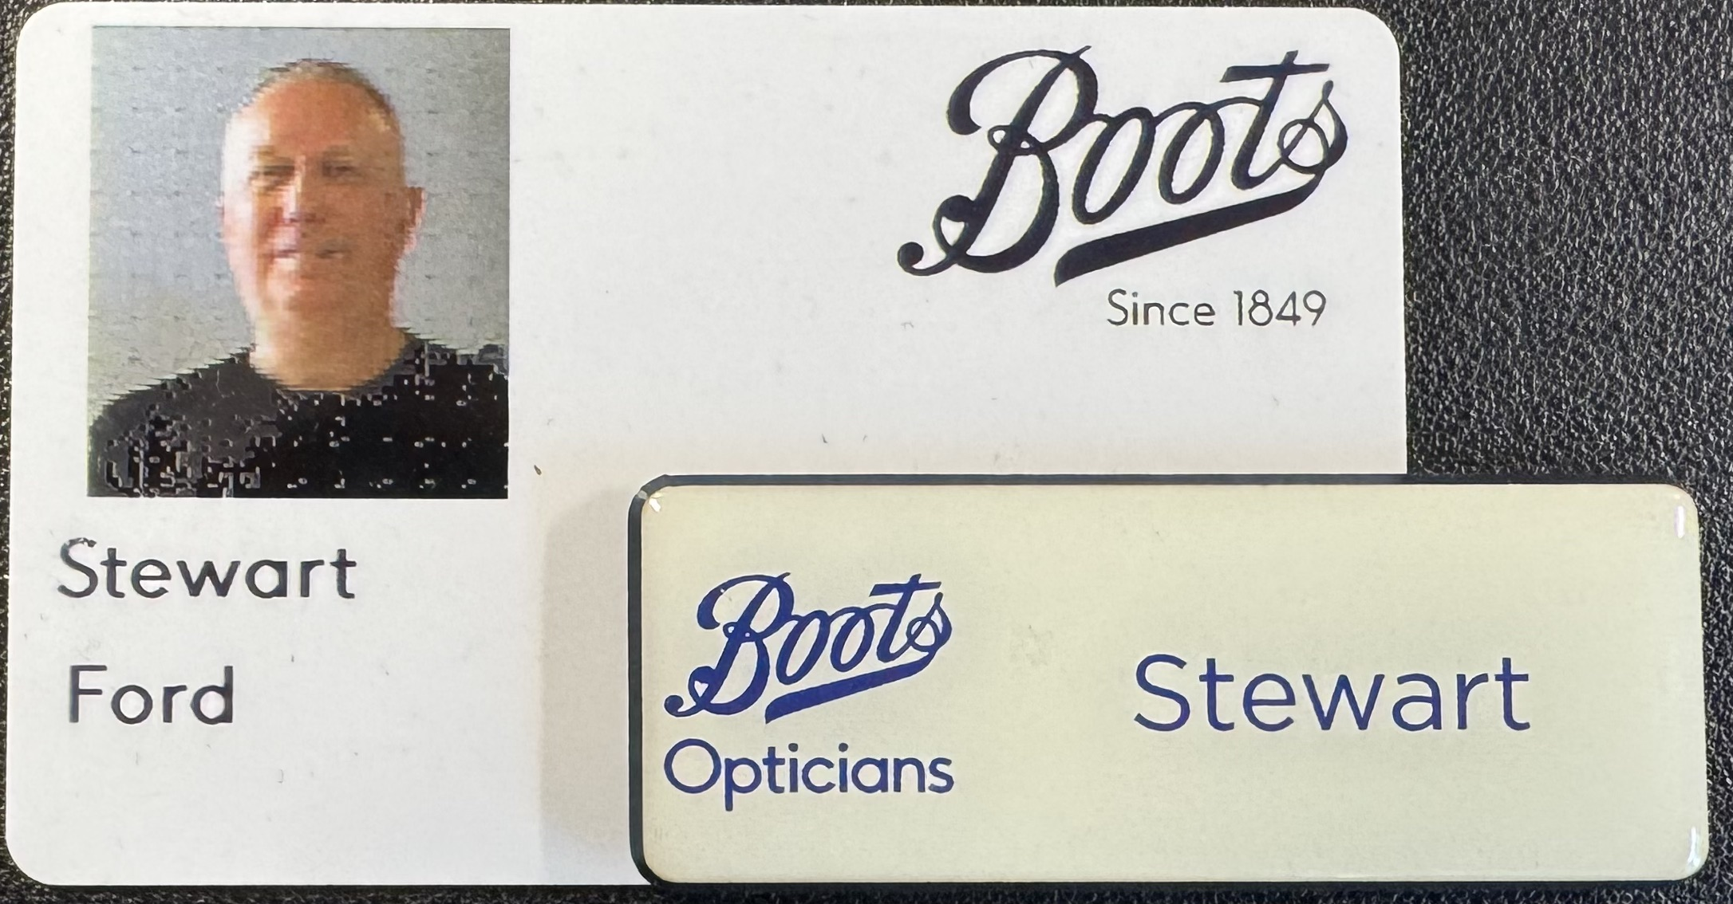
Introduction to me

Slide 8

Introduction to me
Àth C&C LTD

Slide 9
Why Leadership?

Slide 10
Leadership – some definitions
Leadership is the social process of influencing and motivating others to voluntarily work together towards a common purpose, by setting a clear vision and fostering a collaborative environment
Leadership is the ability to guide, influence, or inspire individuals (or teams) toward achieving a common purpose or vision.

Slide 11
Leadership – some definitions
Leadership is the social process of influencing and motivating others to voluntarily work together towards a common goal, by setting a clear vision and fostering a collaborative environment
Leadership is the ability to guide, influence, or inspire individuals (or teams) toward achieving a common purpose or vision

Slide 12

Why you chose to attend this session? What you hope to get out of today’s session? Your interest in leadership and leadership positions going forward. What is holding you back if anything?
Why
Why

Slide 13
Leading Vs Managing?

Slide 14
Leading vs Managing vs Operator
R

Slide 15
Leading vs Managing vs Operator
Operator
Completes day to day tasks
Achieves desired results / outcomes
Operator
R
Actions

Slide 16
Leading Vs Managing Vs Operator
Management
Day to day tactics
Planning and coordinating
Executing strategy
Managing performance
Achieves desired results / outcomes
Operator
R
Manager
Actions
Plans

Slide 17
Leading Vs Managing Vs Operator
Why
Operator
R
Manager
Actions
Plans
Leadership
Being clear on “why”
Setting the vision
Inspiring people towards it
Vision & inspiration
Leader
Possibilities
Relationships

Slide 18
Common Leadership Styles

Slide 19
Leadership Styles - Autocratic
(Leader makes all the decisions with little to no input from others)
Characteristics
Centralised authority
Clear rules and expectations
Strict supervision
Advantages
Fast decision-making
Works in crises or with inexperienced teams
Disadvantages
Low morale and engagement
Suppresses creativity
Supresses individual growth and development

Slide 20
Leadership Styles - Autocratic
(Leader makes all the decisions with little to no input from others)
Characteristics
Centralised authority
Clear rules and expectations
Strict supervision
Advantages
Fast decision-making
Works in crises or with inexperienced teams
Disadvantages
Low morale and engagement
Suppresses creativity
Supresses individual growth and development
High
Supportive Behaviour
Low
Low
Directive Behaviour
High

Slide 21
Leadership Styles - Autocratic
(Leader makes all the decisions with little to no input from others)
Characteristics
Centralised authority
Clear rules and expectations
Strict supervision
Advantages
Fast decision-making
Works in crises or with inexperienced teams
Disadvantages
Low morale and engagement
Suppresses creativity
Supresses individual growth and development
High
Supportive Behaviour
Autocratic
Low
Low
Directive Behaviour
High

Slide 22

Leadership Styles - Autocratic
(Leader makes all the decisions with little to no input from others)
Characteristics
Centralised authority
Clear rules and expectations
Strict supervision
Advantages
Fast decision-making
Works in crises or with inexperienced teams
Disadvantages
Low morale and engagement
Suppresses creativity
Supresses individual growth and development
High
Supportive Behaviour
Autocratic
Low
Low
Directive Behaviour
High

Slide 23
Leadership Styles - Democratic
(Leader involves team members in decision-making.
values input & collaboration)
Characteristics
Shared responsibility
Open communication
Encourages participation
Advantages
Higher morale and trust
Fosters innovation
Generates “buy-in”
Disadvantages
More time-consuming than “tell”
May lead to conflict if opinions differ strongly

Slide 24
Leadership Styles - Democratic
(Leader involves team members in decision-making.
values input & collaboration)
Characteristics
Shared responsibility
Open communication
Encourages participation
Advantages
Higher morale and trust
Fosters innovation
Generates “buy-in”
Disadvantages
More time-consuming than “tell”
May lead to conflict if opinions differ strongly
High
Supportive Behaviour
Low
Low
Directive Behaviour
High

Slide 25
Leadership Styles - Democratic
(Leader involves team members in decision-making.
values input & collaboration)
Characteristics
Shared responsibility
Open communication
Encourages participation
Advantages
Higher morale and trust
Fosters innovation
Generates “buy-in”
Disadvantages
More time-consuming than “tell”
May lead to conflict if opinions differ strongly
High
Democratic
Supportive Behaviour
Low
Low
Directive Behaviour
High

Slide 26
Leadership Styles - Democratic
(Leader involves team members in decision-making.
values input & collaboration)
Characteristics
Shared responsibility
Open communication
Encourages participation
Advantages
Higher morale and trust
Fosters innovation
Generates “buy-in”
Disadvantages
More time-consuming than “tell”
May lead to conflict if opinions differ strongly
High
Democratic
Supportive Behaviour
Low
Low
Directive Behaviour
High

Slide 27
Leadership Styles – Laissez-Faire
(Leader provides little direction - allows team members to self-manage)
Characteristics
Hands-off approach
High autonomy for employees
Leader acts as a facilitator, not a director
Advantages
Works well with highly skilled, motivated teams
Encourages independence and innovation
Disadvantages
Lack of direction can cause confusion
Poor for inexperienced or unmotivated teams
Can feel like disinterested and distant leadership

Slide 28
Leadership Styles – Laissez-Faire
(Leader provides little direction - allows team members to self-manage)
Characteristics
Hands-off approach
High autonomy for employees
Leader acts as a facilitator, not a director
Advantages
Works well with highly skilled, motivated teams
Encourages independence and innovation
Disadvantages
Lack of direction can cause confusion
Poor for inexperienced or unmotivated teams
Can feel like disinterested and distant leadership
High
Supportive Behaviour
Low
Low
Directive Behaviour
High

Slide 29
Leadership Styles – Laissez-Faire
(Leader provides little direction - allows team members to self-manage)
Characteristics
Hands-off approach
High autonomy for employees
Leader acts as a facilitator, not a director
Advantages
Works well with highly skilled, motivated teams
Encourages independence and innovation
Disadvantages
Lack of direction can cause confusion
Poor for inexperienced or unmotivated teams
Can feel like disinterested and distant leadership
High
Supportive Behaviour
Laissez-Faire
Low
Low
Directive Behaviour
High

Slide 30
Leadership Styles – Laissez-Faire
(Leader provides little direction - allows team members to self-manage)
Characteristics
Hands-off approach
High autonomy for employees
Leader acts as a facilitator, not a director
Advantages
Works well with highly skilled, motivated teams
Encourages independence and innovation
Disadvantages
Lack of direction can cause confusion
Poor for inexperienced or unmotivated teams
Can feel like disinterested and distant leadership
High
Supportive Behaviour
Laissez-Faire
Low
Low
Directive Behaviour
High

Slide 31
Leadership Styles - Transformational
(Leader inspires, motivates and drives followers through vision and passion)
Characteristics
Focus on vision, motivation and inspiration
Strong emphasis on personal growth
Strong Communication and Charisma
Advantages
Builds loyalty and commitment
Drives innovation and organisational growth
Disadvantages
Can lead to burn-out
Dependent on leader’s charisma and energy

Slide 32
Leadership Styles - Transformational
(Leader inspires, motivates and drives followers through vision and passion)
Characteristics
Focus on vision, motivation and inspiration
Strong emphasis on personal growth
Strong Communication and Charisma
Advantages
Builds loyalty and commitment
Drives innovation and organisational growth
Disadvantages
Can lead to burn-out
Dependent on leader’s charisma and energy
High
Supportive Behaviour
Low
Low
Directive Behaviour
High

Slide 33
Leadership Styles - Transformational
(Leader inspires, motivates and drives followers through vision and passion)
Characteristics
Focus on vision, motivation and inspiration
Strong emphasis on personal growth
Strong Communication and Charisma
Advantages
Builds loyalty and commitment
Drives innovation and organisational growth
Disadvantages
Can lead to burn-out
Dependent on leader’s charisma and energy
High
Transformational
Supportive Behaviour
Low
Low
Directive Behaviour
High

Slide 34
Leadership Styles - Transformational
(Leader inspires, motivates and drives followers through vision and passion)
Characteristics
Focus on vision, motivation and inspiration
Strong emphasis on personal growth
Strong Communication and Charisma
Advantages
Builds loyalty and commitment
Drives innovation and organisational growth
Disadvantages
Can lead to burn-out
Dependent on leader’s charisma and energy
High
Transformational
Supportive Behaviour
Low
Low
Directive Behaviour
High

Slide 35
Leadership styles
High
Democratic
Transformational
Supportive Behaviour
Laissez-Faire
Autocratic
Low
Low
Directive Behaviour
High

Slide 36
Truly inspirational leadership – my experiences
Truly inspirational and skilled leaders do not display just one style of leadership but flex their style according to the individual and the challenge faced
They do display common characteristics despite their different personalities, skillsets and challenges encountered
They are all skilled in - situational leadership

Slide 37
Situational Leadership

Slide 38
Situational Leadership – Who and How

Slide 39
Situational leadership – who and how
Considers different SKILLSETS and MINDSETS when leading and empowering people effectively
Note -These VARY dependent on the TASK.

Slide 40
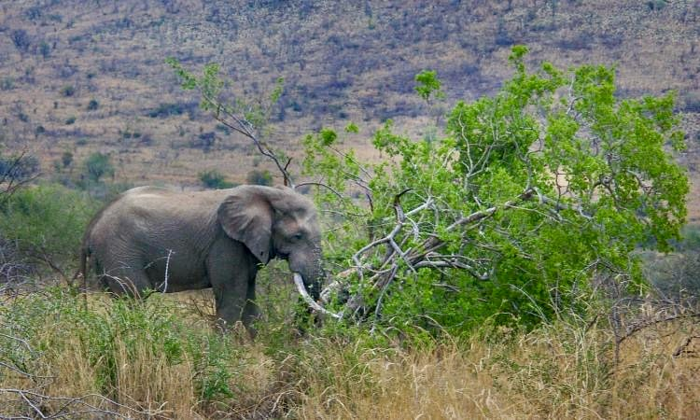
Situational leadership – who and how
Consider different SKILLSETS and MINDSETS when leading and empowering people effectively
Note -these will VARY depending on the TASK.

Slide 41
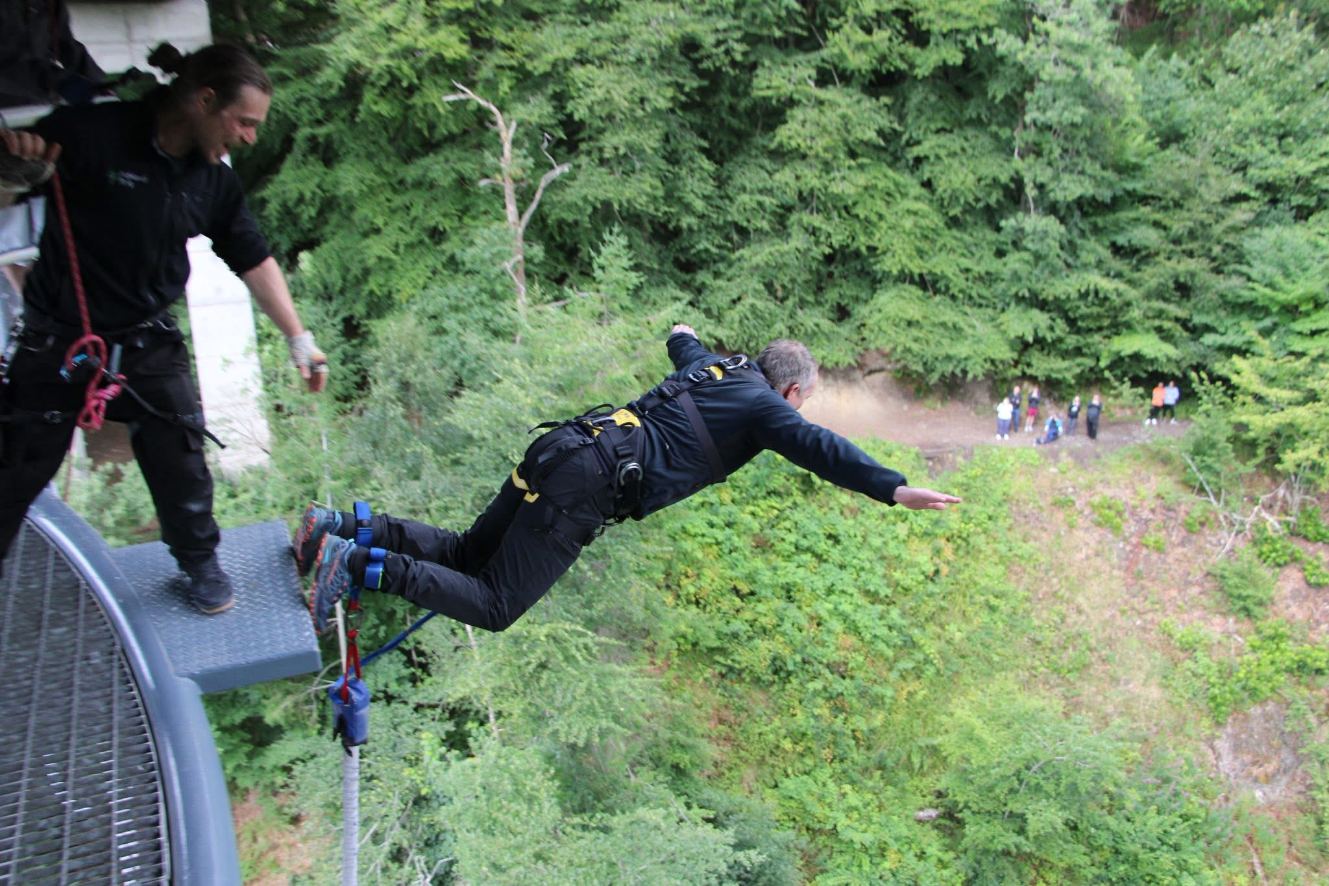
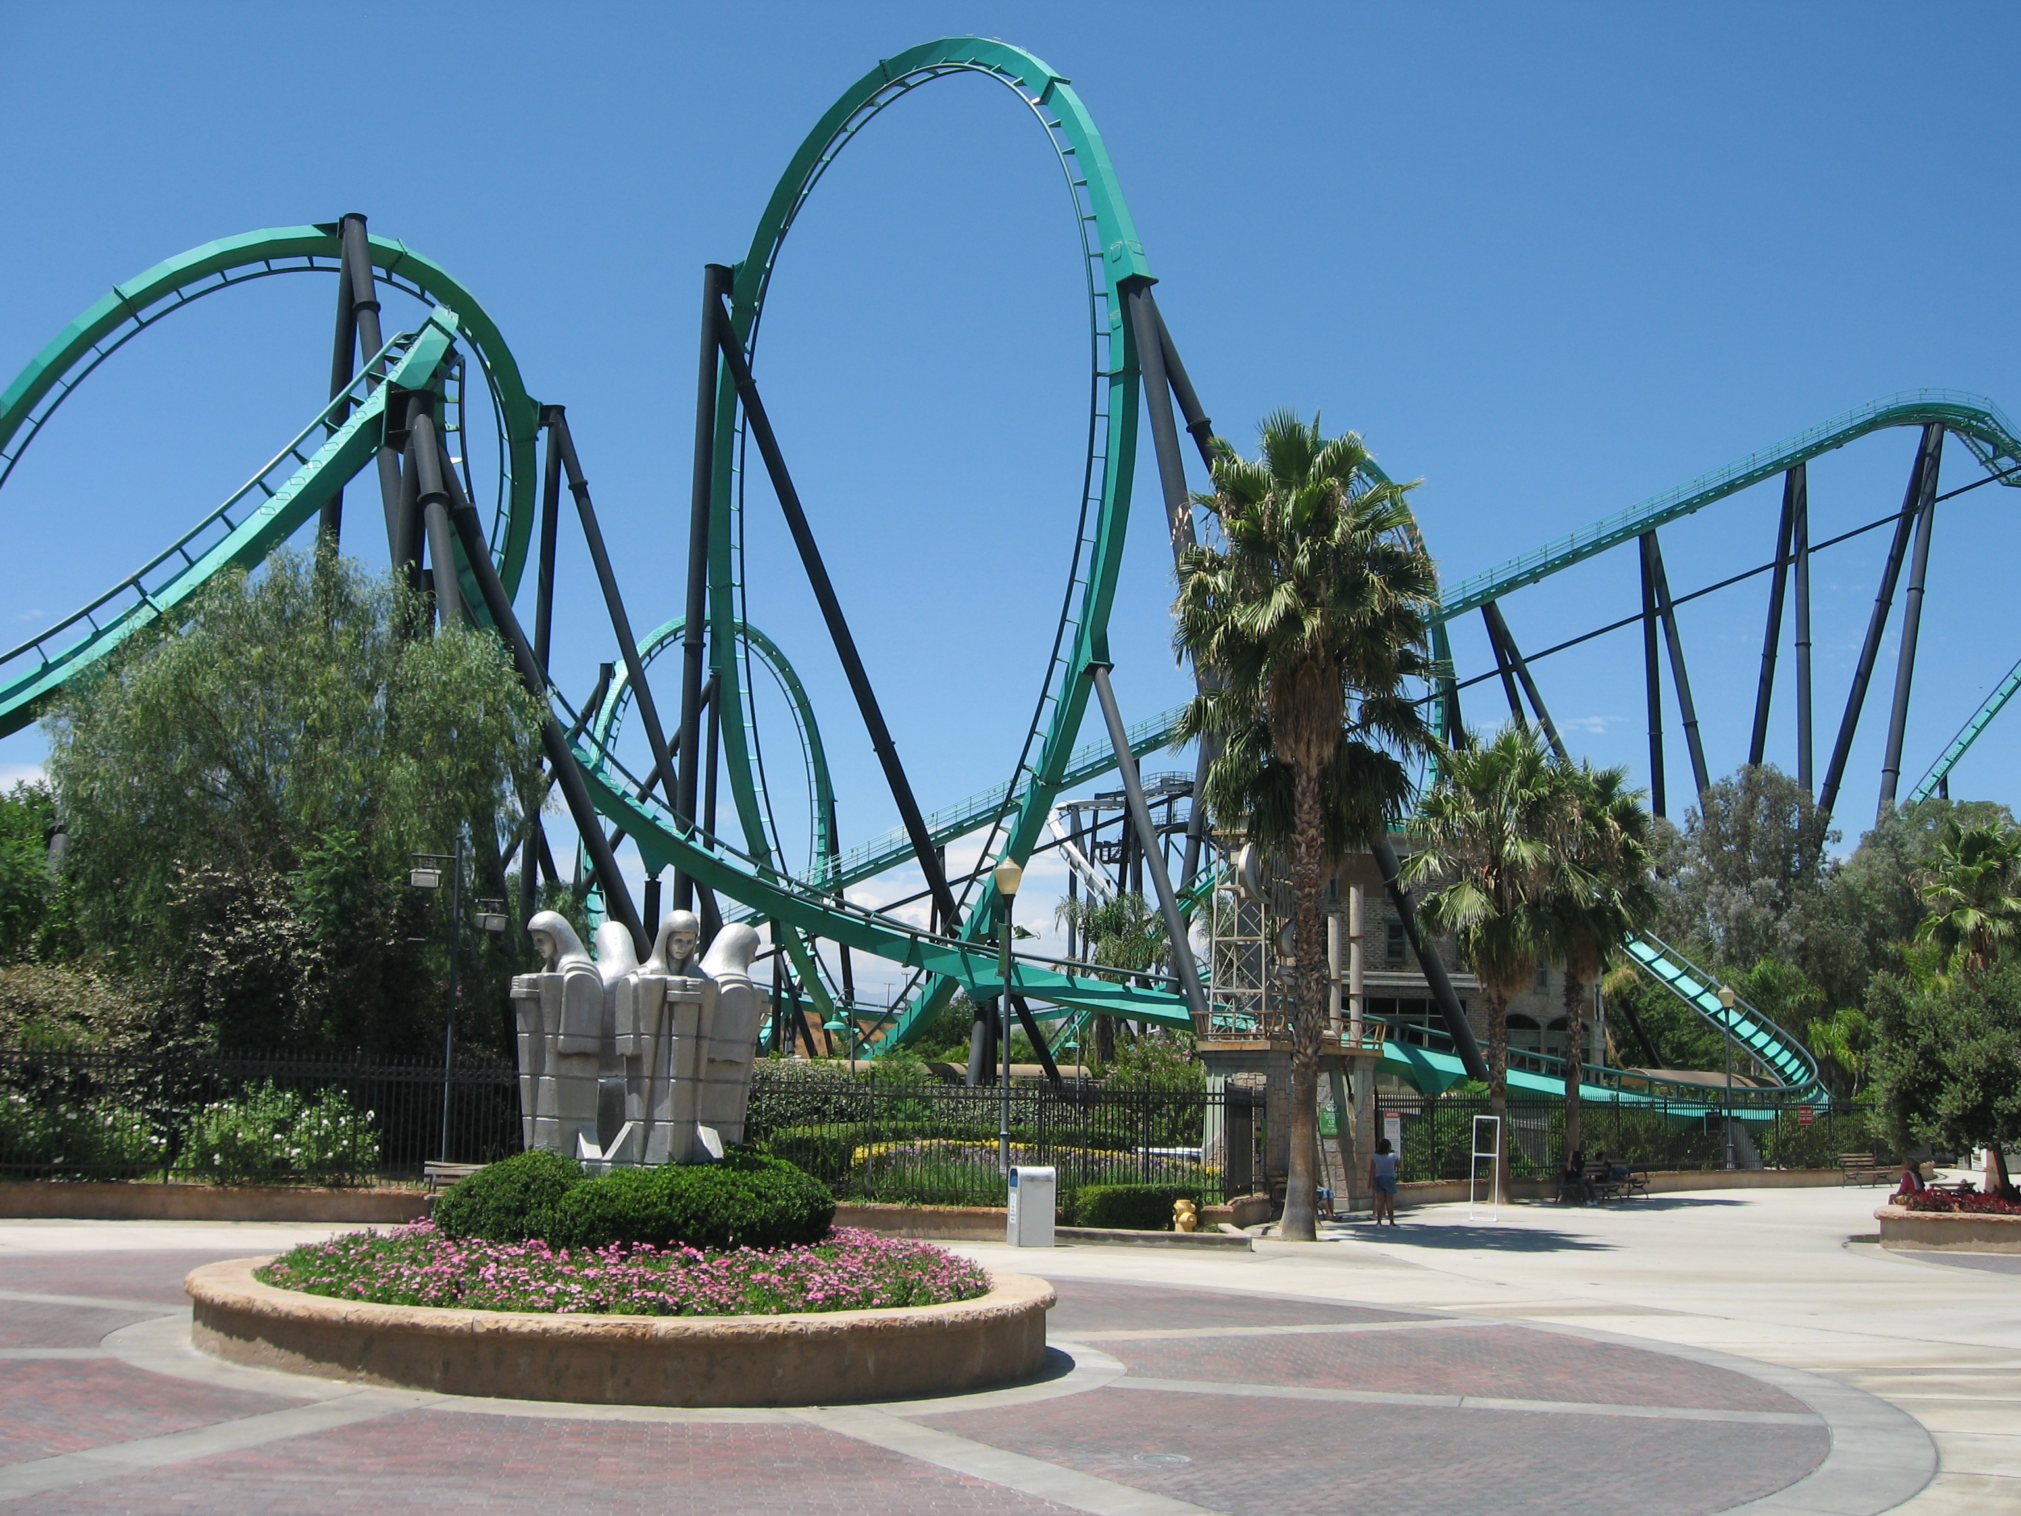
Situational leadership – who and how
Considers different SKILLSETS and MINDSETS when leading and empowering people effectively
Note -These VARY dependent on the TASK.

Slide 42

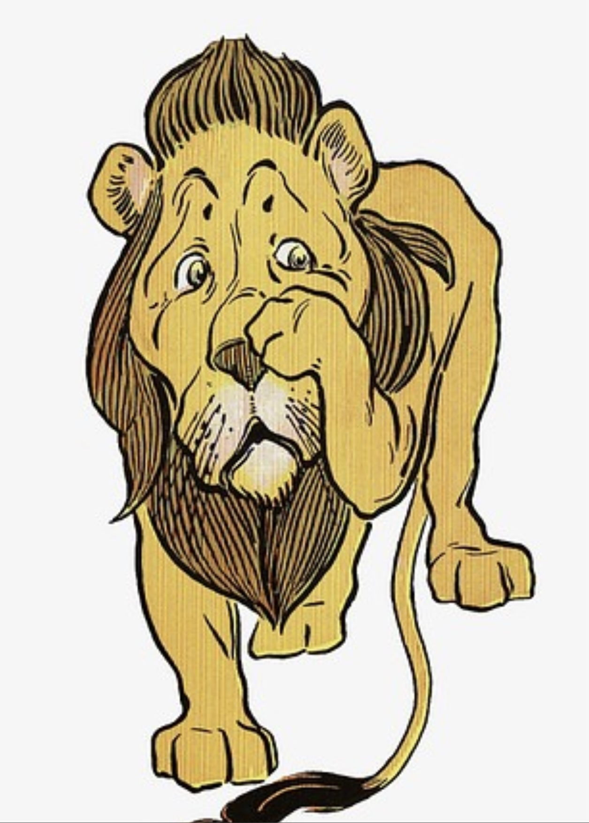
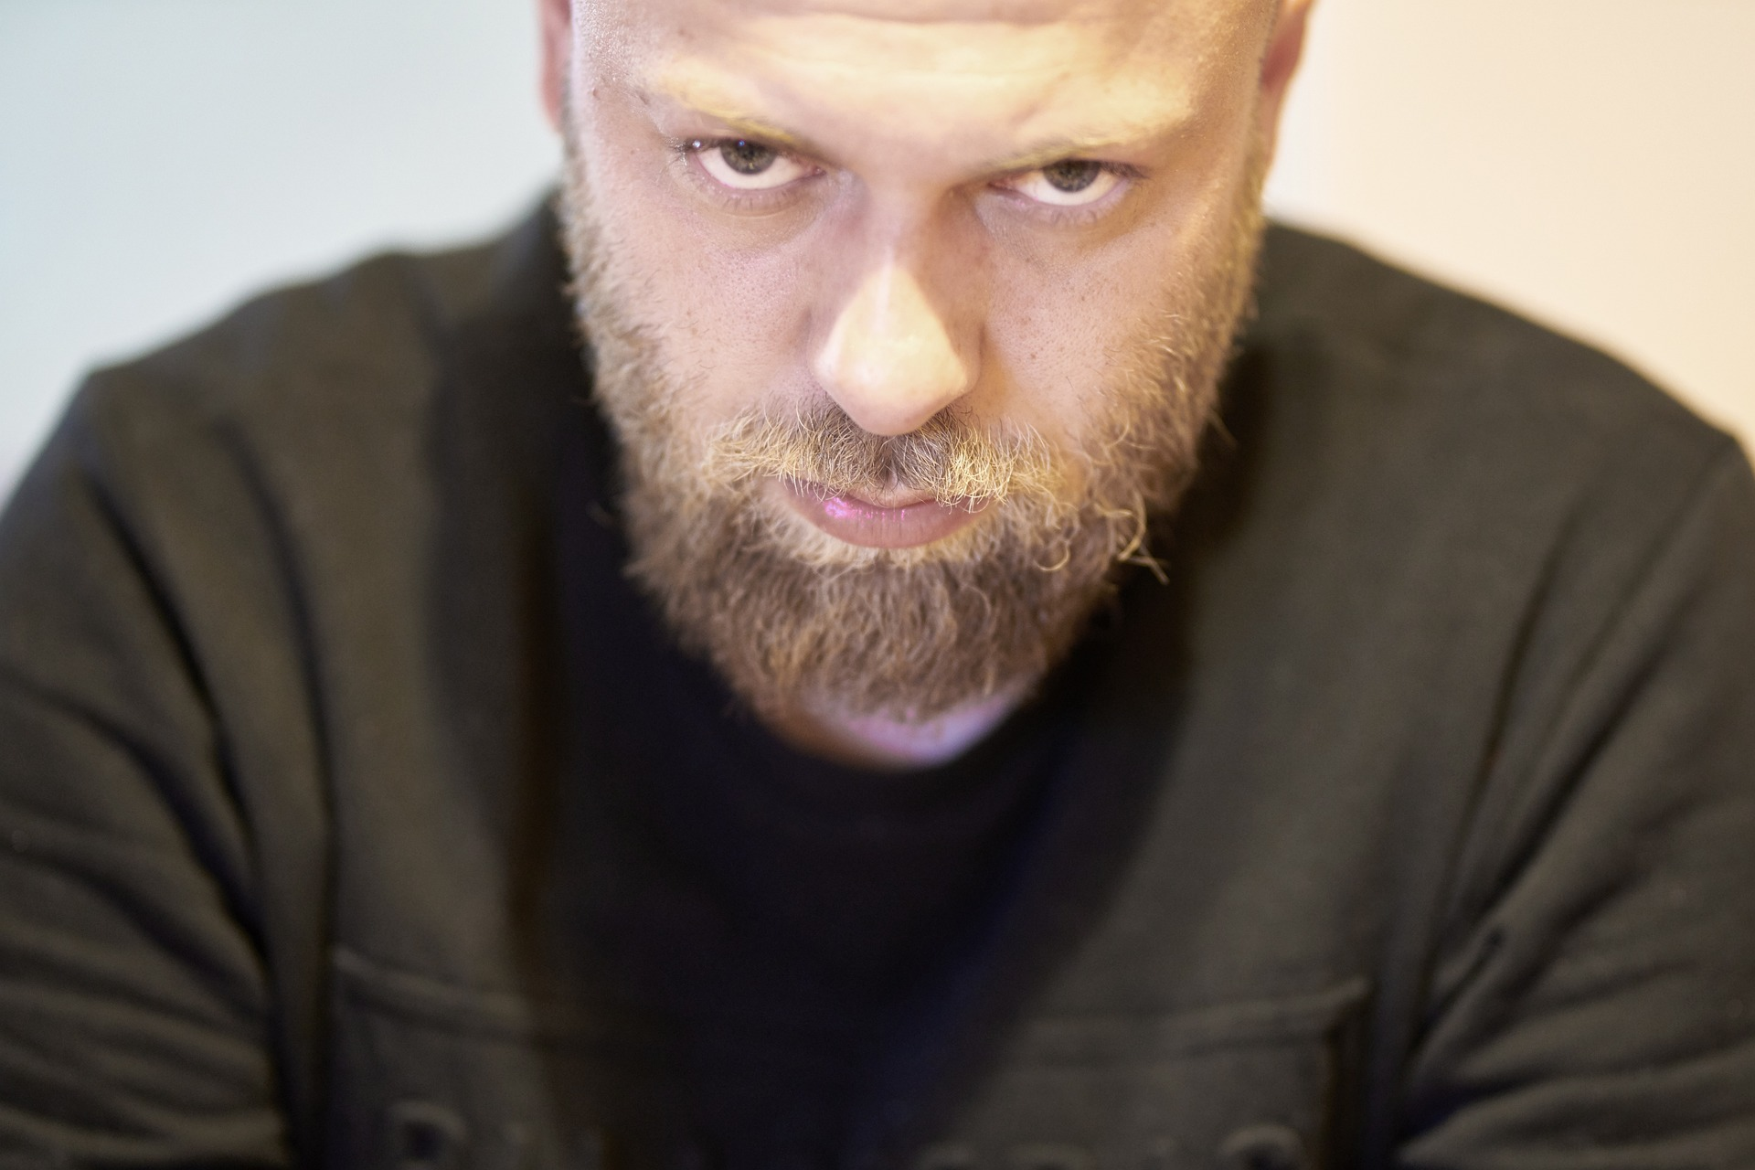
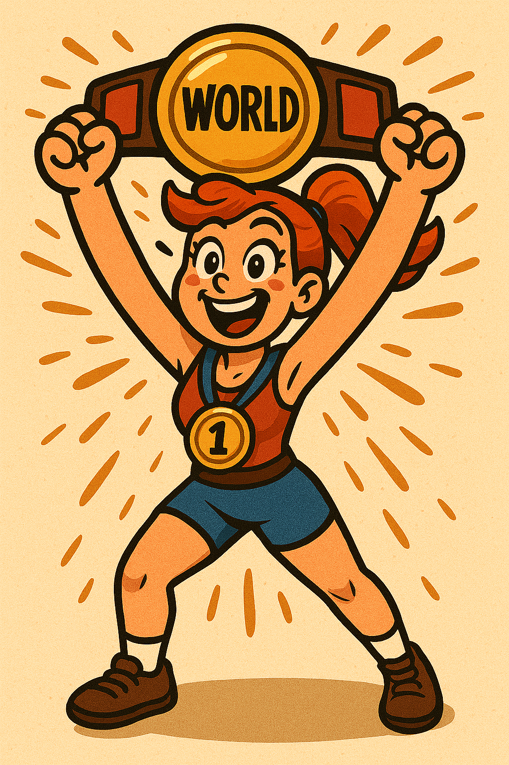
Situational leadership – who and how
Some Character Types to help you decide - all who have different SKILLSETS and MINDSETS
Grumpy & Uncommitted
Eager Puppy
Cowardly Lion
World Champion

Slide 43
Situational leadership – eager puppy
Consider different SKILLSETS and MINDSETS when leading and empowering people effectively
Let’s Go!
Can I try!
Let me at it!
What’s this?
What’s that?
Squirrel!!
Eager puppy

Slide 44
Situational leadership – cowardly lion
Consider different SKILLSETS and MINDSETS when leading and empowering people effectively
What if I do it wrong?
I’m not sure I can do this
I look like a lion; I know what lions do; but I just don’t feel very liony.
Cowardly lion

Slide 45
Situational leadership – world champion
Consider different SKILLSETS and MINDSETS when leading and empowering people effectively
Can I help?
Very safe pair of hands
Let me do that for you
I can do that!!
What if we try it this way?
World champion

Slide 46
Situational leadership – grumpy and uncommitted
Consider different SKILLSETS and MINDSETS when leading and empowering people effectively
It’s not my job!
I’m not interested in this
I wouldn’t know where to start
Can’t cook / won’t cook
Grumpy & Uncommitted

Slide 47
Situational leadership – who and how
Skill
Will

Slide 48
“The eager puppy”
Skill?
Will?

Slide 49
“The eager puppy”
Skill
Will

Slide 50
What style of leadership is required here?
Skill
Will

Slide 51
What style of leadership is required here?
Skill
Will
DIRECTIVE
(Autocratic)

Slide 52
Situational leadership – cowardly lion
Consider different SKILLSETS and MINDSETS when leading and empowering people effectively
Note -These will VARY depending on the task.
What if I do it wrong?
I’m not sure I can do this…
I look like a lion, I know what lions do buy I just don’t feel very liony
Cowardly Lion

Slide 53
“The cowardly lion”
Skill?
Will?

Slide 54
“The cowardly lion”
Will
Skill

Slide 55
What style of leadership is required here?
Will
Skill
SUPPORTIVE
(Democratic)

Slide 56
Situational leadership – world champion
Consider different SKILLSETS and MINDSETS when leading and empowering people effectively
Note -These will VARY depending on the task.
Can I help
Safe pair of hands
Let me do that for you
I can do that - no problems
What if we try it this way
World champion

Slide 57
“A world champion”
Skill?
Will?

Slide 58
“A world champion”
Skill
Will

Slide 59
What style of leadership is required here?
Skill
Will
DELEGATING
(Laissez-Faire)

Slide 60
Situational Leadership – Grumpy & Uncommitted
Consider different SKILLSETS and MINDSETS when leading and empowering people effectively
Note -These will VARY depending on the task.
It’s not my job!
I’m not interested in this
I wouldn’t know where to start...
Can’t Cook / Won’t Cook
Grumpy & Uncommitted

Slide 61
“Grumpy and uncommitted”
Skill?
Will?

Slide 62
“Grumpy and uncommitted”
Skill
Will

Slide 63
What Style of Leadership is Required Here?
Skill
Will
COACHING STYLE
(Transformational)

Slide 64
Situational leadership
Consider different SKILLSETS and MINDSETS when leading and empowering people effectively
Note -These will VARY depending on the task.
DIRECTIVE
(Autocratic)
SUPPORTIVE
(Democratic)
COACHING
(Transformational)
DELEGATORY
(Laissez-Faire)

Slide 65
Consequences of each style
Non-Directive (Coach)
Directive (Tell)
Directing Coaching Supporting Delegating
Ownership
Manager
Individual
Responsibility and Awareness of Individual
Low
High
Sustainability
When tasks and objectives are delegated effectively, they are more likely to be owned and sustained by the individual.
Source: This panel set has been developed with reference to Leadership and the One Minute Manager, Kenneth Blanchard 1986
Notes:
21

Slide 66
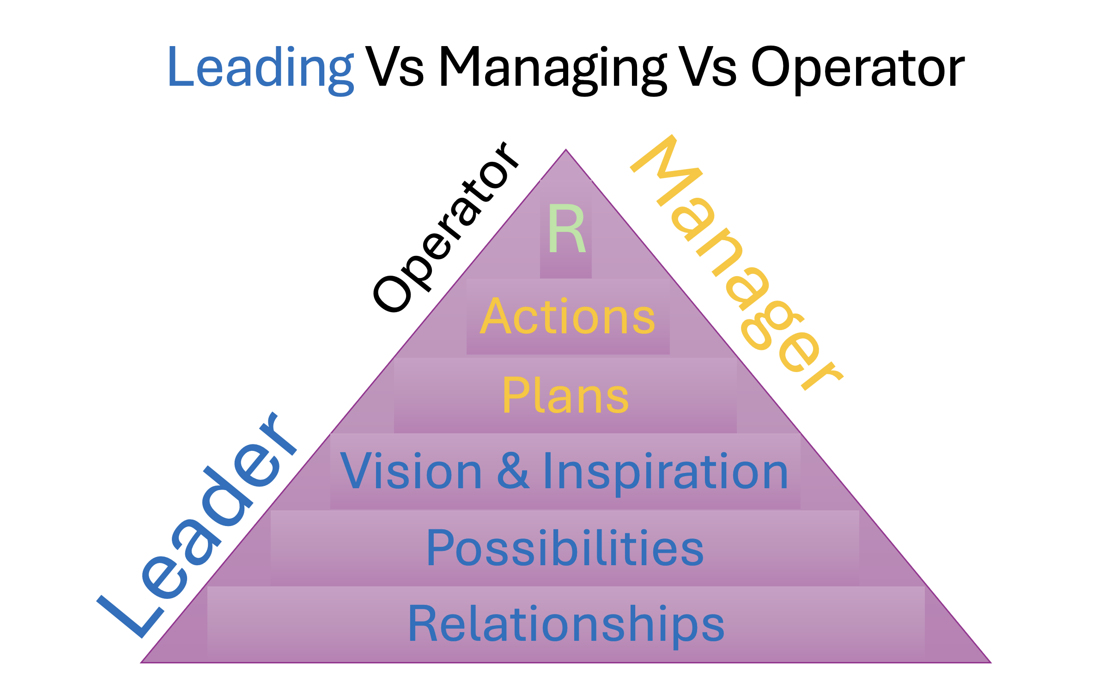
Leadership workshop - summary
High
Democratic
Transformational
Supportive Behaviour
Laissez-Faire
Autocratic
Low
Low
Directive Behaviour
High
Skill
Focus
Will
Directive (Tell)
Non-Directive (Coach)
Directing Coaching Supporting Delegating
Ownership
Manager
Individual
Responsibility and Awareness of Individual
Low
Sustainability
High

Slide 67
For you to consider
How Could You Pro-Actively Spend More Time In The Bottom Layers of The Relationships Pyramid
How Could You Use a Situational Approach To Leadership To Effectively Empower Teams?
What Do You Need to Change About Yourself To Achieve Your Leadership Ambitions?
What Support Do You Need and Where Could You Get It From?
Skill
Focus
Will

Slide 68

Good luck on your leadership journey!

