Slide 1

Helping with your work-life-guiding balance
Lead 2025
1st November 2025
PUT SLIDO DETAILS HERE
Notes:
00:00 / 1 mins
Welcome participants as they arrive and encourage to log onto Slido as they wait for session to begin.
Introductions – trainer name and role
Housekeeping –
Pens/paper/activities
Slides shared
Breaks – potentially sensitive topic
Confidentiality
Fire etc.

Slide 2
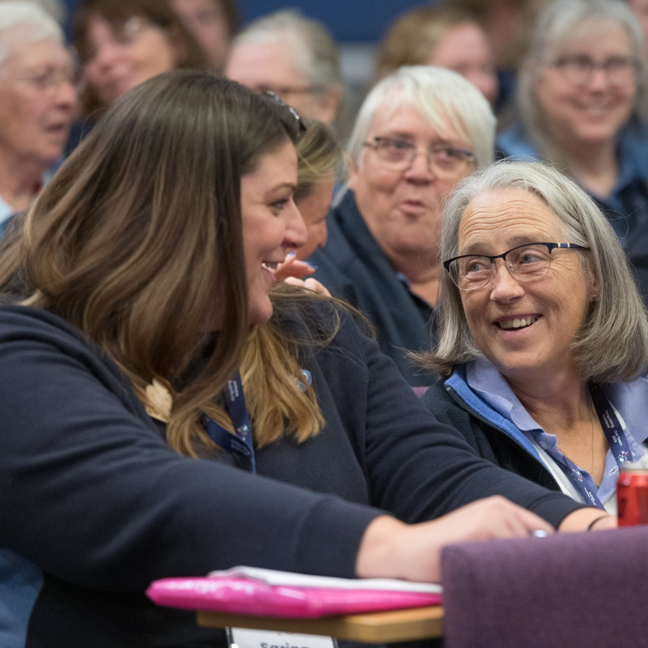
Objectives
Building time management skills and promoting wellbeing
Understand the importance of maintaining a healthy balance between work, life, and volunteering
Identify common challenges faced in balancing these commitments
Explore practical time management techniques to help you balance your time across work, life and guiding
Identify different ways you can support your wellbeing
Signposting to resources for support
SLIDO DETAILS
Notes:
00:01 / 1 mins
Summarise objectives as on slide.

Slide 3

SLIDO DETAILS
Notes:
00:02 / 1 min
Wellbeing and time management techniques are both very personal things. Some things that work brilliantly for one person won’t work at all for another. [Chocolate/sweetie analogy]. Today, we’ll cover a range of different time management techniques and means of supporting your wellbeing at surface level – the idea is to introduce you to different options and if, as I hope, something resonates with you, you can take it away and investigate further.

Slide 4




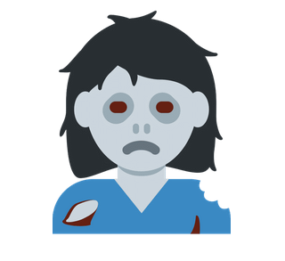
Emoji poll: which emoji best represents how you feel about your work-life-guiding balance?
Slido results integrated if possible
SLIDO DETAILS
Notes:
00:03 / 2 mins
We are beginning with a poll – go onto Slido and select and the emoji which best represents how you feel about your work-life-guiding balance. You can pick any emoji you want - [give some examples of potential choices]
[If slido results not integrated into ppt switch to browser window]
[Comment on emojis as responses come in]
Invite feedback from participants on why they chose the emoji they did and discuss. [Only 1 or 2 given tight timings]

Slide 5
Time management techniques
SLIDO DETAILS
Notes:
00:05 / 10 secs
Going to start of by jumping straight into looking at some time management techniques.

Slide 6
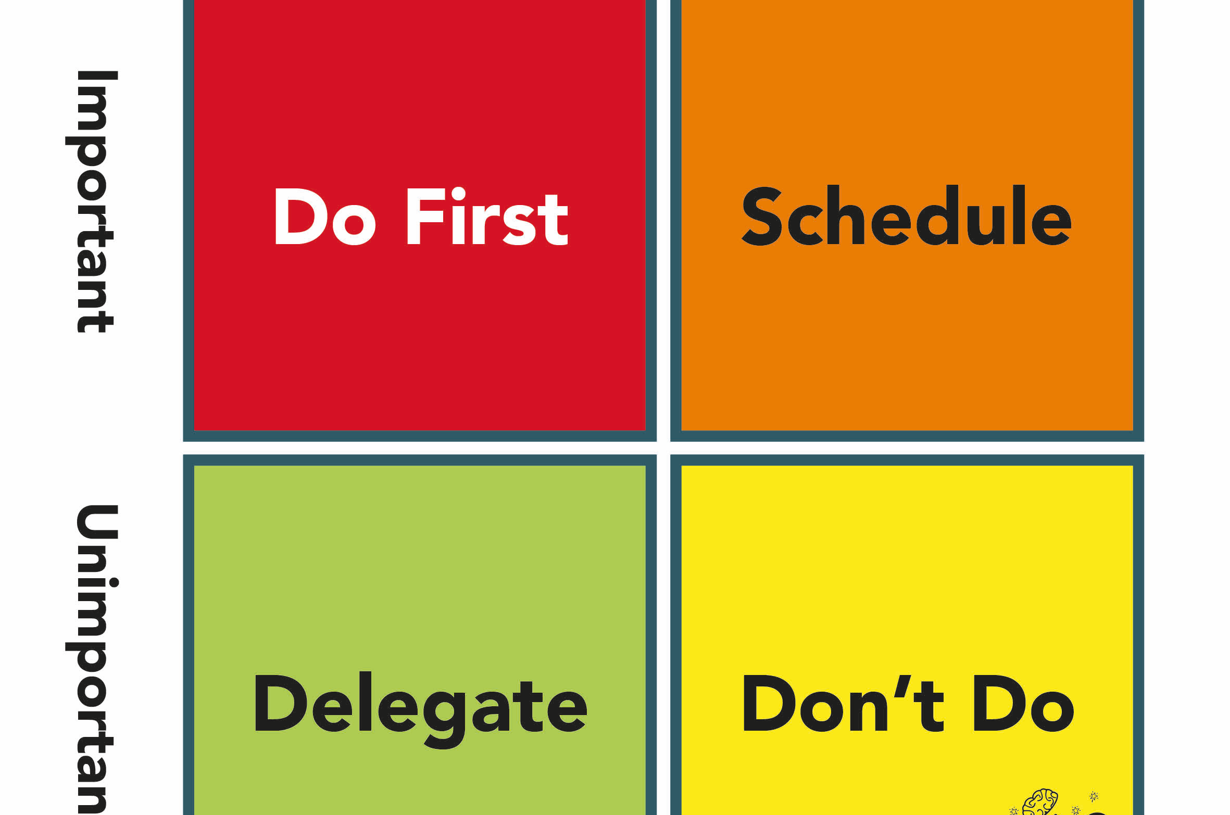
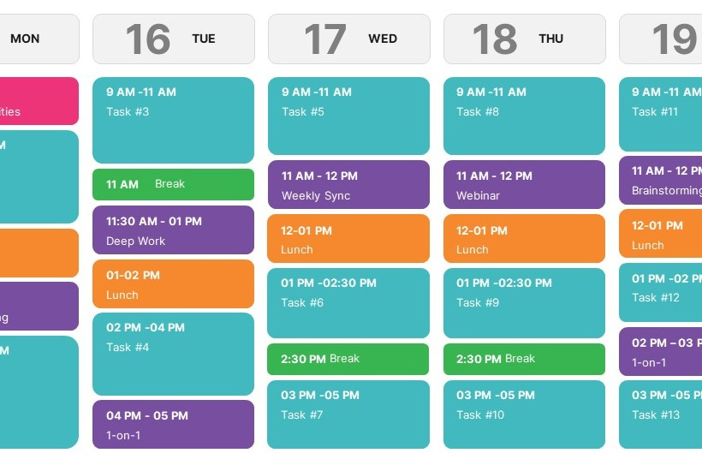
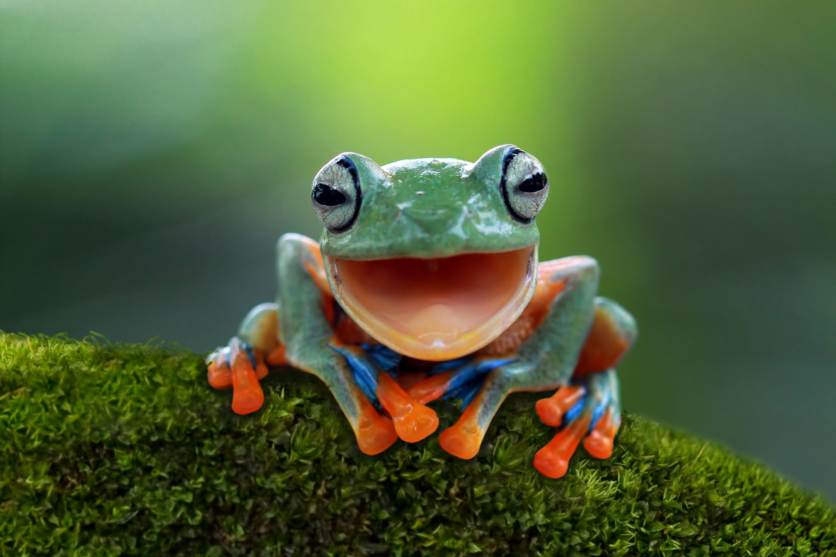
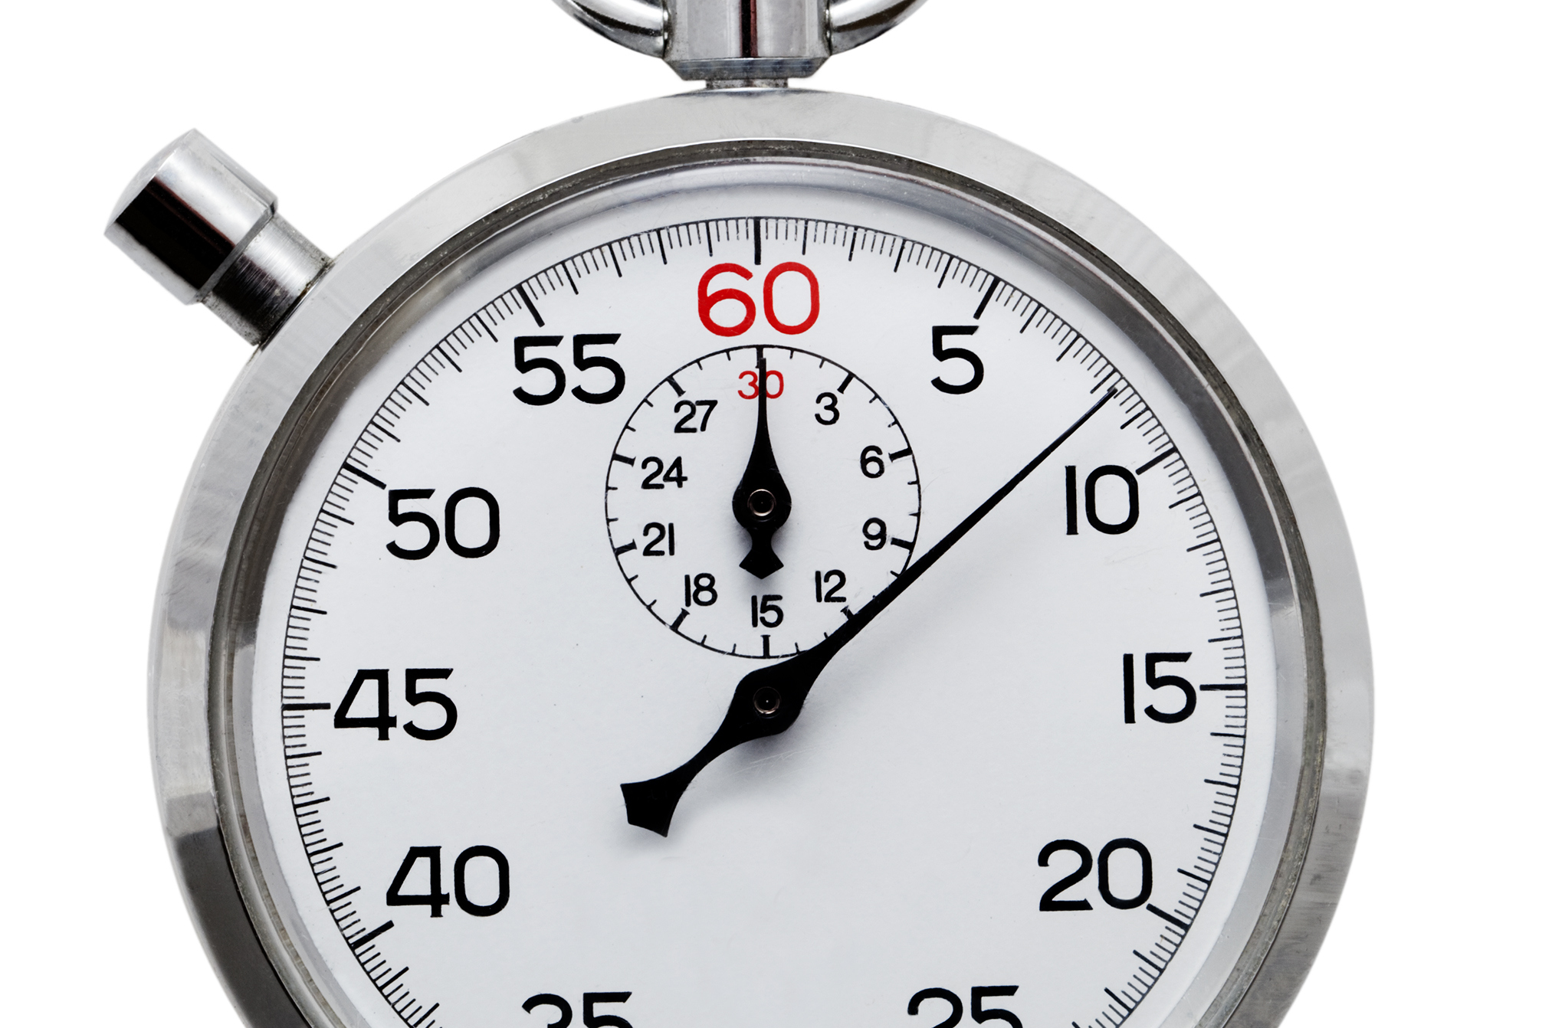
Eisenhower matrix
“I have two kinds of problems, the urgent and the important. The urgent are not important, and the important are never urgent.”
Assess your tasks and prioritise by how urgently they need done and how important they are.
Focus on what matters most.
Helps you get to the important but not urgent tasks
Time blocking
Divide your day into blocks dedicated to specific tasks or activities.
Group similar tasks together and schedule breaks too.
Helps you feel in control
Dedicates time to deeper thinking
Helps you feel proactive rather than reactive in managing tasks
Eat that frog
“If it’s your job to eat a frog, it’s best to do it first thing in the morning. And if it’s your job to eat two frogs, it’s best to eat the biggest one first.”
Tackle your most important, challenging or unpleasant tasks first.
Focus on one task at a time
Helps overcome procrastination
Frees mental space
Prioritises major tasks
2 minute rule
If there is something that can be done in 2 minutes, do it right away.
For quick things – gets them done
For bigger things – helps you get started
Helps you get started on tasks and maintain momentum
Prevents to-do lists piling up
Reduces mental energy spent managing small tasks
SLIDO DETAILS
Notes:
00:05 / 5 mins
Here are four different techniques that we are going to explore. Are people familiar with some of them?
[any responses]
All work in different ways and some might be better suited to some situations than others. They may also work well in combination – whatever suits you.
[Summarise each technique. Handouts on tables with more detailed examples for each]

Slide 7
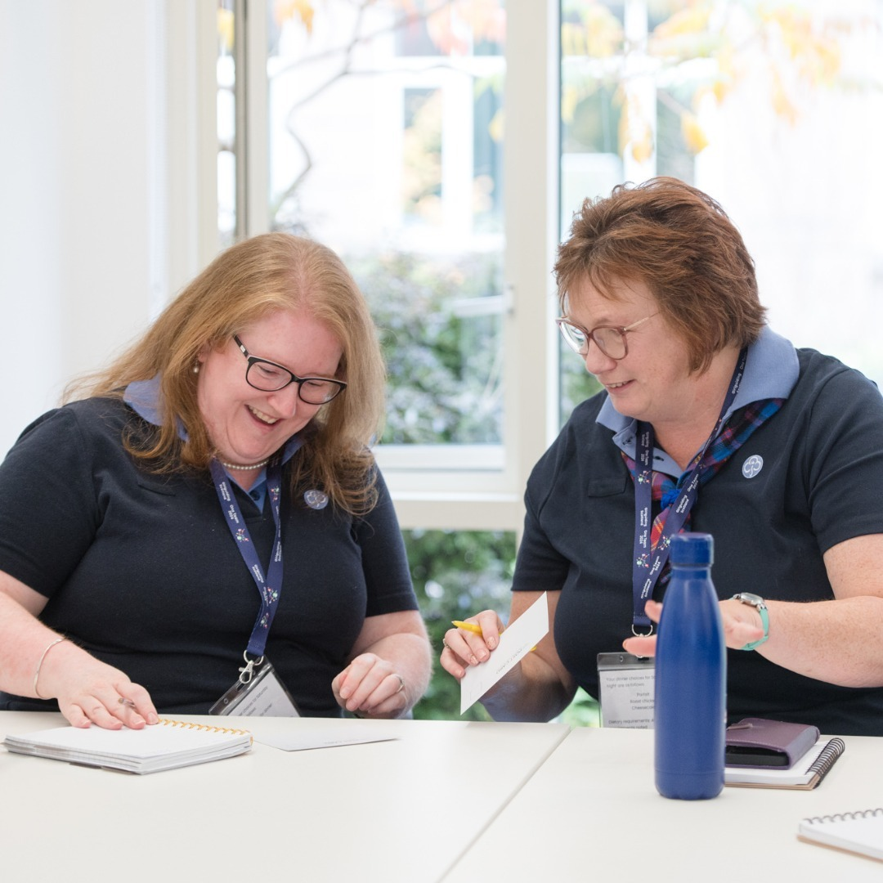
Group discussion
Time management techniques
Which sounds most helpful for you?
What makes some of them difficult for you to use?
SLIDO DETAILS
Notes:
00:10 / 15 mins
[1 minute to explain activity
10 minutes for group discussion
4 minutes to summarise feedback]
So, I’d like you to work together at your tables – groups of 2 or 3 – to discuss the techniques we’ve just covered. There are two discussion questions to help you reflect on your time management approaches and the benefits and drawbacks of some of the techniques.
There are some handouts on your table with the information that was on the slides.
Going to give you 7 minutes and then will ask for some feedback from you.
Do take time to introduce yourselves if you don’t know each other already!

Slide 8
What makes it hard to say no?
SLIDO DETAILS
Notes:
00:25 / 2 mins
Really quick answers via slido
[Summarise responses as they come in]

Slide 9
Setting boundaries
Saying no lets us say yes to other things
Tips
Think about your priorities
Delegate what you can
Be direct and specific when setting boundaries – e.g. I will/won’t do…
Break tasks down to identify how much time they’ll take or if you need to do it all
Respect boundaries of yourself and others
Practice!
Examples
Only checking emails or messages at certain times, or changing phone notification settings
Unscheduled phone calls are only for emergencies [make sure to define emergency!]
Share communication preferences and expectations using something like manual of me, email signatures etc.
Unit nights are for unit only
Take a guiding holiday in the school holidays
“I could help with X, but I would have to stop doing Y. Which would you prefer?”
“I can’t help with all of this, but I could do this part. Is that helpful?”
“I don’t have capacity to do that. Have you spoken to Jane? She might be able to help.”
“I don’t have time to commit to this at the moment, but I’ll be able to help in February.”
SLIDO DETAILS
Notes:
00:27 / 5 mins
[Try to link tips to anything participants said in slido feedback on saying no]
[Summarise slide contents, don’t need to read full examples]

Slide 10
How would I react if another volunteer asked this of me?
SLIDO DETAILS
Notes:
00:31 / 30 secs
All of that is easier said than done. However, think about this question. You’d be understanding and accommodating – other people should be the same way for you. (And if they’re not, that’s a different issue!)

Slide 11
Supporting wellbeing
SLIDO DETAILS
Notes:
00:32 / 20 secs
Going to move on to looking at wellbeing now. Hopefully your time management techniques will support your wellbeing, but we’re going to look at some other things we can do too.

Slide 12
PERMA-V model of wellbeing
All elements have equal weight
Positive emotions
Not just happiness! Also things like hope, confidence and optimism
Positive emotions drive wellbeing as well as being indicators of good wellbeing – they help you cope with stress and build stronger relationships
Engagement
Being ‘in the flow’ of activities
Creates satisfaction through using your skills effectively
Fosters creativity
Relationships
Relationships that make you feel safe and included
How you support those relationships
Positive interactions make you feel good and strong relationships can support you when things are hard
Meaning
Things that make you feel like you have an impact
How what you do aligns with your values
Can come from work, relationships, faith, or anything else
Important for motivation
Accomplishment
Things that give you a sense of purpose
Having realistic goals to work towards and pursuing them for their own sake.
Makes you feel capable and helps you recognise your own abilities.
Vitality (or health)
Helping your body feel at its best.
Things like diet, sleep, exercise.
SLIDO DETAILS
Notes:
00:32 / 4 mins
Ask participants to raise hand if familiar with model.
This is a psychological model of wellbeing, developed by Dr Martin Seligman from the early 2000s onwards.
The model has six elements – positive emotions, engagement, relationships, meaning and accomplishment are the original five. Vitality is the sixth element. You might also have heard the sixth element as being R for resilience, H for health, or ‘Plus’ instead – all amount to broadly the same thing.
These are what each of those elements mean in practice. [Summarise descriptions on slide with illuminating examples where helpful]
The core principle of PERMA is that all of the elements have equal weight – having good relationships is just as important as finding meaning or supporting your health.
How each element of wellbeing manifests will look different for everyone. By considering how they fit into your life, you can identify things that work to support your wellbeing, and areas that you might need to put more focus on.

Slide 13
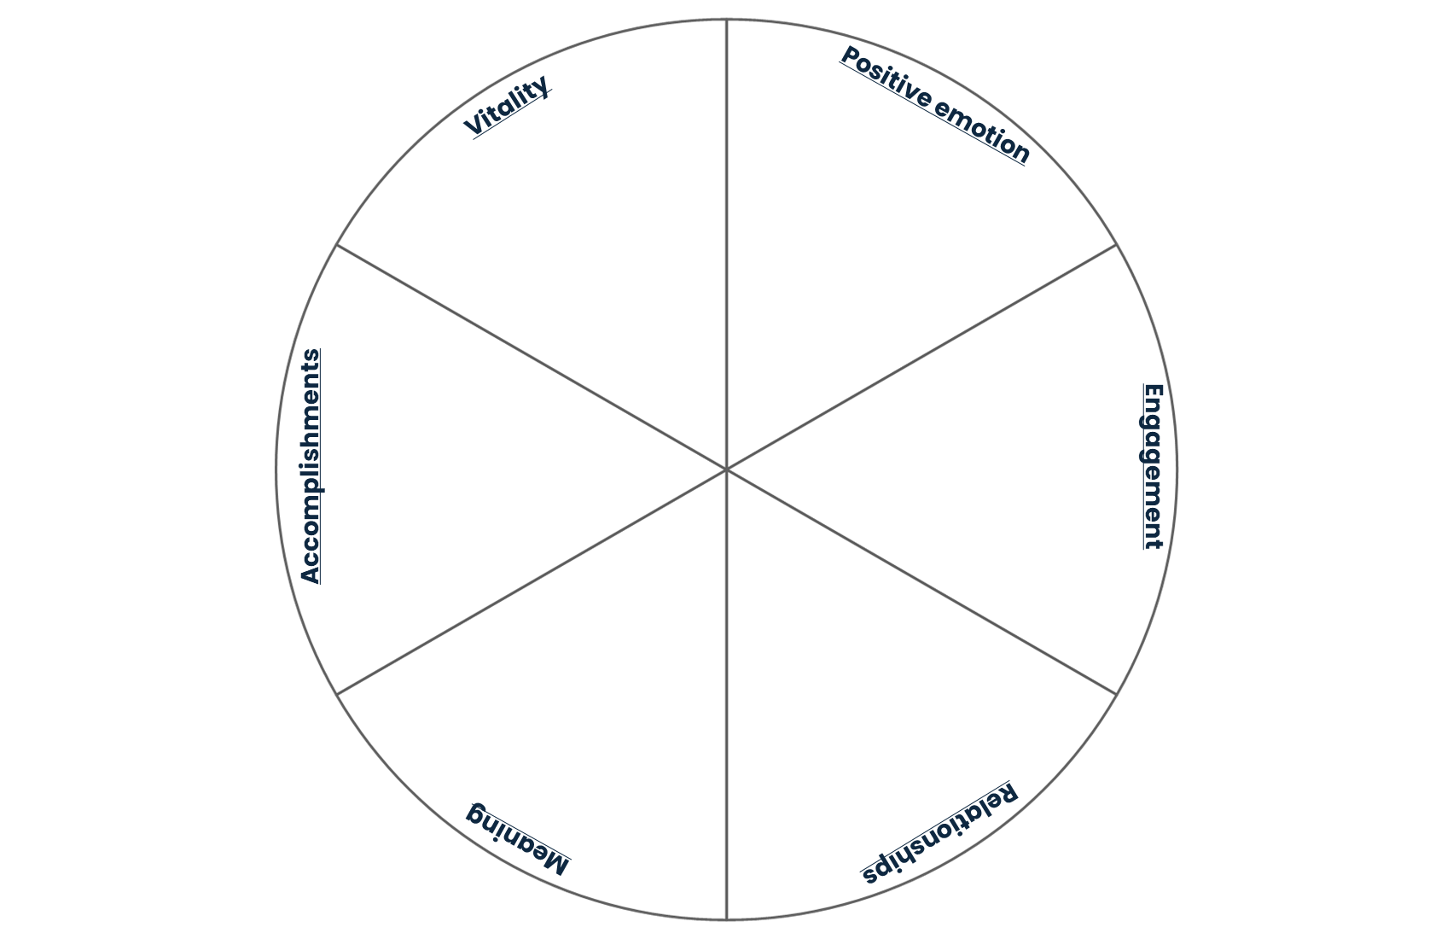
Activity - PERMA-V – your model
The template provided has one question for each PERMA-V element. How you answer them will help you identify things that currently support your wellbeing and areas you may want to work on in future.
Positive emotion - what activities make you feel good?
Engagement - what activities do you lose track of time doing?
Relationships - which relationships make you feel most supported and why?
Meaning – what activities make you feel connected to something larger than yourself?
Accomplishments – what do you enjoy doing for the sake of it?
Vitality - what makes you feel at your best?
SLIDO DETAILS
Notes:
00:36 / 13 mins
1 min to explain activity
9 mins for activity
3 mins for feedback

Slide 14
Girlguiding wellbeing resources
SLIDO DETAILS
Notes:
00:49 / 10 secs
We’re going to briefly look at some of resources Girlguiding has to support wellbeing of members.

Slide 15
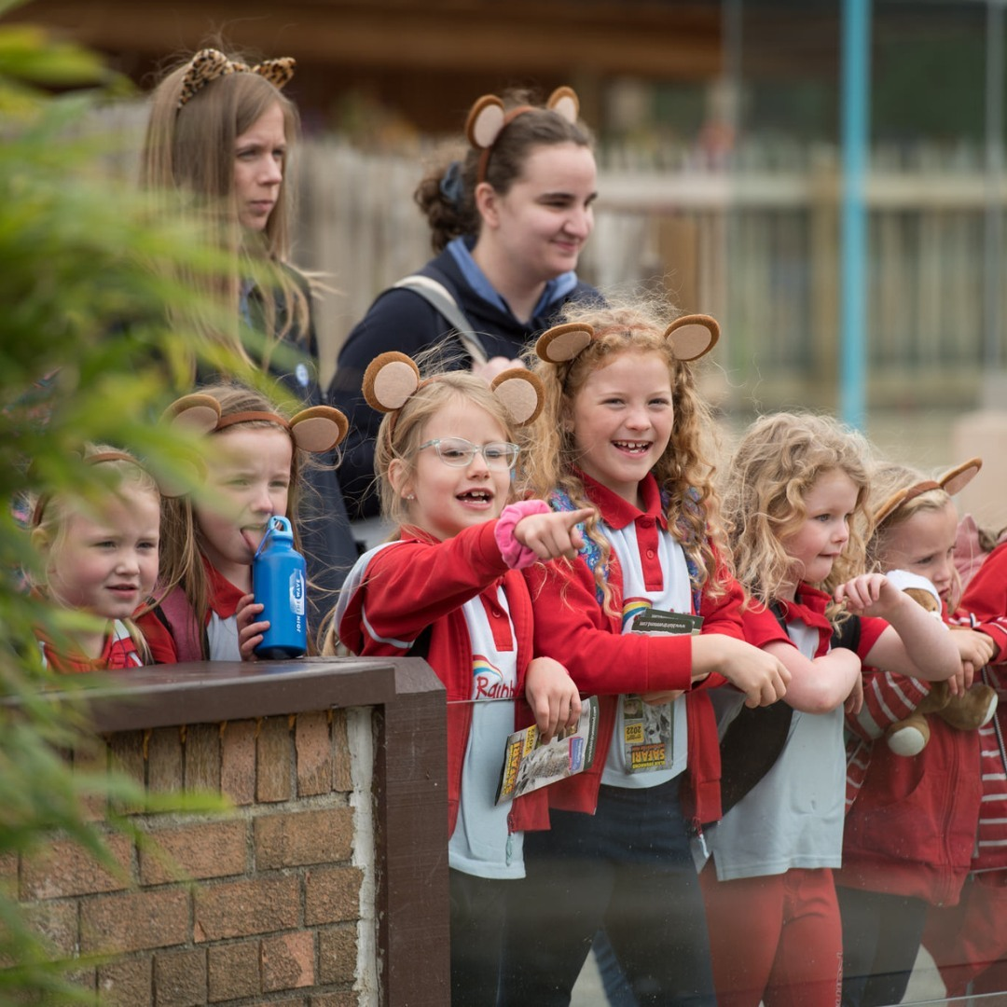
Wellbeing action plans
To help identify and record:
What keeps us well
What causes or triggers us to become unwell
The support we’d like to receive from our leaders, commissioners or volunteer colleagues
Age appropriate versions available for all sections.
SLIDO DETAILS
Notes:
00:49 / 30 secs
[Introduce wellbeing action plans and how they may be used]
Available on the website: https://www.girlguiding.org.uk/information-for-volunteers/running-your-unit/including-all/including-members-with-additional-needs/mental-health-and-guiding/

Slide 16
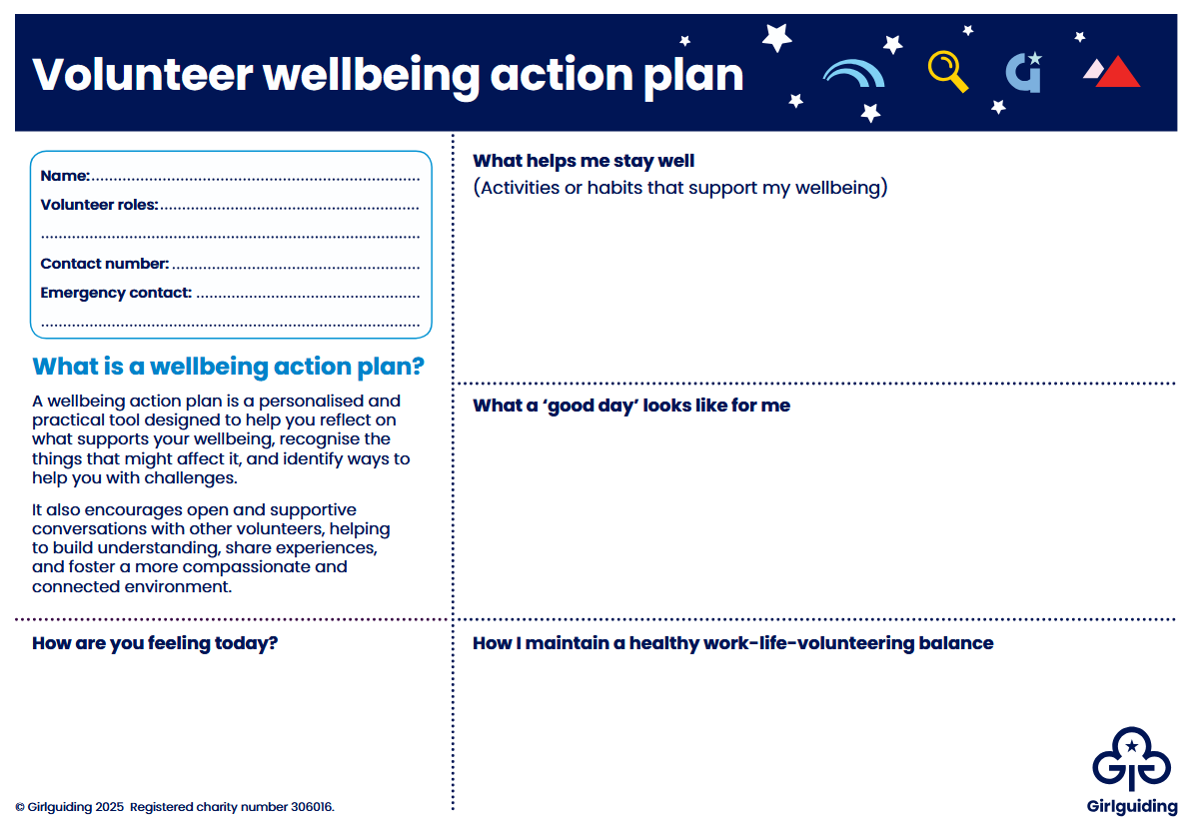
SLIDO DETAILS
Notes:
00:49 / 1 min
First page – thinking about what supports your wellbeing, content similar to some of things that we have been discussing already.

Slide 17
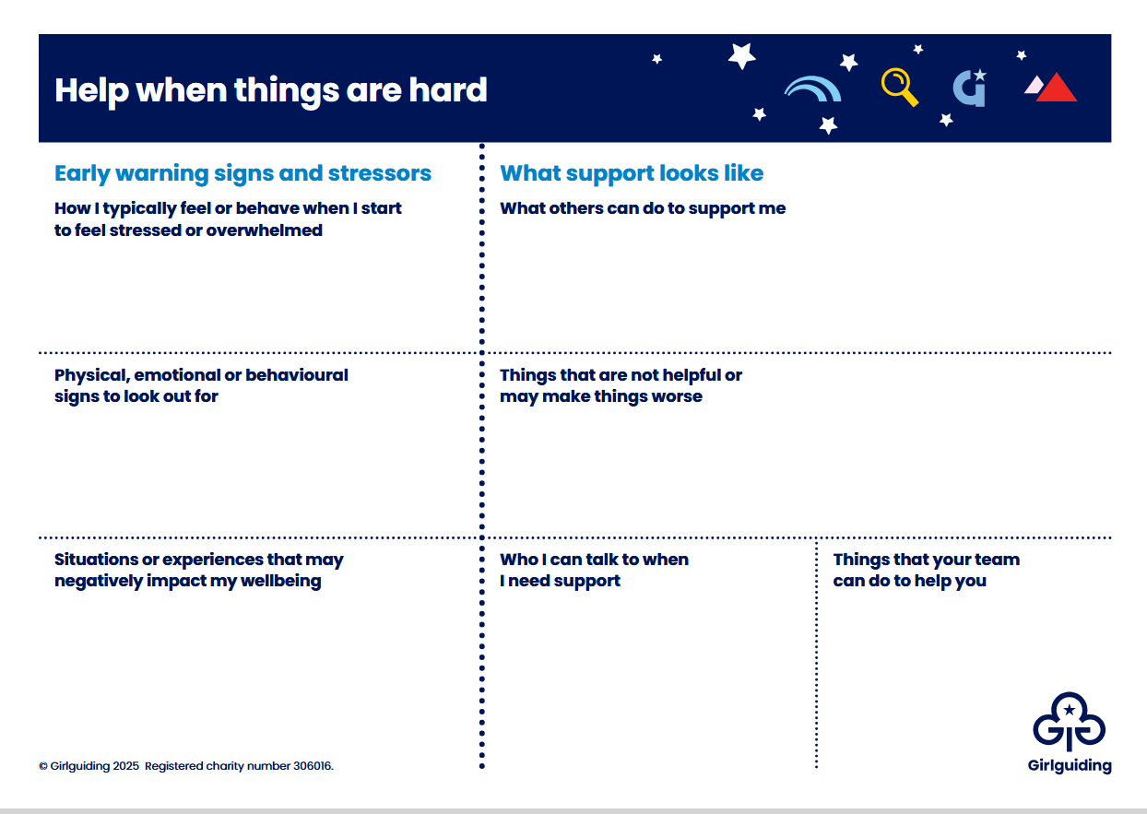
SLIDO DETAILS
Notes:
00:50 / 1 min
Second page – helping identify when there’s a problem and what would help.

Slide 18
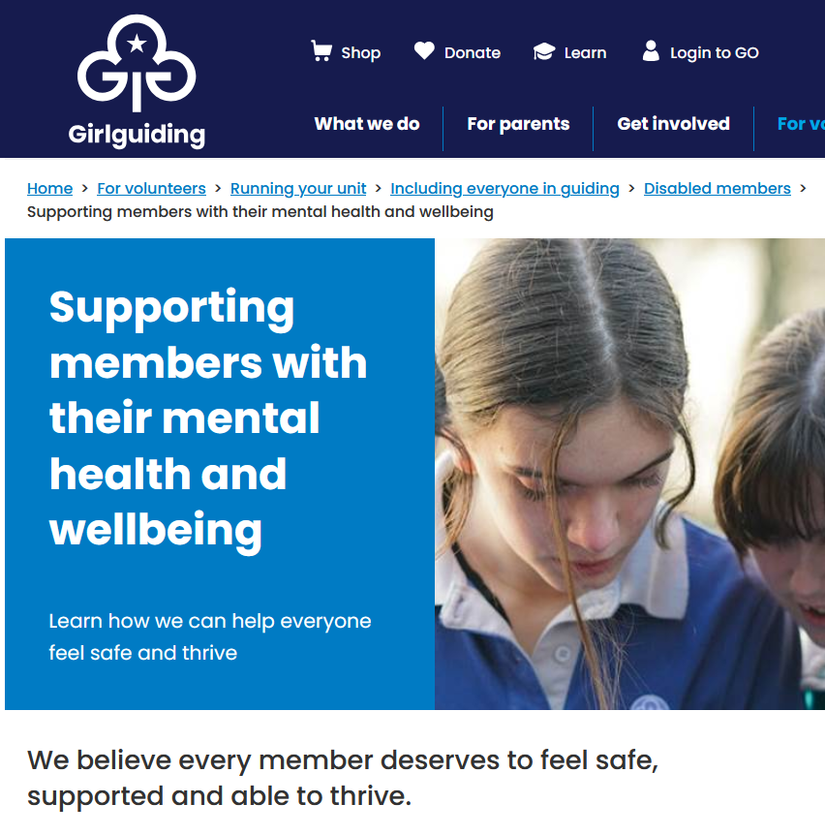
Other Girlguiding resources to support wellbeing
Adjustment plans
Guidance on website
Mental health and inclusion e-learning
SLIDO DETAILS
Notes:
00:51 / 3 mins
These are some of the other resources that might help you.
Adjustment plans – sure most are familiar with. Designed to help where members have a disability or additional support need, and focus more on specific adjustments needed than wellbeing plans do.
Guidance on website – largely aimed at supporting others but there’s a lot you could use for yourself too. It includes information on how to talk about mental health and wellbeing, information for supporting different sections, lots of links to other Girlguiding and external resources.
E-learning – very short. Will help you support those who are struggling with mental health difficulties. It also covers managing wellbeing during times of crisis.

Slide 19
Reflection – what is one action you’ll take to improve your time management or wellbeing?
SLIDO DETAILS
Notes:
00:54 / 2 mins
We are very nearly at the end of our session and I have one final activity for you. I would like you to have a think about one action you’re taking today to support your time management or wellbeing. If you have more than one, great – but one is enough. It could be a time management technique you’d like to try, exploring PERMA-V more, or maybe looking into wellbeing plans.
You don’t need to share or discuss it but, if you would like, you could write it on one of your handouts or in your notepad or on your phone.
[Give a 30-40 secs quiet for people to reflect]
Thank you. I do hope that you’ve found something to take away!

Slide 20
Any questions?
SLIDO DETAILS
Notes:
00:56 / 4 mins
Thank you for listening and participating.
Does anyone have any questions?
[Any instructions for changeover to next session]

