Slide 1
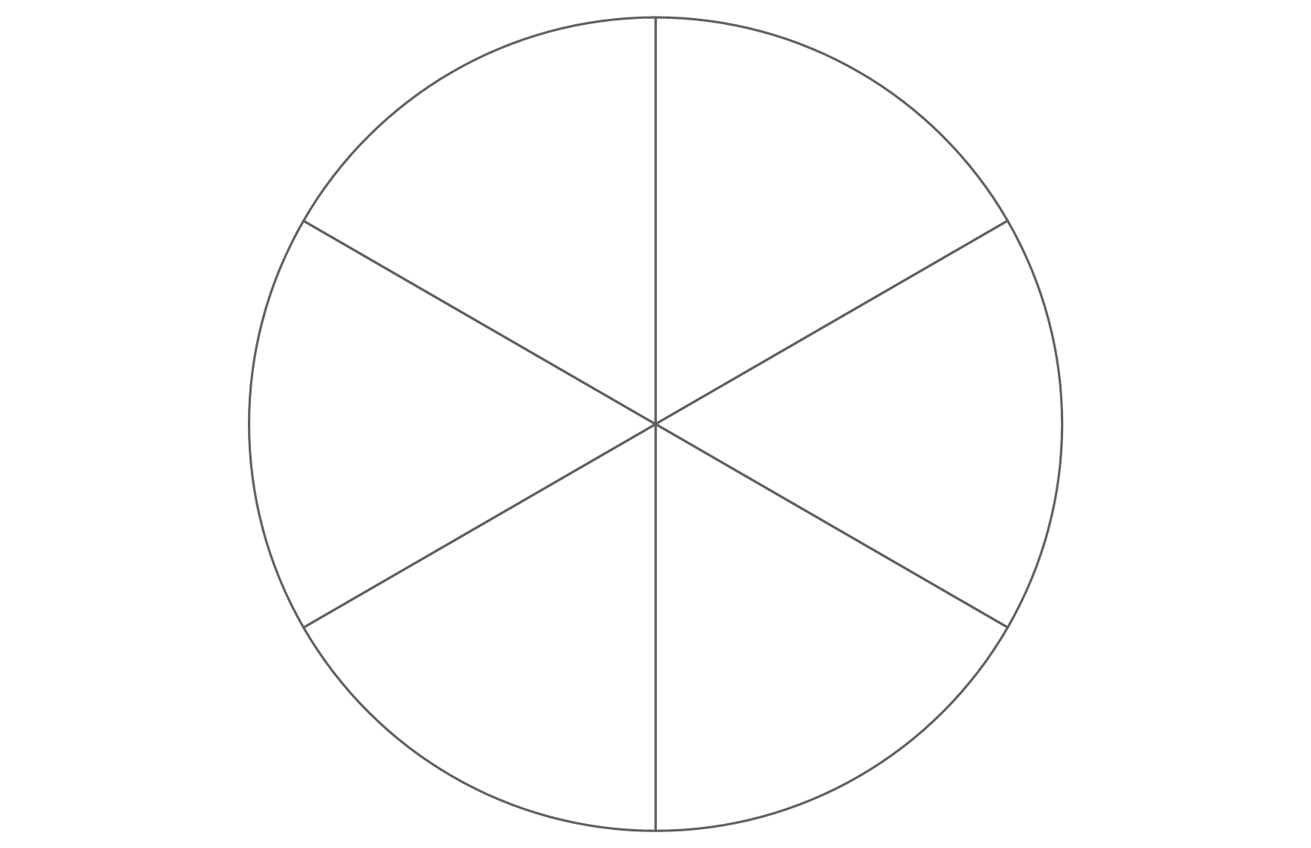
PERMA-V
What supports your wellbeing?
Vitality
Positive emotion
Accomplishments
Engagement
Meaning
Relationships
Positive emotion
What activities make you feel good?
Engagement
What activities do you lose track of time doing?
Relationships
Which relationships make you feel most supported and why?
Meaning
What activities make you feel connected to something larger than yourself?
Accomplishments
What do you enjoy doing for the sake of it?
Vitality
What makes you feel at your best?

Slide 2
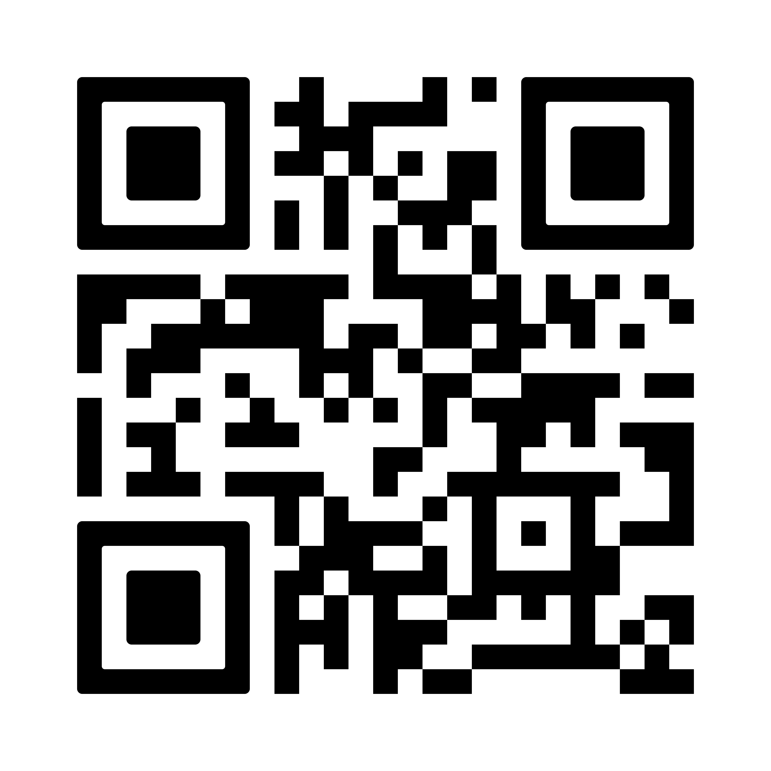
Girlguiding website
Wellbeing and mental health support for members

Slide 3
Time management techniques
Which sound most helpful?
What makes applying them difficult?
Eisenhower matrix
“I have two kinds of problems, the urgent and the important. The urgent are not important, and the important are never urgent.”
Assess your tasks and prioritise by how urgently they need done and how important they are.
Focus on what matters most.
Helps you get to the important but not urgent tasks.
Time blocking
Divide your day into blocks dedicated to specific tasks or activities.
Group similar tasks together and schedule breaks too.
Helps you feel in control
Dedicates time to deeper thinking
Helps you feel proactive rather than reactive in managing tasks
Eat that frog
“If it’s your job to eat a frog, it’s best to do it first thing in the morning. And if it’s your job to eat two frogs, it’s best to eat the biggest one first.”
Tackle your most important, challenging or unpleasant tasks first.
Focus on one task at a time
Helps overcome procrastination
Frees mental space
Prioritises major tasks
2 minute rule
If there is something that can be done in 2 minutes, do it right away.
For quick things – gets them done
For bigger things – helps you get started
Helps you get started on tasks and maintain momentum
Prevents to-do lists piling up
Reduces mental energy spent managing small tasks

Slide 4
Eisenhower matrix
Urgent
Not urgent
Important
Do first
Schedule
Not important
Delegate
Don’t do

