Slide 1



Notes:
Zoe:
My name is Zoe. I am a Careers Adviser and I work for Skills Development Scotland (SDS), Scotland’s skills agency and careers service. This Session called Get Noticed will cover everything you need to know about how to create great CVs and covering letters, and Janice is here to encourage you to shout out about all things Guiding and all the transferable skills you have.

Slide 2
Volunteering on your CV
Notes:
Zoe
The session is based on section 5 of the ‘Positive Steps to Your Future’ handbook which can be accessed electronically via our site and links are at the end of this session and we also hope to forward them on to everyone too
NB the notes and activities here are a guide only but are tried and tested so can be used with confidence. You will have your own knowledge and anecdotes that you can bring to the workshop.
Icebreaker: what’s in a name? Ask the group to note down the letters of their first name and think of a word or phrase beginning with each letter that describes themselves. E.g.:
J – jolly, I – Impatient, M – motivated
Give 5 minutes for this and ask the group to introduce themselves and, if comfortable, read out the words that describe them. This can be quite tricky for some people and that is OK. Let them know that we are here to help people describe themselves to future employers and there are tools to help them too e.g. the skills discovery tool on www.myworldof work.co.uk or section 2 in the Positive Steps handbook. Also pages 70-72 in Positive Steps have lots of words they can use to do this too. There is also a recorded webinar What have I got to offer? covering in more details how to identify skills, strengths and achievements – show or provide the link to this: https://www.youtube.com/watch?v=ldOi9oFjSaU
Let’s look at what we will cover in this session…

Slide 3
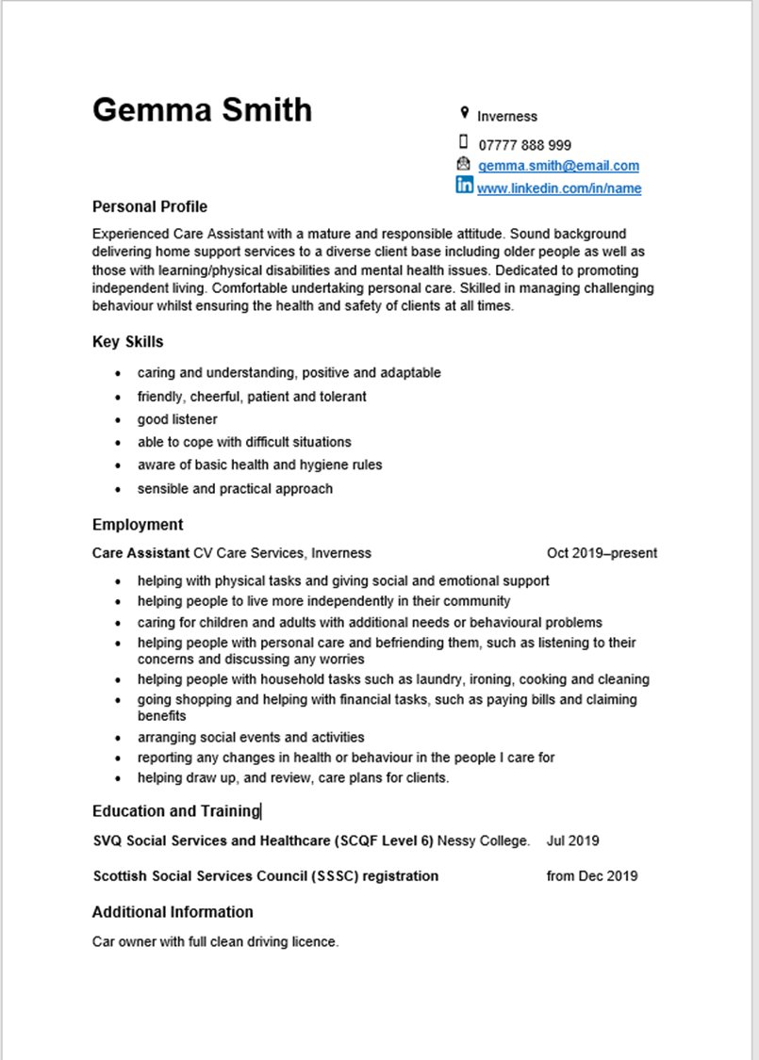

Session Overview
Your guiding experience is full of valuable skills—let’s make sure they stand out on your CV!
This session will show you how to showcase your volunteering in job applications and interviews.
If time allows you'll get a brief walkthrough of the CV Builder tool on the My World of Work website and explore other helpful career resources.
What are Applicant Tracking Systems of ATS
How to create covering letters
Notes:
Zoe
CV is short for curriculum vitae and is a vital part of the job search process. It is a personal marketing document used to sell yourself to prospective employers. It should tell them about you, your work experience, and your skills, abilities and achievements. Ultimately, it should highlight why you’re the best person for the job.
If you don’t have a CV then this session will get you started and if you do you should get some ideas to help you improve your CV. We will talk about what goes into a CV so that you can produce a CV which best suits your and the employer’s needs. A CV is personal to you and therefore no 2 CVs are alike. It is the employer who ultimately decides what makes the perfect CV but we will go over best current practice when it comes to CV writing.
Applicant Tracking Systems or ATS are widely used by employers and we will give you our top tips for helping your CV beat the ATS so it will be read by a real person!
A covering letter can be the first impression the employer will get of you and may determine whether they read your CV. We will discuss covering letters at the end of this webinar.
Janice: Little bit of intereaction
Hands up who has previously used Girlguiding experience as part of their job application or interview before

Slide 4
Why Volunteering Matters
“I was asked to be a first aider at work because I had my qualification with Girlguiding. Its opportunities have given me the edge in the job market"
“It’s given me examples to use in interviews and skills to put on my CV, it is a major factor in my progression in my professional life.
Notes:
Janice
Emphasise transferable skills: leadership, teamwork, organisation, communication.

Slide 5
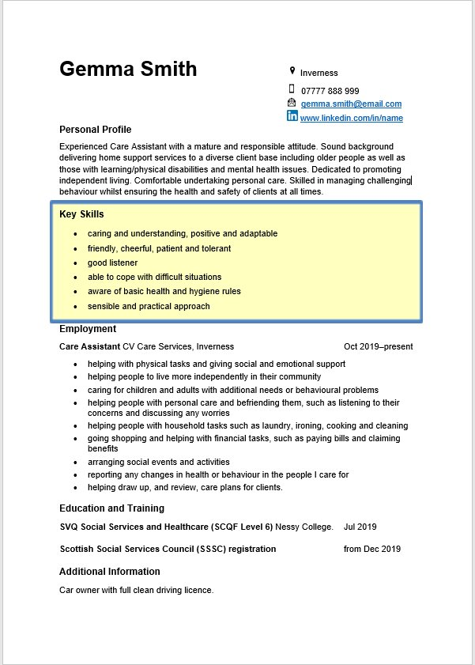
What Employees look for
Key Skills:
Written communication
Verbal communication
Time management
Problem solving
Teamwork
Digital/IT
Initiative
Planning
Notes:
Zoe:
This slide show the core skills an employer wants. Do you have these? What else do you need? What would be the best way to find out which skills the employer wants? Ask for ideas from the whole group or ask them to discuss in pairs for 5 minutes.
Job descriptions can be really helpful as they normally let you know exactly what the employer is looking for. A job description can be your skills checklist – you can see if your skills match what the employer requires. It is important to be able to identify the key skills required for a job to ensure that a future employer knows you are a good match for the job they want to fill but also due to the increase in the use of ATS (Applicant Tracking Systems). Applicant Tracking Systems scan the CV in the first instance to identify that the applicant possesses the skills required for the post being advertised. We have more about ATS later in the workshop.
As with everything on your CV, the skills you mention should be the most relevant to the employer’s requirements – you need not list every skill you have.
When including your key skills on your CV it can also be useful to provide an example of where you have used them. These examples can come from the workplace but also from volunteering or your personal life.
So, instead of “I have good time management skills” you could write “I use my time management skills to prioritise work effectively and meet deadlines”.
Or “I am a good listener” could become “I use well developed listening skills to make sure I understand the needs of customers and provide the best possible service at all times.”

Slide 6
Scenarios
What skills can they be attached to?
Writing newsletters or emails to parents about upcoming events and badge updates.
Planning a term’s programme and ensuring activities fit within weekly sessions.
Adapting a planned outdoor activity due to bad weather with minimal disruption.
Collaborating with other leaders to run a district event or residential weekend.
Using GO! to manage member records or creating digital posters for recruitment.
Organising a Thinking Day celebration including activities, guests, and logistics.
Mentoring a Young Leader through their qualification and giving feedback.
Supporting girls with additional needs by adapting activities on the spot.
Speaking at a local community event to promote Girlguiding.
Completing and reviewing risk assessments for a residential trip.
Managing the unit’s petty cash and planning costs for a camp.
Working with external partners (e.g. schools or charities) for joint activities
Notes:
Janice- so thinking of Zoes last slide and the key skills, shout out potential skills for each scenario
Written Communication
Writing newsletters or emails to parents about upcoming events and badge updates.
Time Management
Planning a term’s programme and ensuring activities fit within weekly sessions.
Problem Solving
Adapting a planned outdoor activity due to bad weather with minimal disruption.
Teamwork
Collaborating with other leaders to run a district event or residential weekend.
Digital/IT Skills
Using GO! to manage member records or creating digital posters for recruitment.
Planning
Organising a Thinking Day celebration including activities, guests, and logistics.
Leadership
Mentoring a Young Leader through their qualification and giving feedback.
Flexibility
Supporting girls with additional needs by adapting activities on the spot.
Public Speaking
Speaking at a local community event to promote Girlguiding.
Risk Management
Completing and reviewing risk assessments for a residential trip.
Budgeting
Managing the unit’s petty cash and planning costs for a camp.
Collaboration
Working with external partners (e.g. schools or charities) for joint activities.

Slide 7
Why do Girlguiding Scotland volunteers stand out with employers?
Transferable skills:
Problem-solving
Leadership
Self-confidence
Teamwork
Collaboration
Working independently
Time management
Organisation
Prioritisation
Flexibility
Dealing with change
Communication
Public speaking
Risk management
Record keeping
Budgeting
Adapting to include members with diverse need
Volunteering with us offers essential experience for educational courses or jobs such as childcare and teaching.
It provides practical examples for job applications and interviews, and standout answers for questions like “describe a situation when you worked well in a team”.
It proves you’re reliable, committed and responsible. You’re a proactive person when it comes to self development!
It builds confidence to help you shine in interviews.
Notes:
Janice: Lets Brainstorm, shout out some skills you think are transferable

Slide 8
Features tell, benefits sell
Features are facts
The list of items on your CV that describe you
Benefits convert features into relevant information
Benefits describe the value that a potential employer might find in one of your features.
To translate features into benefits
Answer the question “So what?”
Notes:
Zoe
(Animated slide)
When thinking about skills, a really useful way to create engaging content for your CV is to think about your “features” and “benefits”. This way you can turn your skills and experience into achievements.
(Click for first point) Features are facts: the list of items on your CV that describe you – Who you are, Where you’ve worked, Dates you were there, Job titles, Employers, Education, Community involvement/Voluntary work and so on.
(Click for second point) Benefits convert features into relevant information: Benefits describe the value that a potential employer might find in one of your features.
(Click for 3rd point) Whoever is reading your CV is going to ask - So what? How is this relevant? Why should I care? What can you do for me? An employer will recruit you because of the benefit that they hope to obtain. Anything that you have achieved at work brings benefits to your employer – this might be more sales, lower costs, quicker or simpler operations, better standards of customer care etc. A future employer wants to know what benefits you brought to your last employer. This will encourage them to believe that you might be able to bring similar benefits to their company. Therefore, recognising past achievements, identifying them clearly and being able to write and speak about them with confidence is vital to achieving success.
Here is an example of how to turn features into benefits…

Slide 9
Turning Girlguiding experience into CV language
Features
Benefits
“I run a Brownie unit”
“I lead a team of volunteers to deliver weekly programmes, demonstrating leadership, planning, and safeguarding awareness.”
Notes:
Zoe
(Animated slide - bring up the left had table first and read out the features, ask so what then bring up the right hand table and read the sentence.)
Take a moment to consider the difference.
Turning your features into benefits can really help to sell yourself to employers. Once you are skilled in identifying your achievements you may wish to include an Achievements section in your CV.
Janice – Interactive
In groups of 3 or 4 have a go at turning a feature into a Benefit

Slide 10
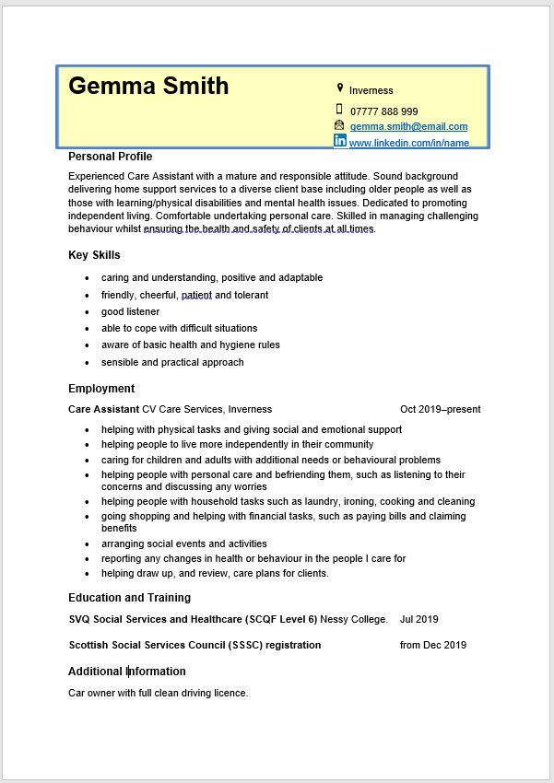
Structuring your CV
What to include?
Name
Location
Telephone/mobile number
Email address
LinkedIn
What to leave out?
Date of birth
National insurance number
Photograph
Referees
  But it is good practice to know who is willing to do this for you
Things to think about
How do you want to be contacted?
How much information do you want to give?
Notes:
Zoe
Your personal details should be at the top of the CV. This is your name and details of how a potential employer can contact you. There is no need to provide an address if you have an up-to-date email address and a telephone number but you may wish to include your general location, for example, Glasgow.
Make sure your email addresses is be appropriate for use on a CV. For a professional approach use a personal email address that includes your name. it is best not to have an email that includes your date of birth or other dates. Ask the group: Why is it a good idea not to have date of birth in an email address? Comment on responses. This can be to prevent identity theft but also to prevent bias. While age discrimination is against the law, employers can often have their own internal biases about age.
There is no need to include date of birth, national insurance number or photograph. Encourage discussion on this as appropriate.
You only need to include contact information for the way you want to be contacted – it is unlikely someone will send you a letter by post – communication is much more likely to be by email – so you need not put your address if you don’t want to. However, it can be useful for an employer to know which town/area you live in so they can be confident you can commute to work easily. On the other hand, you may be applying for an opportunity that requires you to work from home so your address would not be necessary.
You may also want to include a link to your LinkedIn profile, if you have one. If you include this information, make sure that your account is up to date and reflects the sector you wish to work in .
Let’s move on to consider the key features of your CV starting with the Personal Profile…

Slide 11
Structuring your CV
An overview of your:
  Skills
  Achievements
  Work experience
  Relevant experience
  Education and training
  Additional information
Notes:
Zoe
A CV is a document that you would use to explain to an employer why you would be a suitable candidate for a job. A CV should tell employers about you, your work experience, your skills, and achievements, and any learning or training you have done, qualifications achieved. The main purpose of a CV is to highlight why you are the best person for the job so that you can secure an interview.
It can be used for an advertised vacancy that you would find on a recruitment or company website.
You can also use it to make speculative approaches to employers to find out if they have any vacancies that would be suitable for you. A speculative approach is when you contact an employer to enquire whether they would consider offering you an opportunity. The employer is not advertising a position, but you want to work for them.
A CV is a working document that you will continually update as you gain new skills and experience.
The next few slides give some great examples of guiding to consider

Slide 12
Skills
Time Management
      “I manage weekly unit meetings, balancing activity planning, badge work, and admin tasks to ensure everything runs smoothly.”
      “I coordinated a district event for 60+ girls, creating a timetable and delegating tasks to ensure we stayed on schedule.”
Teamwork
      “I work with other leaders to plan termly programmes, sharing responsibilities and supporting each other during sessions.”
      “As a Peer Educator, I collaborate with fellow volunteers to deliver workshops on body confidence and healthy relationships.”
Communication
      “I regularly communicate with parents about events, permissions, and progress, adapting my tone for different audiences.”
      “I led a campfire session for international guests, using clear instructions and inclusive language to engage everyone.”
Notes:
Janice

Slide 13
Achievements
Queen’s Guide Award
      “Completed the Queen’s Guide Award, demonstrating long-term commitment, leadership, and community action.”
      “Organised a community project as part of my Queen’s Guide, raising funds and awareness for a local charity.”
Event leadership
      “Led the planning and delivery of a regional camp, managing logistics, risk assessments, and volunteer coordination.”
      “Delivered a successful Thinking Day celebration for 100+ members, including themed activities and guest speakers.”
Notes:
Janice

Slide 14
Work experience (volunteering)
Unit leadership
      “Volunteer Leader with Girlguiding Scotland, responsible for planning and delivering weekly sessions for Brownies aged 7–10.”
      “Leader in Charge for a Guide unit, overseeing programme delivery, safeguarding, and volunteer mentoring.”
Administrative roles
      “District Treasurer, managing budgets, processing expenses, and reporting to the local commissioner.”
      “Membership Secretary, maintaining accurate records on GO! and supporting new volunteer onboarding.”
Notes:
Janice
Tho it is also good practice to avoid 'Girlguiding Jargon'
LQ (Leadership Qualification) → “Completed Girlguiding’s adult leadership training, covering programme planning, safeguarding, and team management.”
Peer Educator → “Trained volunteer delivering educational sessions to young people on topics like mental wellbeing and inclusion.”
GO system → “Used Girlguiding’s membership platform to manage records and communications.”

Slide 15
Relevant Experience
Residential leadership
      “Led a weekend camp for Guides, managing logistics, safety, and team coordination.”
      “Supported international visitors at a jamboree, demonstrating cultural awareness and adaptability.”
Advocacy & inclusion
      “Delivered sessions on body confidence and disability awareness as a Peer Educator.”
      “Worked with local schools to promote Girlguiding and recruit new members.”
Notes:
Janice

Slide 16
Education and Training
Girlguiding training
      “Completed Girlguiding Safeguarding training, ensuring best practice in safeguarding and inclusion.”
      “Trained in first aid and residential leadership through Girlguiding’s adult learning modules.”
      “Trained Peer Educator, delivering sessions on disability awareness and mental wellbeing to young members.”
External courses via guiding
      “Attended Skills Development Scotland CV workshop through Girlguiding Scotland.”
      “Completed outdoor first aid training for residential events.”
Notes:
Janice

Slide 17
Additional information
Hobbies & interests
      “Enjoy outdoor activities and camping, regularly leading residential trips for young people.”
      “Passionate about youth empowerment and inclusion, reflected in my work with Girlguiding Scotland.”
Volunteering abroad or national projects
      “Represented Scotland at an international guiding event, promoting cultural exchange and leadership.”
      “Participated in national campaigns on girls’ rights and body confidence through Girlguiding’s advocacy programmes.”
Notes:
Janice

Slide 18

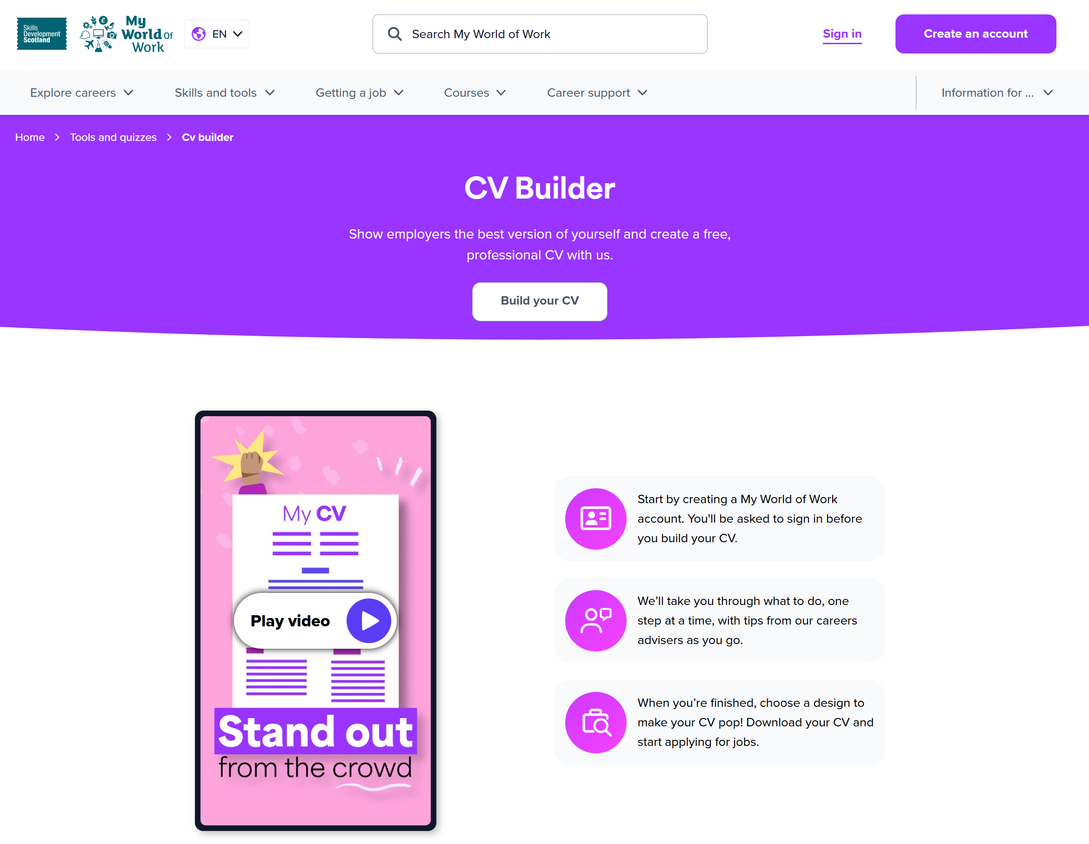
CV builder walkthrough
Positive Steps PDF
Notes:
Couple of Good resources and if time at end, we can do a brief demonstrations

Slide 19
Using STAR Techniques in interviews
Situation, Task, Action, Result
Example 1: Leadership & Planning
Situation:
I was leading a Guide unit preparing for our annual camp.
Task:
I needed to plan the weekend programme, ensure safety, and coordinate volunteers.
Action:
I created a detailed schedule, completed risk assessments, delegated tasks to other leaders, and communicated with parents about logistics.
Result:
The camp ran smoothly, all activities were delivered safely, and we received positive feedback from both parents and girls. It strengthened my confidence in leading teams and managing events.
Example 2: Problem Solving & Communication
Situation:
During a district event, one of the activity leaders became unavailable last minute.
Task:
I had to quickly adapt the programme and ensure the girls still had a meaningful experience.
Action:
I restructured the timetable, stepped in to lead the missing session myself, and kept parents and volunteers informed of the changes.
Result:
The event continued without disruption, and the girls enjoyed the activities. It showed my ability to stay calm under pressure and communicate effectively.
Notes:
Janice Interactive activity:
STAR Speed Sharing
Setup:
Split attendees into pairs.
one shares a STAR story from their guiding experience in 2 minutes. Based on tell me about a time you worked well as a team
Their partner listens and identifies the STAR elements (S, T, A, R).

Slide 20
Applicant Tracking Systems (ATS)
Do
Use a font such as Arial, Calibri, Tahoma or Verdana
Use a font size of 11 as a minimum
Include all keywords and phrases unique to the job you are applying for
Include as much information as you can that matches your skills, qualifications and experience to the job
Put employer names and job titles on the left-hand side of the document
Tip!
Keep your headings simple e.g. Work Experience
Notes:
I briefly mentioned earlier Applicant Tracking Systems commonly known as ATS. ATS are used by many employers, recruitment agencies and job vacancy sites to scan CVs before the top candidates’ information is passed to the recruiter.
How can you stand the best chance of getting your CV past the computers and read by a real human being?
Here are some things to help (Read out the slide)

Slide 21
Applicant Tracking Systems (ATS)
Don’t
Include tables, diagrams, pictures or graphics
Use headers or footers
Only send a pdf version of the document
Use abbreviations
Tip!
www.jobscan.co/ offers free scans
Recruitment agencies may also offer this service
Notes:
(Read the slide)
(use this additional info when talking about pdfs) Note that while it can be helpful to have your CV in a .pdf format, as most systems can open this, they are not easily read by ATS – it can be a really good idea to contact the employer if you can to find out what format works best for them. If in doubt send a Word version and a pdf version.
The good news is that Applicant Tracking Systems do not care about the length of your CV. However, it is worth bearing in mind that when your ATS-friendly CV gets past the system and onto the desk of a recruiter it will still have to conform to accepted practice when it comes to writing a CV.
Employers and recruiters will have their own preferences on the length of a CV but 1-3 pages is acceptable.
TIP: You can try this out for yourself. An example of a site you can use is https://www.jobscan.co/ sign up to get free scans per month i.e. upload your CV and the job description to check how well they match using an ATS. Most recruitment agencies offer this service too and you shouldn’t have to pay for it.

Slide 22
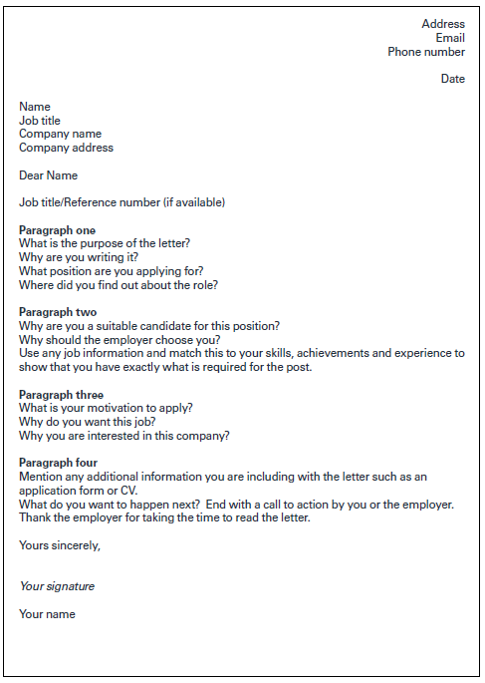
Covering letters
Tip!
You can make your email your covering letter
Notes:
It is good practice to include a covering letter with a CV. A covering letter is the first impression the employer will get of you and may determine whether they read the CV. It is an often overlooked but very important part of the application process. Employers tell us that a candidate including a covering letter can have the edge as it demonstrates attention to detail, your motivation for the job and what you know about the company so even if it is an optional part of the application process we recommend you take up the option.
This slide shows you how to go about writing a covering letter (Describe the content)
It is useful to address the letter to a named person: this information is often on the job advert or job description but if in doubt contact the company to find this out. This is especially important for speculative applications as it means the letter will be read by the right person.
Keep it brief whilst covering the key content mentioned and by following the letter format. You can make your email your covering letter or attach the letter to the email as a pdf document.
You can get help with a covering letter from a Skills Development Scotland Careers Adviser.

Slide 23
Skills Development Scotland Support
Call our helpline to speak to a SDS adviser
  0800 917 8000
  Monday to Friday 9am – 5pm
Contact your local SDS Careers Centre
Visit www.myworldofwork.co.uk
All services are free and confidential
Notes:
If we are around the 50min mark we could then do a quick demo of the my world of work cv builder?

Slide 24
Thank you
And your time for any questions

