Slide 1


Slide 2
Introduction to management (Girlguiding)
Carol Morwood & Alison Plummer

Slide 3
Aim
This session will give attendees a basic knowledge of the role of a manager, management styles and the basics of management techniques in Girlguiding

Slide 4
Objectives
1. Discuss what a people manager in Girlguiding does and the skills they develop to do this effectively
2. Learn about different management styles in Girlguiding
3. Discuss different management techniques and when you might use them in Girlguiding
4. Look at scenarios and discuss how they might begin to approach it as a people manager in Girlguiding

Slide 5
Outcomes
1. Attendees will feel more effective in their role
2. Attendees will feel more confident and competent in their role
3. Attendees will feel more empowered to take on a new management role in Girlguiding

Slide 6
What does a people manager in Girlguiding do?
Vision
Values

Slide 7
What skills are required to be developed to be an effective manager in Girlguiding?

Slide 8
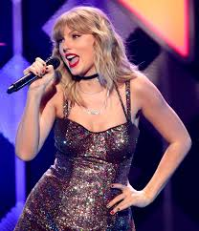
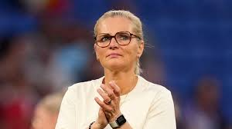
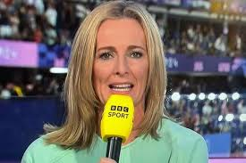
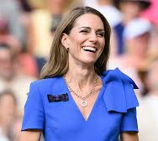
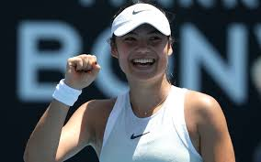
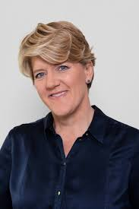
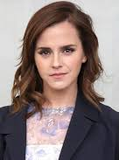
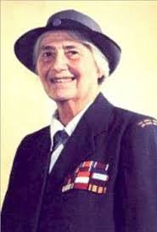
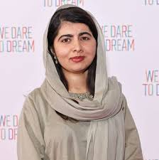
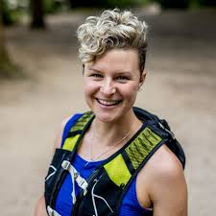
Notes:
Taylor Swift
Sarina Wiegman
Gabby Logan
Catherine, Princess of Wales
Malala Yousafzai
Anna McNuff
Emma Raducanu
Emma Watson
Clare Balding
Lady Olave Baden Powell

Slide 9
Management Techniques
problem solving;
time management;
delegation;
conflict-resolution;
communication;
team development……

Slide 10
Scenarios

Slide 11
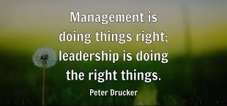

Slide 12
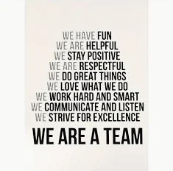

Slide 13
