Slide 1


Slide 2
Inspiring and motivating others
Carol Morwood & Alison Plummer

Slide 3
Aim
This session will give attendees the opportunity to consider the importance of inspiring and motivating others, and how they can develop these skills to bring out the best in the teams they work with.

Slide 4
Objectives
What is the definition of inspiring and motivating behaviour?
Discuss who do they find inspiring & motivating and why?
What skills did these people have?
How can they develop these skills for themselves, to bring out the best in the teams they work with (either girls and/or adults)?

Slide 5
Outcomes
Attendees will feel more empowered to inspire & motivate others.
Attendees will produce a personal action plan about how are they going to inspire and motivate others.

Slide 6
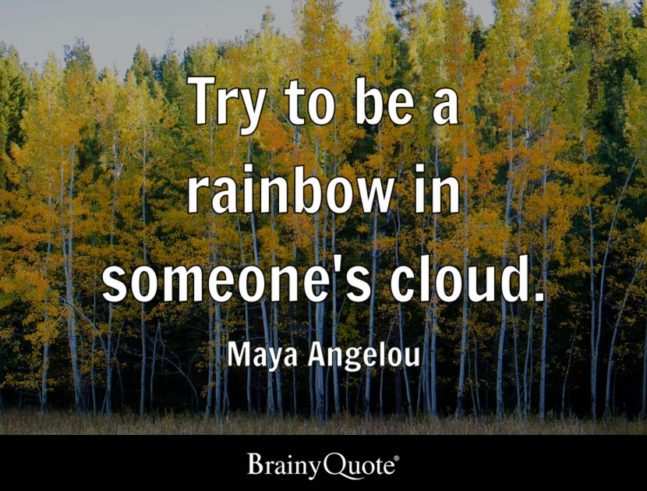
Motivational postcards
Please choose a postcard that means something to you and keep till later.

Slide 7
What do we mean by inspiring and motivating behaviour?
Inspiring:
Encouraging, or making you feel you want to do something
Motivating:
Able to influence someone to behave in a particular way

Slide 8


Who inspires or motivates you?
This could be someone you know e.g. a family member, a teacher, colleague, Guide leader etc.
Or …
It could be someone famous
What made or makes that person inspiring or motivating?

Slide 9
Who inspires or motivates you?
What skills do or did they have?
Some examples could be:
Lead by example; demonstrate passion, commitment and dedication; setting an example for others to follow or …….

Slide 10
How can we inspire or motivate others?
Find a partner and write down your top 3 ways to inspire and motivate others (on post it notes)
Get together with another pair and choose your top 3 from both groups (discarding 3)
Get together with another group and choose your top 3 from both groups (again discarding 3)

Slide 11
Consider our final examples of how we can inspire and motivate others
In a small group of 4/5 discuss practical examples of how these can be used in a Guiding context with individual volunteers or a team of volunteers.

Slide 12
Individual Action Plan
Use your postcard to write down what you are going to do to inspire and motivate others so that you can bring out the best in the teams you work with.

Slide 13
