Slide 1


Slide 2
CREATING A CULTURE OF BELONGING LEAD 2025
Saturday 1st November

Slide 3
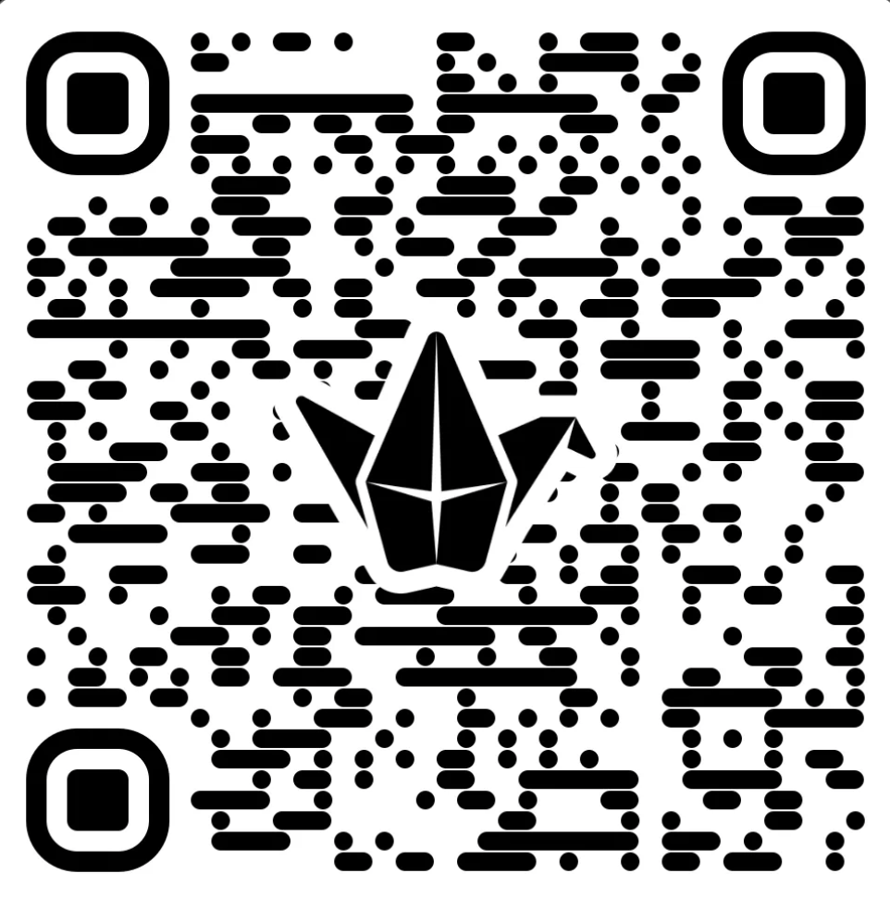
Please join the Padlet
Notes:
Link to board https://padlet.com/hannahroberts22_2/creating-a-culture-of-belonging-girlguiding-scotland-dasdkior4ggu6hw4

Slide 4
Session aims
To help you to foster an inclusive environment: by creating a welcoming and inclusive culture within Girlguiding, where all volunteers feel valued and respected.
To Encourage Self-Reflection: by promoting self-awareness amongst regarding biases and how these can impact interactions and decisions.

Slide 5

What does inclusion mean to you?
When was a time you really felt included?
Pop it on the Padlet (section 1 – in the comments)
Small group discussion- share with your neighbours – what made you feel included? What made the difference?

Slide 6
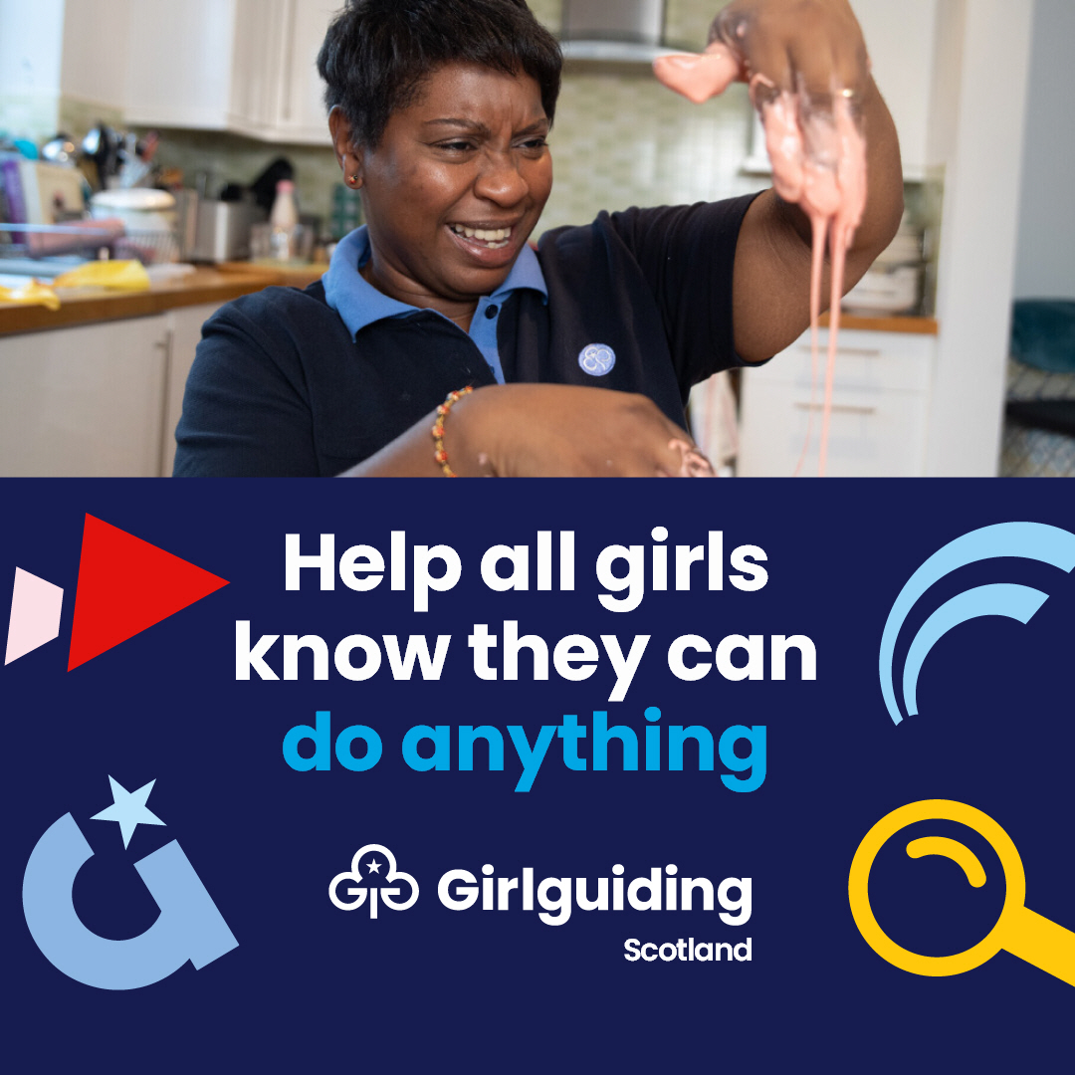
How can we define inclusion?
In Girlguiding it means:
Inclusion means giving all girls the same chance.
It is achieved by creating a safe environment where girls feel an equal sense of belonging and receive tailored support so they can reach their maximum potential.
Inclusion doesn’t just mean girls, it also includes adult volunteers

Slide 7
Unconscious bias
Social stereotypes about certain groups of people that we all form without realising
How might unconscious bias impact the decisions we make?
What can we do to reduce the impact?
How can we reduce it?
Notes:
Unconscious biases are social stereotypes about certain groups of people that we all form without realising. This can affect how we act or communicate with people.
Give example – get on a train at 2 in the afternoon and see some younger men drinking lager. You move to another carriage as a single female traveller. Unconscious bias can be helpful to keep us safe, to weigh up risks and are based on prior experience. However, these guys could be perfectly nice and just starting out on a stag do or going to the football.
If we’re not aware of them, we won’t know they’re there. We have to challenge ourselves to face our unconscious bias and take a moment to consider whether an unconscious bias might affect the way we interact or think about a particular person or group.
We must also look at unconscious bias when making decisions. This can be decisions about the activities we run, the places we visit, the young members we give leadership opportunities to, or more.
- We make decisions all the time as leaders: who give a job to, how to deal with an argument, who to make a patrol leader, what activity to do next, where to go on a trip and much more. How might unconscious bias impact the decisions we make? Discuss answers including:
We might perceive someone as more or less trustworthy and dole out jobs or opportunities accordingly?
We might perceive some people to be more or less intelligent and perhaps not give them the help they need or stop them reaching their full potential?
In the case of an argument or disagreement between young people or volunteers we might take someone's side or judge without hearing the evidence?
- What can we do to reduce the impact of unconscious bias on our decisions? discuss answers including:
educating ourselves
talking to people as individuals
be mindful of potential biases: being aware that we all have unconscious biases and might make snap decisions when talking to or dealing with someone who we don't know as well or has a different background or life experience as you.
The most effective way to reduce unconscious bias in decision making is to get everyone involved in making decisions. With your leadership team:
Make sure everyone feels heard and involved in making decisions
Think about different ways to make sure that everyone is included
With the young members in your unit, to get their feedback and make sure they are included:
Use different strategies, like post it notes or secret polls, so that feedback can be anonymous
Learn more about getting young members involved in decision making with the ‘girl-led guiding’ and ‘Involving young members in decisions and planning’ e-learnings on the Girlguiding learning platform
In our diversity and inclusion audit we found that young members from certain groups felt excluded from leadership opportunities because of bias. Leadership opportunities should be highlighted for all members. We should support members applying for leadership opportunities and support them with applications. This applies to all members, from Rainbows to Rangers, and even adult volunteers.
Trainers: The D&I audit can be found on the Girlguiding website
https://www.girlguiding.org.uk/globalassets/docs-and-resources/diversity-and-inclusion/diversity-and-inclusion-audit-report.pdf

Slide 8
LEAD 2025
Universal Barriers
Attitudes – negative assumptions or stereotypes, not open
Time – not enough to complete a task e.g., get training
Finance – cost for uniform, trips, subs etc.
Physical access e.g., physical, transportation
Communication barriers – warm? Welcoming?
Technological barriers – websites, apps not accessible to all
Systemic – policies or structures that unintentionally disadvantage
Cultural – fails to recognise the culture of others. Makes people feel misunderstood
Language - use of complex language, jargon
Information – not being shared clearly enough, too much, too little
Enthusiasm – lack of willingness to engage

Slide 9
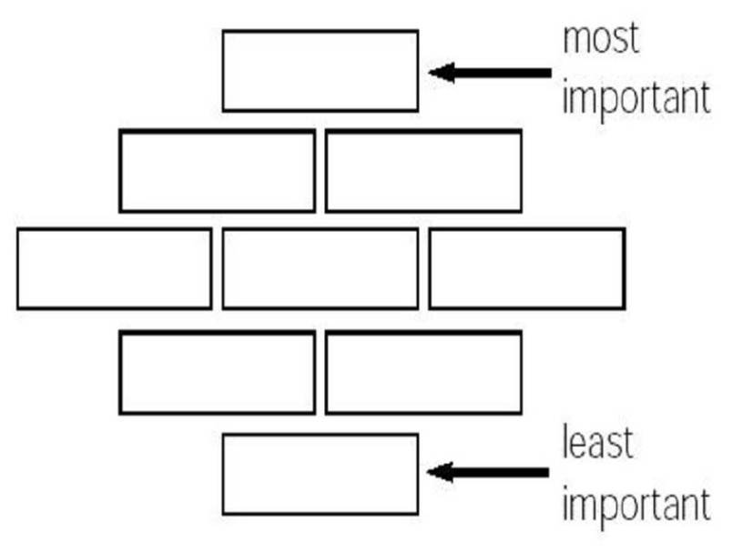

LEAD 2025
Group work!
As an individual or in a small group:
Lay out the barriers as a diamond
The most relevant barrier in your area or for your role is at the top, and the least relevant at the bottom.
Pop some thoughts on the Padlet (section 2)

Slide 10
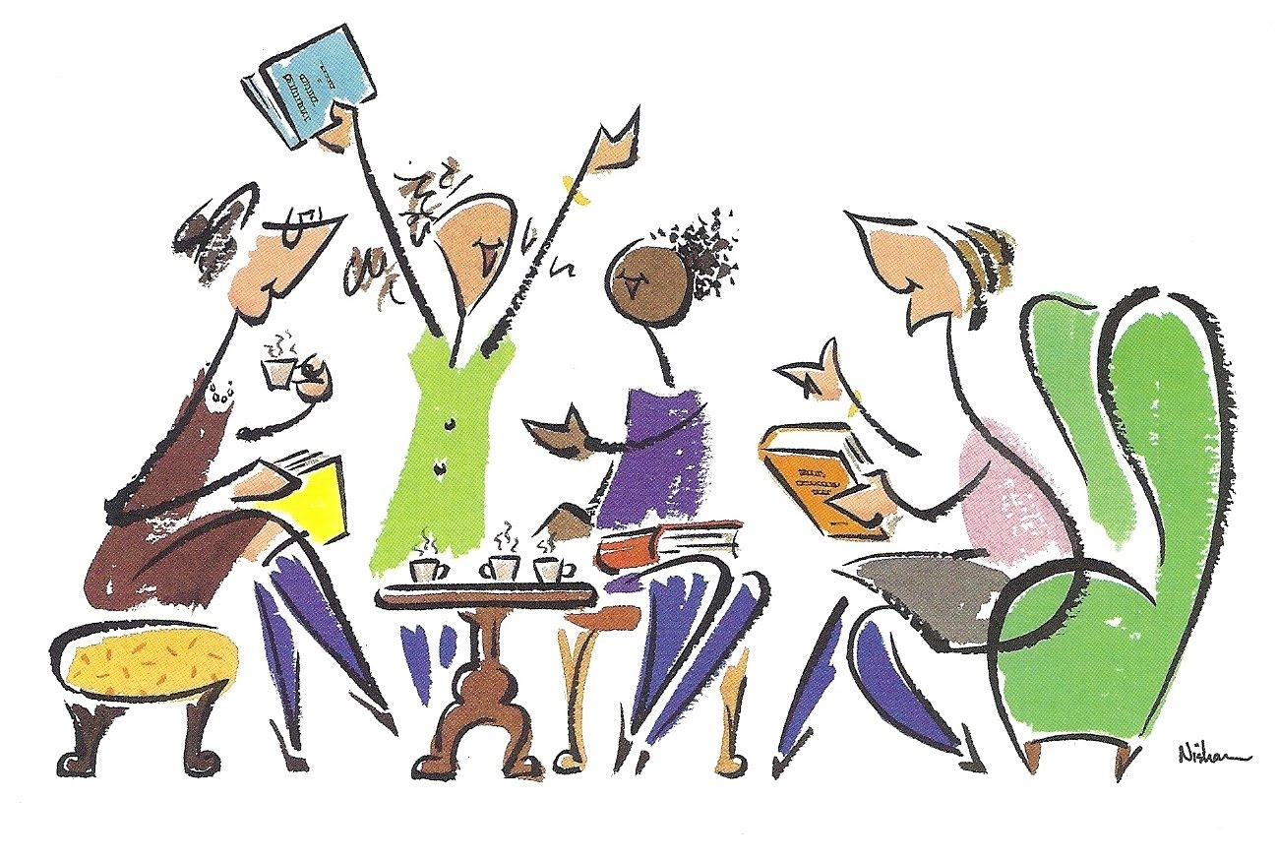
LEAD 2025
Group work!
In groups:
Use the statements as a thought provoker (select the ones that most interest you)
Discuss how to reduce these barriers in your areas
What are some practical steps we could take
Pop some ideas on the Padlet (section 3)

Slide 11
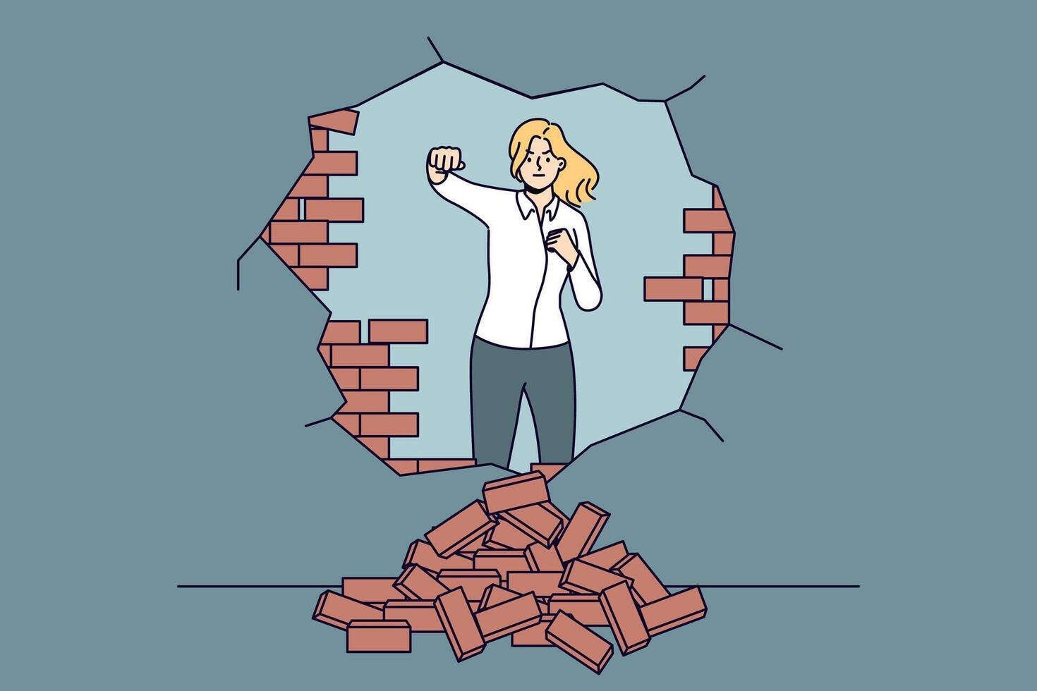
LEAD 2025
Think about
Have a think…
What’s an action you can take in the near future to tackle a barrier?
What help might you need to tackle other barriers?
Pop in on the Padlet (section 4)

Slide 12
LEAD 2025
Final thoughts
Thinking about the level you lead within Girlguiding and where you’ve ranked the barriers and how you responded to the scenarios, think about:
What are the biggest barriers for inclusion for you in your role?
Is it a barrier that is a bigger issue for Girlguiding Scotland as a whole? Or is it something you can tackle with your team at a local level?
Is it something you can individually tackle or does it need a team approach?
Is it something you need support with? – training, commissioner, chat with someone else

Slide 13

Being an ally
LEAD 2025
An ally is defined as someone who is not a member of a marginalised group but wants to support and take action to help others in that group.
Notes:
An ally is often defined as someone who is not a member of a marginalised group but wants to support and take action to help others in that group.

Slide 14

Takeaway
LEAD 2025
Treat people as individuals, ask questions, challenge yourself, ask for help, do your best

Slide 15
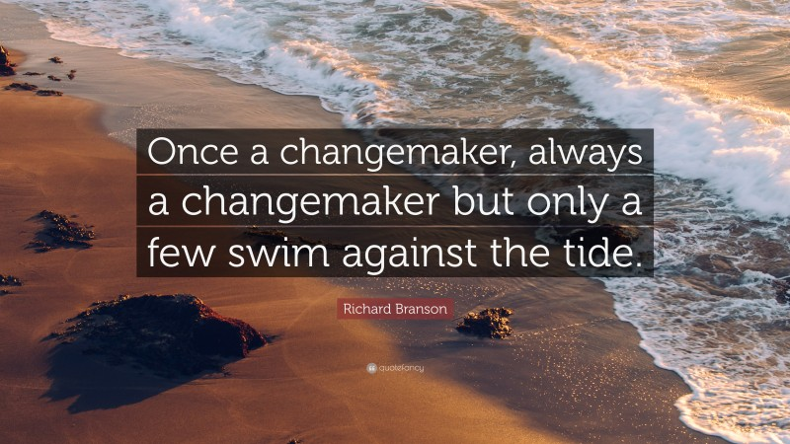
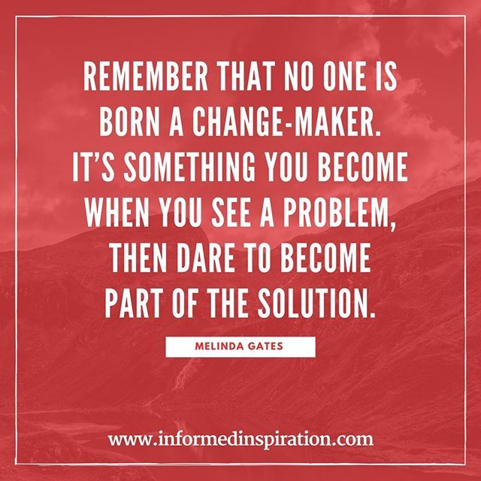
LEAD 2025
Change Maker

