Slide 1


Slide 2
Confident communications
Helen Humphreys
1 November 2025

Slide 3
Objectives of the session
Effective information sharing - Ensuring that information is conveyed clearly, concisely, and in a way that is easily understood by the audience.
Building stronger relationships - Fostering connection, trust, and rapport with others through clear and empathetic communication
Increased self-confidence - Developing the ability to express oneself confidently and assertively, leading to greater self-esteem and belief in one's abilities.
Enhanced leadership - Using communication to inspire, motivate, and influence others, becoming a more effective leader.
Achieving specific goals - Using communication to achieve desired outcomes, whether it's persuading someone, informing an audience, or resolving a conflict.
Increased job performance - Using communication to improve teamwork, productivity, and overall performance.

Slide 4
Activity one
Listen and follow these instructions

Slide 5
Would this have been more useful
Draw a square in the middle of the paper
Draw a triangle on the top of the square
Draw an oblong to the right of the triangle, ensuring that there is no gap between the oblong and triangle
Insert a small square into the large square, and draw lines to divide the square into 4
Insert a small oblong shape with a rounded top into the square
Add a heart shape to the oblong

Slide 6

Would this have helped?

Slide 7

Summary
We all hear or interpret things differently
Some people prefer written information
Some people prefer a diagram or picture
Some people prefer detail/some don’t

Slide 8

Communication Challenges
I send all the information I receive to leaders by email in my area- but I’m not confident they ever read it

Slide 9

Communication challenges
I tell leaders the dates for any up coming trainings, but they still seem to miss the deadline for booking
This Photo by Unknown Author is licensed under CC BY-NC-ND

Slide 10

Communication challenges
I’m not sure leaders listen to me at the district/division meeting

Slide 11

Challenges with communication
Some leaders text me repeatedly asking about the information I’ve already sent them

Slide 12
Principles of communication
Right message
Right person
Right time
Right method

Slide 13
Communicating with leaders
F2F meetings
Zoom meetings
Email
Social media
WhatsApp groups
Phone
Post
Handwritten notes

Slide 14
Communication
Do you ask leaders how they would like to receive communication
Do you consider how frequently you communicate
Do you consider communication overload

Slide 15
F2F or Zoom Meetings
Be welcoming and consider the venue
Consider new leaders – use of jargon or referring to people everyone else knows but they may not
Listen
Body language facial expressions
Humour where appropriate or light heartiness
Encourage feedback and discussion- not a briefing session
Be appreciate- they are all volunteers

Slide 16
Table activity
Identify which method of communication, fits best with the message

Slide 17
Communication styles
Quick quiz
Not scientific
Keep your own scores- but be honest with yourself
No ‘right answer’

Slide 18
Another commissioner takes credit for an event you organised. Do you…
Keep quiet, it’s not worth making a fuss
Call them out in front of others
Discuss it with them F2F
Let it happen, but let everyone else know, you organised the event

Slide 19
A leader keeps missing the deadline for submitting her accounts/first response/safer guiding – do you…
Don’t mention it- surely, she’ll work it out one day
Raise this at a district meeting
Talk to her F2F and ask how you can help
Wait until her membership is at risk

Slide 20
Your CC contacts you to see how things are going with a specific problem - do you…
Tell her it’s going great-don’t want to look incompetent
Tell her that you cannot cope and that you should never have agreed to be a Commissioner
Ask her to explain again what to do/handle
Ask for help-but let her do most of the work

Slide 21
A leader complains about a difficult decision you have made at an event – do you say…
Nothing
I’m the commissioner and entitled to make this decision
I respect your opinion, it was difficult, but I stand by what I’ve done
Well, I could have made a different decision, I’ll think about it

Slide 22

Answers
Mainly 1-Passive
Mainly 2-Aggressive
Mainly 3 Assertive
Mainly 4- Passive Aggressive

Slide 23

Communication styles
No communication style is wrong.
Some methods will be more effective than others.
The way you communicate can easily strengthen a bond, or it can cause stress and tension.
To avoid misunderstanding, it helps to understand your own and other’s communication style.

Slide 24
Communication styles
Passive
People with a passive communication style are generally more quiet, reserved, and less likely to openly express their feelings. They prefer to be supportive and defer decisions to others and have a tendency to be overly apologetic.
What are the challenges with this style in the commissioner role

Slide 25

Passive
More difficult to be a visible leader
Can make it hard to make crucial decisions
Seen as weak
Avoid conflict/emotional
Try practicing at speaking out more, being brave, be mindful of your style
In responding to passive communicators, take time to let them speak, prob their answers, encourage them to say what they think, give them time

Slide 26
Aggressive
People with an aggressive communication style tend to be overly direct and dominant, often with minimal consideration for others. This often takes the form of yelling, shouting, dominating the conversation, and speaking forcefully before thinking
Aggressive communicators might feel good at getting a point across in what they perceive to be an efficient manner, but when the message is shared harshly—or at the expense of others’ feelings—it makes it hard for people to hear it and respond in a regulated way
What are the challenges of his style in the commissioner role

Slide 27
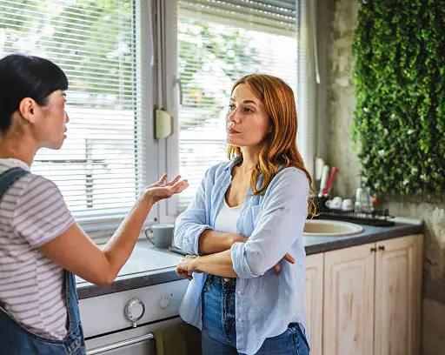
Aggressive
There may be times when a more aggressive style might be appropriate, to restore order in chaos, or to prevent an accident but this is usually not an appropriate communication style in a Guiding context
If this is your style, be mindful of the impact on others.
If you feel yourself moving into the style, take a deep breath, and be self aware
When communicating with aggressive communicators, suggest that you do not rise to what they are saying and try to match them as this gives them credence for their style
Take deep breaths before responding,
Model a different communication style

Slide 28
Passive Aggressive
This might seem passive on the surface; this style can be a type of covert aggression.
Sarcastic comments, or procrastination, communicating in indirect ways, (hinting) or backhanded ways, hoping that the other person will work it out or notice .
This behaviour can be frustrating when the person on the receiving end must try to interpret or figure out what the passive-aggressive person wants.
And it makes the passive-aggressive communicator equally frustrated when they just can't seem to get the message across clearly.
What are the challenges of his style in the commissioner role?

Slide 29

Passive Aggressive
This style often feels like a safer way to express our frustration. Instead of addressing the problem head-on, we do this to get our point across without getting involved in a direct confrontation
Be self aware, practice asking/saying what you really mean/watch how others communicate and the impact of that on the recipient and you
Start by thinking why someone won’t do what you want them to do- and acknowledge that and then offer to help/a solution

Slide 30
Assertive
Generally considered the most effective communication style because it’s both emotionally honest and considerate of other people’s feelings. Assertive people are able to be direct, clear, and respectful.
Assertive communication promotes open, honest, and respectful dialogue. Effective communication often involves respecting others and expressing oneself clearly and confidently.

Slide 31

Assertive
Consider what you want to say ahead of time, prepare, the key points and avoid being impulsive.
Be as clear and concise as possible
Once you have your plan be as direct and succinct as you can be.
If you stick to a clear point initially many conversations will unfold with more detail and exploration, and sometimes a solution will emerge
Practice active listening, be prepared to fully absorb what the other person is saying in response to you.
Ask questions for clarification for better understanding as needed.

Slide 32

Putting this into practice
You receive an email from a parent of a brownie
The parent is very angry because her child has come home from Brownies very upset because all the other Brownies got a badge tonight and she didn’t.
She says that Brown owl said she could not have the badge because she has not done all of her skills tests
The mother does not know what these skill tests are and why she cannot do them at home
She says I thought that Brownies was supposed to be fun.

Slide 33
Discuss on your table what your next steps will be

Slide 34

Next steps
Email parent to acknowledge her upset, say sorry that they are both upset
Inform her that will find out what has happened and respond within xxxxx number of days
Contact the leader possibly by phone and arrange to meet or talk to establish the facts
Be clear that this is about an email from xx parent
Acknowledge her upset, but that you will help/support her to sort this out

Slide 35

Thinking about assertive communication style
Speaking to the leader/plan your conversation
How will you start the conversation with the leader
How will she be feeling?
So what do you need to acknowledge?
What do you need to find out (why the brownie did not receive a badge)
Agree how this matter can be resolved- what does the Brownie need to do to get a badge
Has the leader been clear with parents and Brownies

Slide 36

Thinking about assertive communication style
Talking to the parent/plan your conversation
Acknowledge their upset- which may by now have calmed
Inform what you have done to find out what has happened/ taken her complaint seriously
Tell her what you have found out
Tell her the solution to move things on
Summarise, acknowledge, advise she can contact you again if this doesn’t end satisfactorily

Slide 37
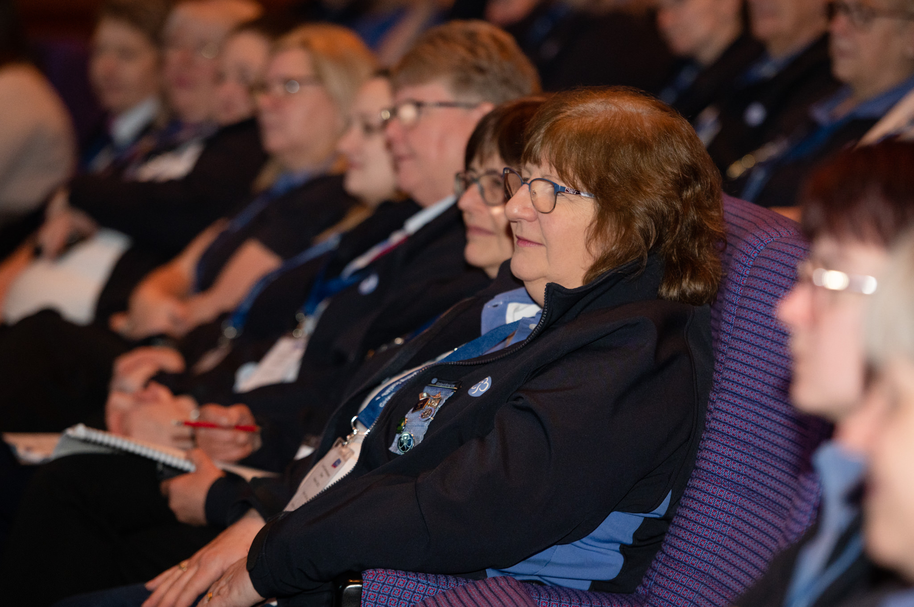
Confident Communicators
Summary
Think about the impact
Prepare
Be brave
Be clear
Ask for help
Practice

