Slide 1


Slide 2
Building a team now and in the future
Lead 2025
Barrie Stewart and Bronach Hughes
Notes:
Trainers introduce themselves

Slide 3
A very warm welcome
Notes:
+ 2 minutes – Barrie, 2 minutes
We would like to give you a very warm welcome to our session - Girlguiding couldn’t survive without you.
Now that you know who we are we would like to find out a bit about you
Put your hand up if you are
A County Commissioner
A Division Commissioner
A District Commissioner
Anyone else thinking about a Leadership role
Acknowledge each group in turn

Slide 4
Aims and Objectives
Aims
To explore
What makes a team?
The roles needed for your team
How to choose the right people for your team
How to get your team to work (together).
Future proofing your team
Objectives
To understand how teams' function.
Know who is in your support network
Problem solving your team
How to recognise (future) talent
Notes:
+4 minutes – Barrie, one minute
Just read out

Slide 5
Think unit leader
Spend a moment considering your unit team
Who is in your team?
How did they get there?
Why do they stay?
Notes:
+ 5 minutes – Barrie, 2 minutes
Let’s start with the basic team – the unit. Units form the basis of your district team, so as a first line commissioner, you need to know your unit teams. Ask yourself these questions.

Slide 6
My unit team
Three fully trained leaders
One leader in training
One unit helper
Three young leaders
“We belong here”
“I just like you guys”
“You care about me”
“It’s my safe space”
“The girls are so funny”
“We all like eating curry”
Notes:
+ 7 minutes – Barrie, 3 minutes
Explain the make up of Barrie’s team and the reasons people have given for wanting to be in that team. Their teams might be quite different, but understanding what makes a team work starts with understanding who is in your team, and why they want to be part of your team. What do you think your team would say if you asked them?

Slide 7
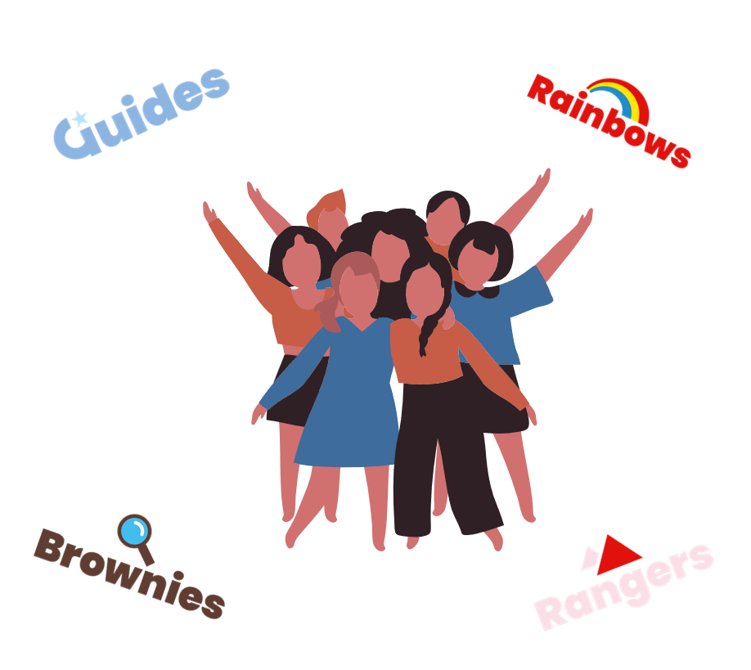
What is a team?
A group of individuals who collaborate to achieve a common goal or complete a specific task.
Notes:
+ 10 minutes – Bronach, 4 minutes
Here is one definition of a team (read it out), but it begs several questions.
Does your (unit or district or division or county) team have a common goal or a specific task to do? Probably not. You’re probably doing lots of different things at the same time, some of which might detract from other things. For example, you want to encourage a LiT to start slowly to build her confidence, but you’ve got a long waiting list for a unit. How do you balance her needs against the needs of the girls who are waiting to get in to guiding? Not to mention the fact that having more girls would help balance the books.
How often does your team stop to think about what its goal or task is? Do we all just assume that everyone knows? Counties might have some sort of strategic plan, but post-Covid, we keep hearing that lots of district and division meetings are not happening, so when do you take time out to discuss your goals? And there are likely to be multiple goals, which may need ranked, or may need more or less attention at different times.
- Do all teams need the same sets of skills? Well, that probably depends on what your goal or task is, doesn’t it? When the task is to get all the accounts submitted, it might need one set of skills. When it comes to recruiting new volunteers, you might need very different skills, mightn’t you?
- Another question to ponder. Does a team only work if the people in it are buddies/pals too? Knowing the other people well might mean you have a shared history and can predict how they’ll behave so you kind of slot around each other. But being too close might make it difficult to offer constructive criticism when things are not going well. It might mean you only ever do the same things, in the same way, with the same result, but what worked 10 years ago might not work so well now. It also excludes other people who might be very valuable additions to your team.

Slide 8

What makes a good team?
The effectiveness of a team often depends on factors such as
leadership
the diversity of skills and perspectives
the clarity of goals
the quality of interpersonal relationships within the group.
Notes:
+14 minutes – Bronach, 3 minutes
So we need to ask ourselves, what makes a good team?
What makes a team really work well isn’t just having good people—it’s about how we work together.
Strong leadership helps guide us while having a mix of different skills and viewpoints makes us more creative and capable. Of course, the more diverse your team the more ‘managing’ the leader has to do! And good leaders can have very different styles, so don’t assume there’s only one way to be a leader. Can they suggest any good leaders they’ve come across, in their working or volunteering life, or in public life?
Being clear on what we’re trying to achieve keeps us focused, especially when times are hard.
How we treat and support each other makes all the difference. Whether we’re pals or not, we can be professional and supportive.
As a Commissioner, at whatever level, you’re part of a team that helps shape the experience of every girl and volunteer in your area.

Slide 9

Why diversity matters
"Diversity of skills and perspectives" refers to the presence of a variety of competencies, experiences, viewpoints, and backgrounds within a team.
This diversity can significantly enhance a team's effectiveness and innovation.
Notes:
+ 17 minutes – Bronach, one minute
A successful team isn’t made up of people who all think the same or have the same skills—it’s made up of people who bring different strengths, experiences, and ideas.
That mix helps us solve problems better, come up with new approaches, and support each other in ways we couldn’t do alone.
In Girlguiding, we’re lucky to have volunteers from all walks of life—each with their own story, skills, and perspective. As Commissioners, you help bring those differences together in a way to promote strength and an inclusive approach.
When we value and use that diversity, we build teams that are not only more effective, but also more creative and resilient.

Slide 10

The power of relationships
Interpersonal relationships are the social connections and interactions between two or more people. These relationships can be personal, professional, or social, and they play a critical role in an individual's emotional and psychological well-being.
Notes:
+18 minutes – Bronach, one minute
Strong teams are built on good relationships. How we connect with each other—whether it’s through friendship, teamwork, or just everyday conversations—really matters.
When we feel respected, supported, and understood, we’re more likely to feel confident and motivated.
As Commissioners, the way you interact with others—your tone, your encouragement, your ability to listen—can have a huge impact.
Positive relationships help people feel safe to learn, ask questions, and grow. And when we build those connections within our teams, we create a culture where everyone can thrive.
When people feel supported and valued, they are more likely to take on roles and more likely to carry them out effectively.

Slide 11
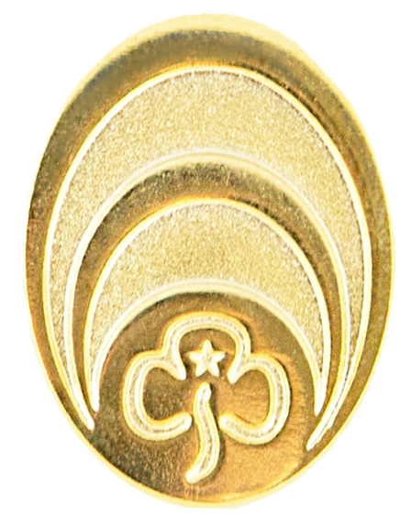
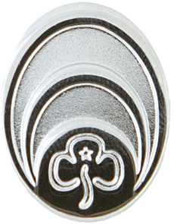

Who is in my team?
You may have inherited a team of people from your predecessor.
Consider: are these the right people for the tasks they need to do?
Notes:
+ 19 minutes – Bronach, 3 minutes
In the workplace, people usually have to apply for jobs. If you don’t get the right people applying, you can readvertise or you can use an agency to find you more suitable people. When you work with volunteers, your options are not always so open. Often, you take on a team leader role – as a commissioner or adviser or co-ordinator – and you inherit a team. Now, they might be delighted to have you as their new leader, or they might be resentful that someone they know better didn’t get that job. Maybe they thought they should have got that job! Posts at Scottish level are advertised and there is a professional recruitment process for them, but the same isn’t generally true of county or division or district roles. Maybe – shock horror – your predecessor is on you new team, because she’s a unit leader in your district, or holds an adviser role at division or county level. How will you cope with that? Barrie will pick up on this issue later.
How many hats do people in this room wear? Count up how many roles you hold in guiding, never mind all those other roles you have in life. Does anyone have just the one? Very unlikely! Two, five, ten – who thinks they have the most? Do the people you inherited have multiple roles, or could they do more?
So, ask yourself: Does the team you’ve taken over have: a. all the people you need in it? And b. only the people you need in it?
Even if people in your new team are good and have the right skills, do they have time to give to the job? Do they have divided loyalties or conflicts of interest? Do they not get on with someone that you really need them to be working with?

Slide 12
Who do I need in my team?
Think about the support you actually need.
Identify the roles you need.
Identify people for these roles.
Remove roles that are no longer valid.
Notes:
+ 22 minutes – Bronach, 3 minutes
Going back to what we said about good teams, you need to review:
What support you think you need as leader of this team. Do you have skills that you’re confident about and the time to do all these roles, or would you welcome some support for some of the tasks you need to do?
If you’ve now scoped out the job and understand what you need to get the job done, what specific roles do you now need to fill in your team? Are there new jobs that need done that need new skills that the existing team doesn’t have? Could the work be divided up differently to spread the load or make better use of the skills the people you have available can bring to the tasks that need to be done? If your big issue in your district or division or county is recruiting new volunteers, having loads of accountants is not going to help! However, if there are issues around compliance – accounts or safeguarding – then you do need people with very specific skills who can focus on those very specific jobs.
Be creative. Just because it was done one way in the past, that doesn’t limit you in the future. Even at county level, where you may have a written structure with roles and role descriptions, you can quickly and easily change things to better suit the current needs by having a vote at a county executive meeting. At other levels, where there probably isn’t anything written down, a chat at a meeting to get people on board might be all you need.
And we often focus on what new roles are needed, but do we weed out those that are no longer needed as well? Otherwise, it just causes confusion – and a headache for the next person doing your job. Say ‘thank’ you’ to the incumbent and perhaps find them something else to do, but don’t just do things because ‘that’s the way we always did it in the past’.
There are lots of role descriptions on the Girlguiding UK website that might help you think about the team that you need. If you look at the commissioner role descriptions, they set out what is expected of the commissioner, but, of course, you just need to make sure across your team that you’re covering all these tasks. There are also role descriptions for people running events, being an outdoor adviser, a treasurer and so on. You can use these as a starting point and amend them to suit your particular needs.

Slide 13
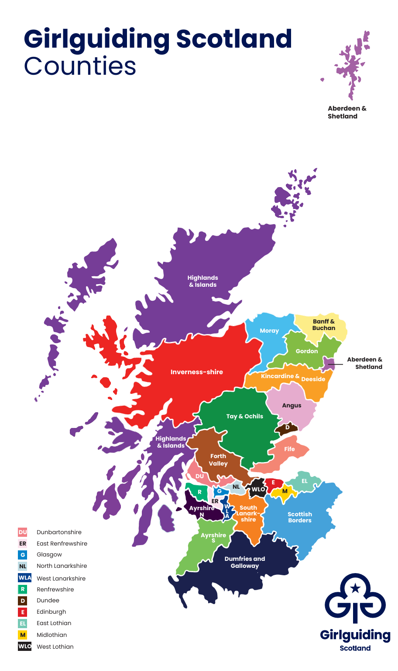
It depends where you are
Notes:
+ 25 minutes – Barrie, 2 minutes
If you are a Commissioner of a large geographic area you may need to consider if you need a larger team to cover the area. Perhaps you need to duplicate roles or make them smaller to make them manageable for people.
What works for you? Perhaps you can make more use of online support/meetings, but nothing beats face-to-face contact, as we’ll come back to shortly.

Slide 14
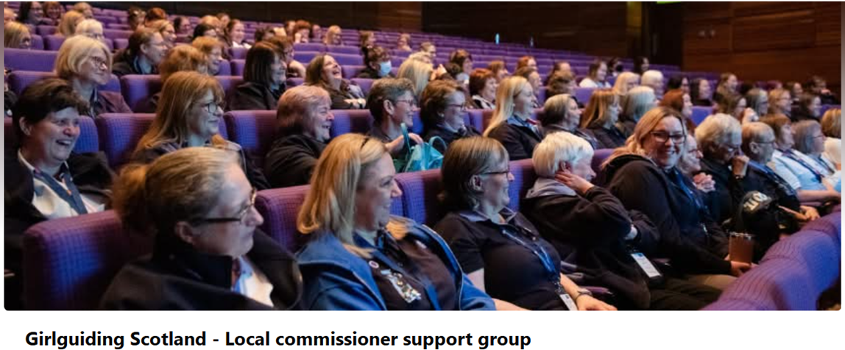
Don’t try to do it all by yourself
Remember you are never alone.
There is a whole commissioner network for you to tap into.
Notes:
+ 27 minutes – Barrie, one minute
Make friends with your neighbours, take advantage of conferences like this to build your network, go to the support groups or trainings put on by Girlguiding Scotland. That’s your big team.

Slide 15
How do you recruit your team?
Notes:
+ 28 minutes – Barrie, 6 minutes
Of course, getting the right people for the job isn’t always that easy. Ask for suggestions – how do they find people? Do you need different strategies depending on the role you’re trying to fill, or the level that the vacancy is at (district/division/county)?
How have people found suitable members for their team? Have a chat with the people around you and share your successes with them. If anyone is willing to share with us all, please do so!
According to a National Council for Voluntary Organisations’ report into volunteering in 2019, Among those who had not volunteered in the last year, some said they could be encouraged to get involved. The things that would most encourage them to get involved are having flexibility with their time committed (50%), flexibility with the way they give their help (eg doing it from home) (40%) and being asked directly (28%). Also it’s really important to note, especially in relation to volunteering, if someone is good at something, or it’s a topic/area of volunteering that they enjoy – it’s less likely to feel like a chore. So bear those things in mind when trying to recruit someone into your team!
What are the boring but often effective ways of finding people? Expect them to say:
Consult the district team: they might have a volunteer or a parent who would fit the job
Use the volunteer bureau to advertise vacancies
Advertise on social media
Ask the neighbouring district/division if they have someone who might take on the job
Ask generally: people are less likely to put themselves forward for a role, but might take it on if approached directly
Think about young people who might want experience to put on their CV, or as a clause for their Queen’s Guide or DoE etc.
Remind them to be as inclusive as possible – can’t just give the job to your mates, so how can be as open to new people, younger people, people from different backgrounds as possible?

Slide 16

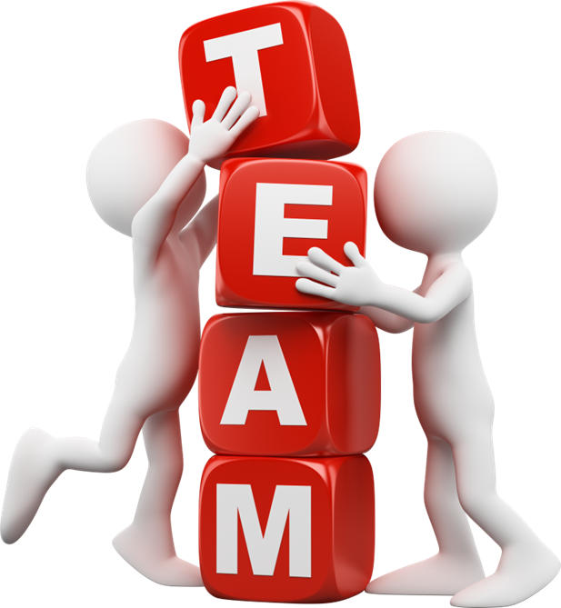
Finding that superhero!
Notes:
+ 34 minutes – Barrie, 3 minutes
How do you find that really key person who would complete your team? How did you end up on the team that you’re currently part of? Would that work for other people? What’s the most unusual way that you’ve recruited someone to a team? Have you recruited a superhero and how did you do it – has anyone got a story that they’re prepared to share with us?

Slide 17
Valuing your team
Do you visit members of your team?
How well do you know them or they you?
When you ask for volunteers is everyone asked?
Do you identify, cherish and celebrate talent?
Do you encourage everyone to get involved?
Notes:
+ 37 minutes – Barrie, 4 minutes
You need to keep the people you have already, while thinking about potential recruits and new roles, so here are some ideas for doing that.
- You need to get to know people and visiting them in your units is a great way to do that. You can spot the talent. You can see who the peacemakers and the negotiators are, who the really focussed people are, who the creatives are. Or who might get there with a bit of support and training.
They will get to know you if you visit them or you organise district or division meetings or social events. The better they know you, the easier it will be for you to approach them about a prospective role.
Are you too limited in who you make approaches to? Just because someone is younger, only been involved a guiding for a short time, seems to be a busy person, hasn’t previously done a similar role, lives in a particular place, has family or other commitments, comes from a less privileged background or a minority ethnic group, it doesn’t mean they wouldn’t be good for the role you’re trying to fill. They might need support, at least initially, but if you limit the pool of people you approach, then you are less likely to be successful.
At the same time, you can grow existing members of your community by giving them the opportunities to develop their skills. Celebrate their talents – publicly if they’re happy with that, or privately by a positive email or card or a simple thank you. Do you regularly give out thanks badges or nominate people for awards?
Some volunteers are put off by cliquishness or the perception that you have to be part of the ‘in’ crowd to play a part in the wider team. Is that true in your area? What can you do encourage everyone to get involved?

Slide 18
Top tips
Be clear and concise – avoid jargon, acronyms and keep things simple.
Listen actively – show you’re paying attention and value what others say.
Be approachable – create a safe space for questions and feedback.
Adapt your style – different people respond to different approaches.
Use positive language – encourage and uplift wherever possible.
Notes:
+ 41 minutes – Barrie, 4 minutes
Some top tips here for making sure that every interaction you have with your team or potential team members is a positive one.
It’s very off putting if you use acronyms that people don’t understand but are too embarrassed to ask what they mean, and we’re often very guilty of that. REN, anyone?
Make sure people are heard when they make a contribution – don’t let the quieter ones be drowned out by the loud people. We all try to ensue that with our girls, but you need to do it with adults too.
Try to see yourself as other people see you. Are you someone that people are wary of? Or are you open and approachable?
Treating people differently is not showing prejudice. Instead, it’s responding to them in a way that meets their needs or allows them to do their best. So don’t be patronising, but do be willing to adapt your approach for different people.
Avoid ‘no’, ‘don’t’, ‘can’t’ etc. Try to use positive words instead – tell people what you want them to do, not what you don’t want them to do. Challenge gently, turn questions back on them so that they can see that you’re interested and trying to help them rather than being critical. One great way to stem creativity is to immediately criticise what someone says.

Slide 19
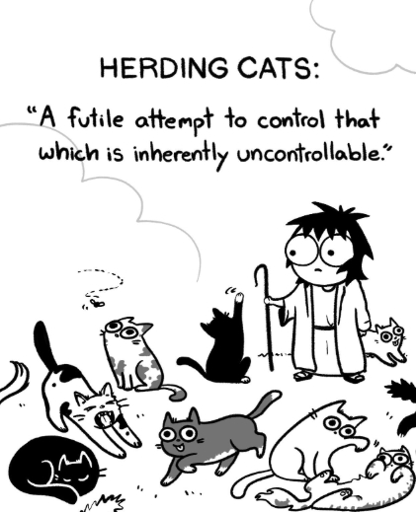
Sometimes it feels like ……..
Notes:
+ 45 minutes – Bronach, one minute
Once your team is up and running you will probably find that there is a whole lot of work going on, but not all of it might have an obvious purpose or be well co-ordinated. Sometimes it’s easier to deal with one cat at a time but do hold a full team meeting every so often just to check that everyone is coping with what they need to do.

Slide 20
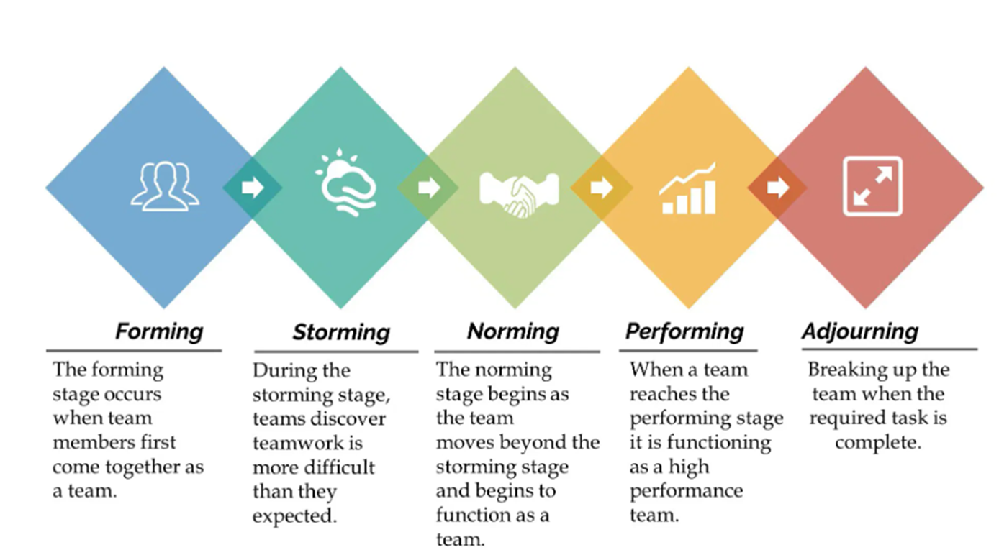
It won’t always be plain sailing!
Notes:
+ 46 minutes – Bronach, 4 minutes
Some of you will be familiar with this model from Tuckman and Jensen. Although it comes from the world of business management, it is very relevant to teams in Girlguiding. We work in teams a lot of the time – it’s one of our Five Essentials after all – and sometimes those are short-lived, get set up and finish at a particular time, and have a very specific task. Other teams are around for longer, have people leave and join at different times, and may have a number of tasks to complete, as we said earlier. However, the principles still hold.
Most teams go through a similar process in terms of their development.
Initially, in the forming stage, people are usually polite but they are sussing the rest of the team out. They may wonder why someone has a particular role when they feel they could do it better. They might not speak up if they have concerns, or may look like they’re deliberately not engaging, when really they’re just a bit nervous about committing themselves.
In the storming stage, relationships and meetings may become rather heated and it is your job as Commissioner to stay calm and smooth ruffled feathers. Those feathers may be ruffled by the most random of things. Every time you get someone new into the team, you may find a bit of a storm coming on, but hold your nerve – it will pass!
Once you get to the norming phase, it will feel like you’re making progress, and that will redouble when the team becomes a well-oiled machine in the performing stage. And then a key person leaves, or the commissioner’s term comes to an end, and it feels like everyone is thrown into the mourning or adjourning phase, or right back to the forming stage again. Of course, for most of our teams, the task is not complete – it just gets handed on to another team, which we will look at shortly.
Other management experts (such as Belbin) have suggested that an ideal team size is 4-8, as anything smaller is too small to creatively manage the task and a bigger team will inevitably split into smaller ones. Belbin also emphases the importance of having people within the team who are task focussed, so they keep things on track, while other people need to be focussed on the social aspects of how the team members relate to each other, and others provide the more strategic or creative thinking side of things. If you’ve got all of those covered in your team, you will do well.

Slide 21
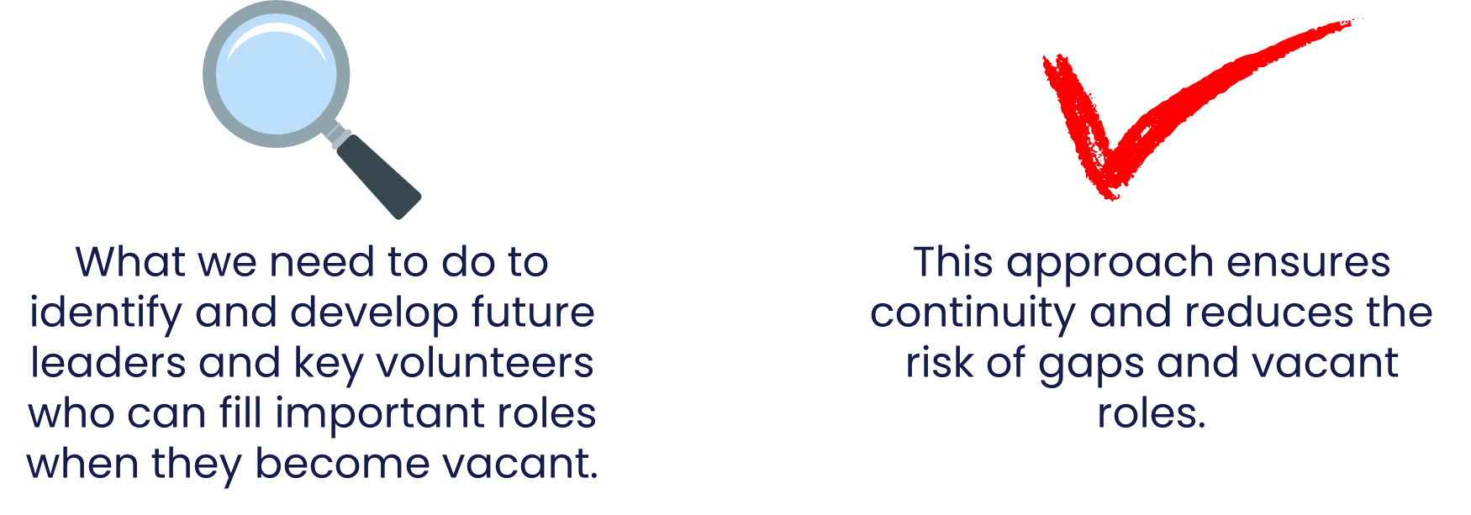
Planning for the future
What is succession planning?
Notes:
+50 minutes – Bronach, one minute
Some of us might have had to do this in another context, but we’re not great at doing it in guiding. We often seem to get taken by surprise when a commissioner or adviser finishes their role or a unit leader steps down, even though we know that some people are appointed for a fixed period and leaders don’t stay forever. So how can we do this better?

Slide 22

Building tomorrow’s teams
Notes:
+51 minutes – Bronach 2 minutes
Here are some things that we could do to plan for the future. A lot of it is the same as for building your current team, but perhaps with a different timeframe in mind.
Identifying Key Positions: Recognise the roles that must have someone in place to take over and when the current person is likely to finish.
Assessing Current Talent: How well do we know our current team or other people who could join the team, and what skills they could offer? How can we find that out?
Developing Talent: Perhaps we could offer more skill-led mentoring or opportunities to shadow someone in the team or come and help at events or projects.
Creating a Talent Pipeline: Establishing a pool of qualified and prepared candidates who can step into key positions when needed.
Leadership Development: Providing opportunities for volunteers to develop leadership skills, such as decision-making, strategic thinking and team management.
Monitoring and Evaluation: Continuously assessing the effectiveness of succession planning efforts and adjusting as necessary, such as regular reviews of the talent pipeline.
Communication: How can we advertise positions so that the right people see them and feel encouraged to apply for them?

Slide 23
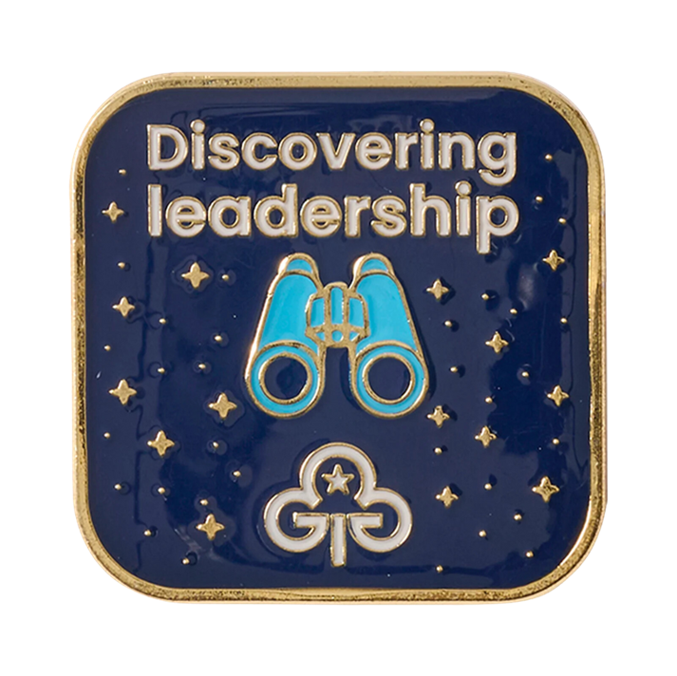
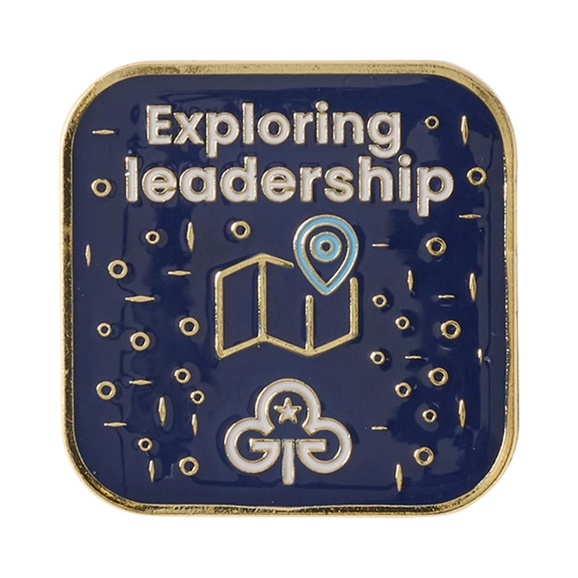
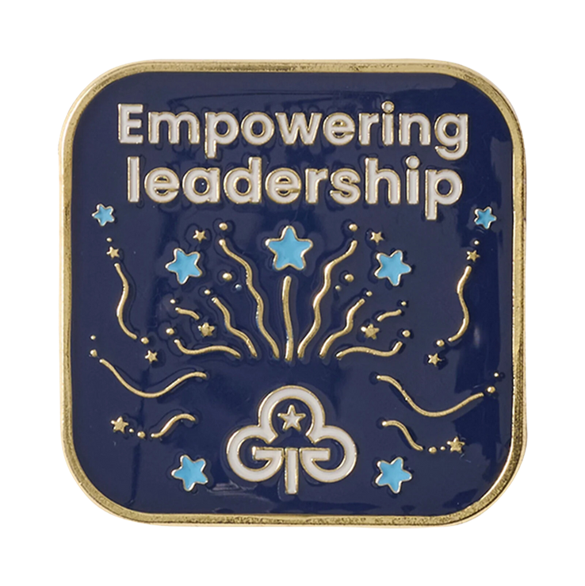
The leaders of the future?
Notes:
+53 minutes – Bronach, one minute
We need to think about growing the leaders of the future who might currently be Young Leaders. Excite them about the YLDP and what it can mean for succession planning and team building. The experience Young Leaders get can be very unit-specific: some are given responsibility and encouraged to think and act for themselves, while others are not. As a commissioner, you can try to ensure that all get the best experience and opportunities.

Slide 24

Notes:
+ 54 minutes – Bronach, one minute
We talked earlier about the ex-commissioner who stalks her successor. Don’t be that person!

Slide 25


Slide 26
Thank you

Slide 27
Building a team for now and in the future
Whether you're starting a new team or strengthening an existing one, this session has ideas to help you lead with purpose. We’ll explore what makes a team thrive, how to balance roles and tasks, and how to plan for the future including succession planning. You’ll leave with helpful approaches to build inclusive, sustainable teams that feel great to be part of.

