Slide 1
Welcome to Girlguiding
Learn more about volunteering with us and meet other new volunteers.

Slide 2
In the next hour, you will…
Learn more about volunteering with Girlguiding
Meet other volunteers at the beginning of their volunteering journey
Have the opportunity to ask all the questions you have
Learn about the next steps

Slide 3
Who are we?
Girlguiding is the UK’s largest youth organisation dedicated completely to girls.
Girls can do anything. We help them know that, whether they’re 4 or 18 or in between.

Slide 4
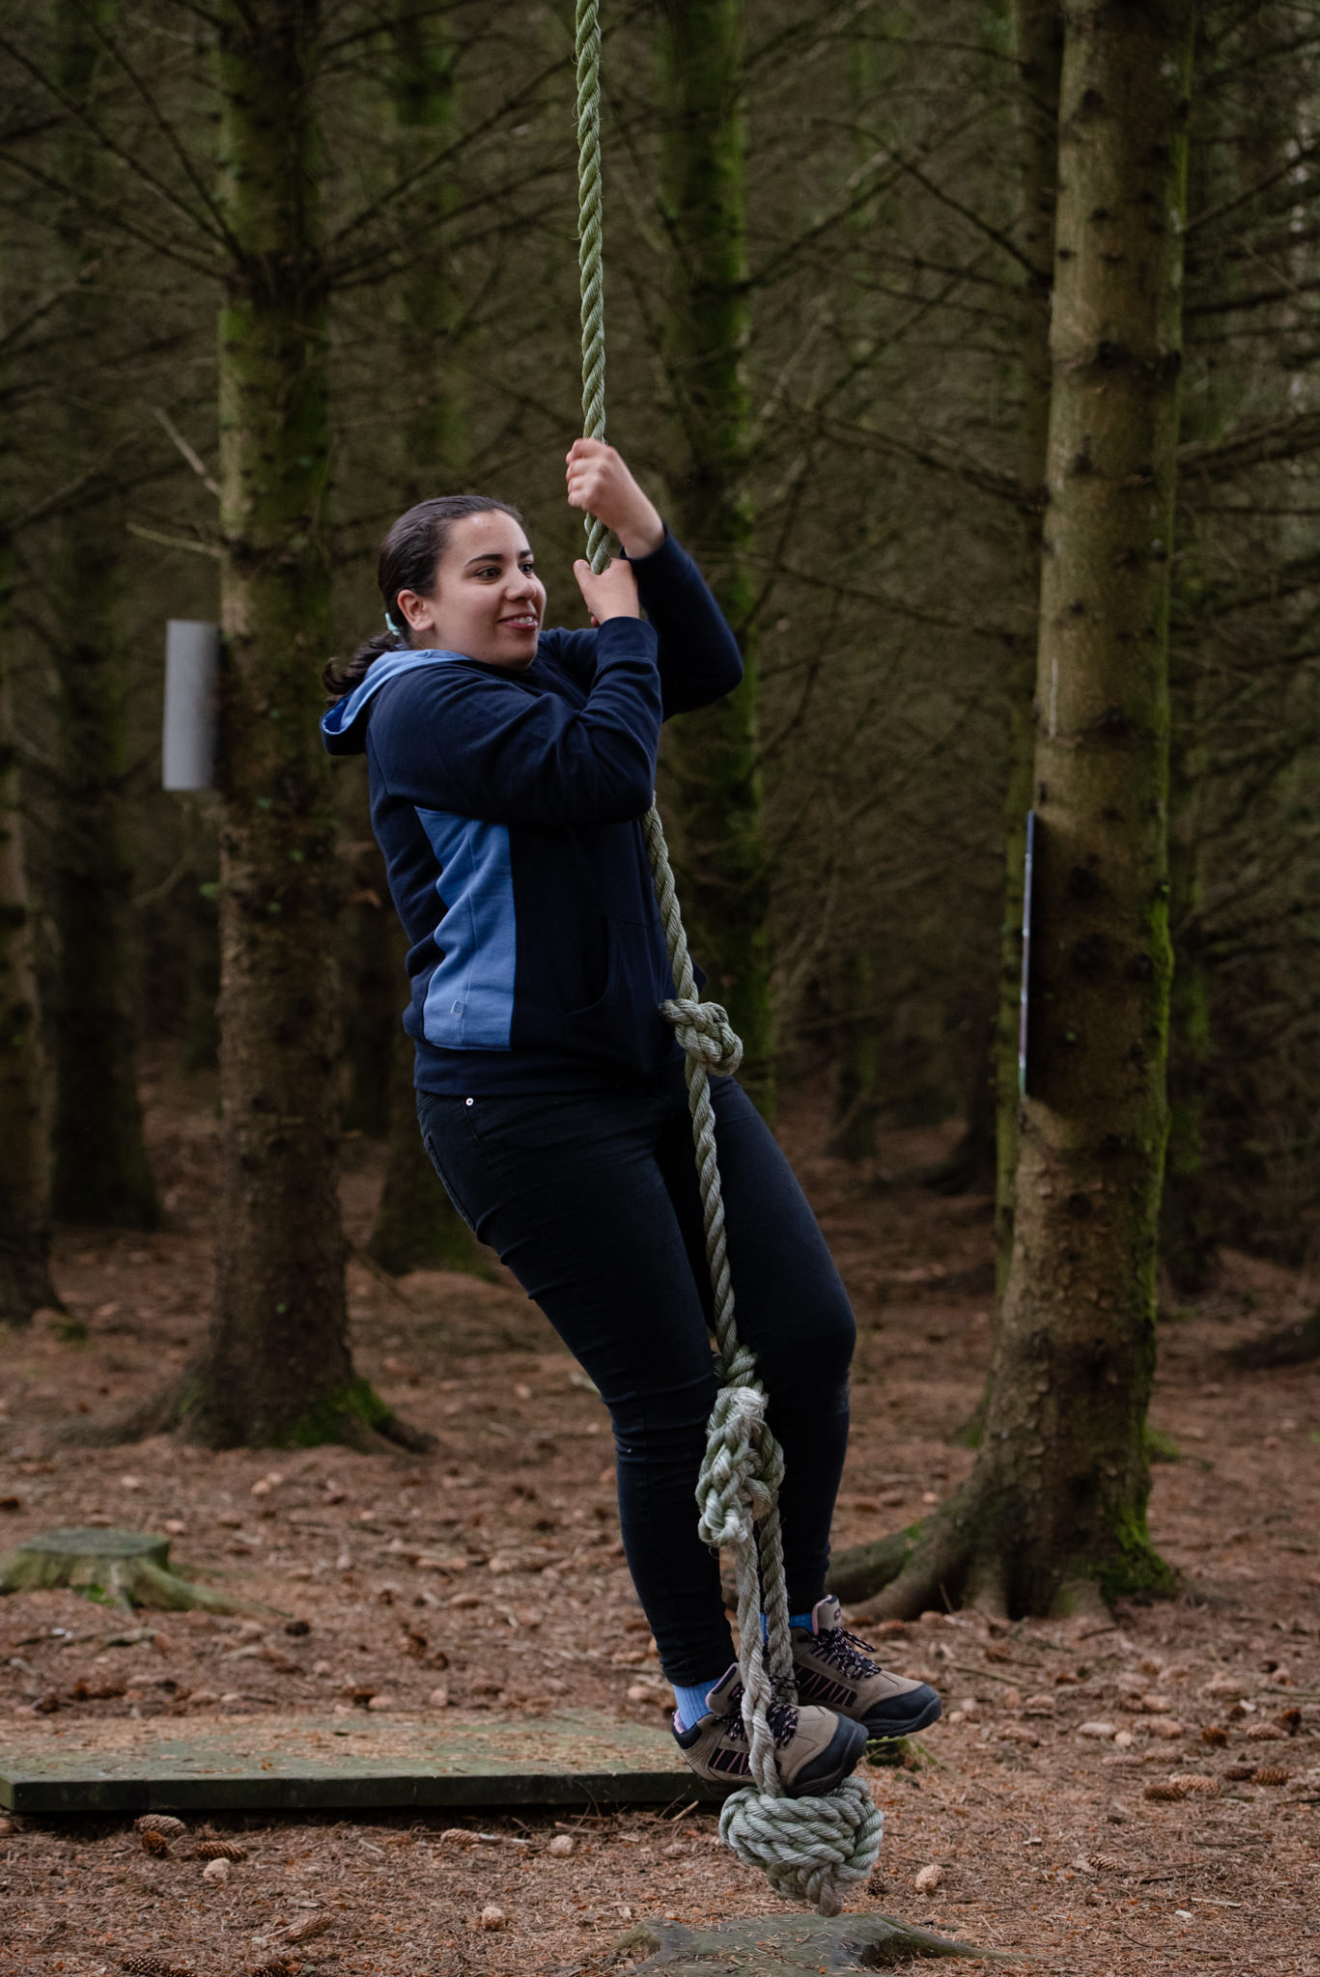
Girlguiding for girls and adults
In Girlguiding we create an environment where everyone can:
Create a safe space to have fun and build new friendships
Build confidence and raise their aspirations
Let everyone’s voice be heard and make our own decisions
Give everyone the chance to discover their full potential
Encourage girls and adults to be a powerful force for good

Slide 5
Local and national guiding
WAGGGS
Girlguiding
Country/Region
County
WAGGGS
Girlguiding (UK)
Girlguiding Scotland
Division
District
Your Unit!
Division
District
Unit
District
Division
County
Country/Region
Girlguiding
WAGGGS

Slide 6
Where are you?
County District/division
County Name
Key people to know in X county:
e.g. county commissioner, assistant county commissioner, volunteer support team lead, badge secretary, leadership coordinator, First Response coordinator, county treasurer
Talk about regular county events here. For example, county camps, development days etc.
District/division name
Key people to know in the district:
e.g. district commissioner
Our district has:
X Rainbow units
X Brownie units
X Guide units
X Ranger units
Talk about regular district events here. For example, district meetings, an annual district event etc.

Slide 7
Volunteering with girls at unit meetings
Roles available include:
Unit Helper
Unit Leader
Unit Treasurer
Unit Administrator

Slide 8
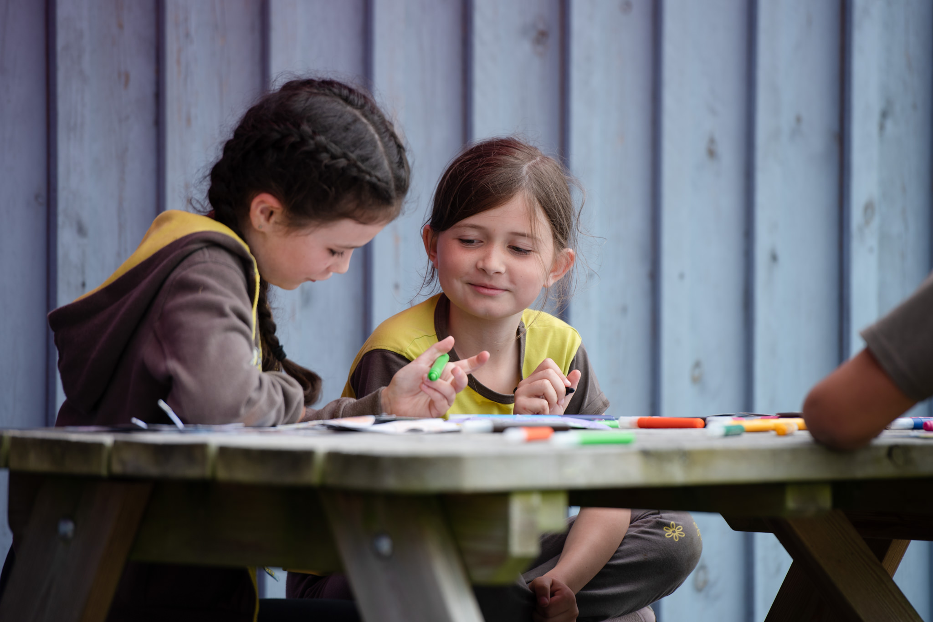
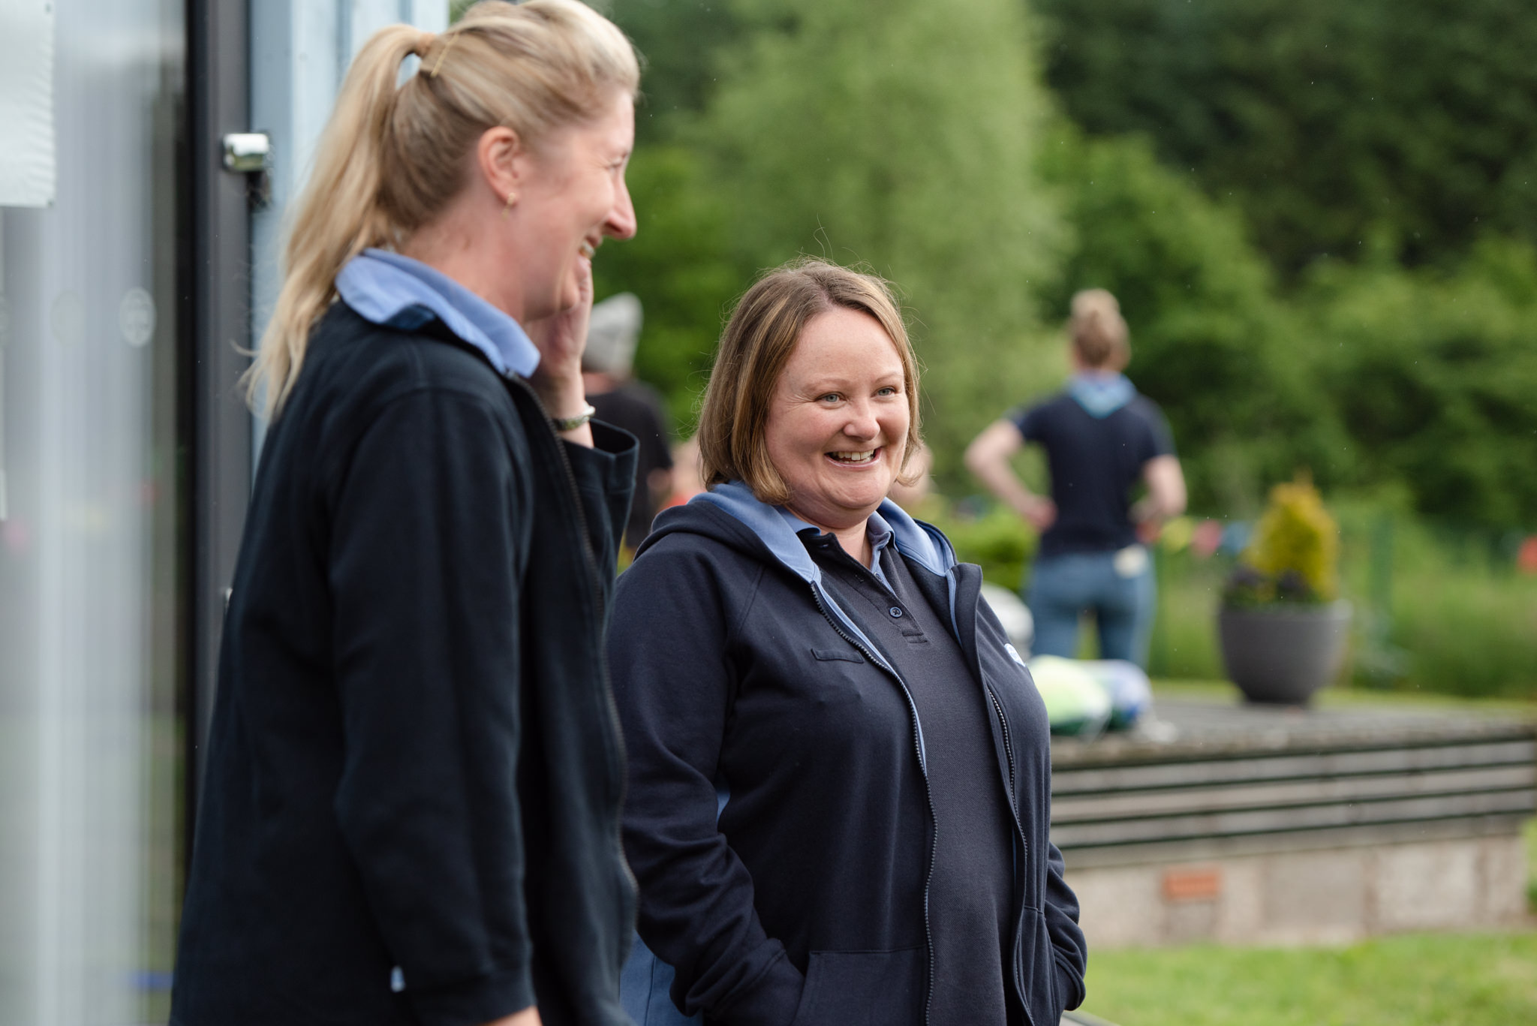
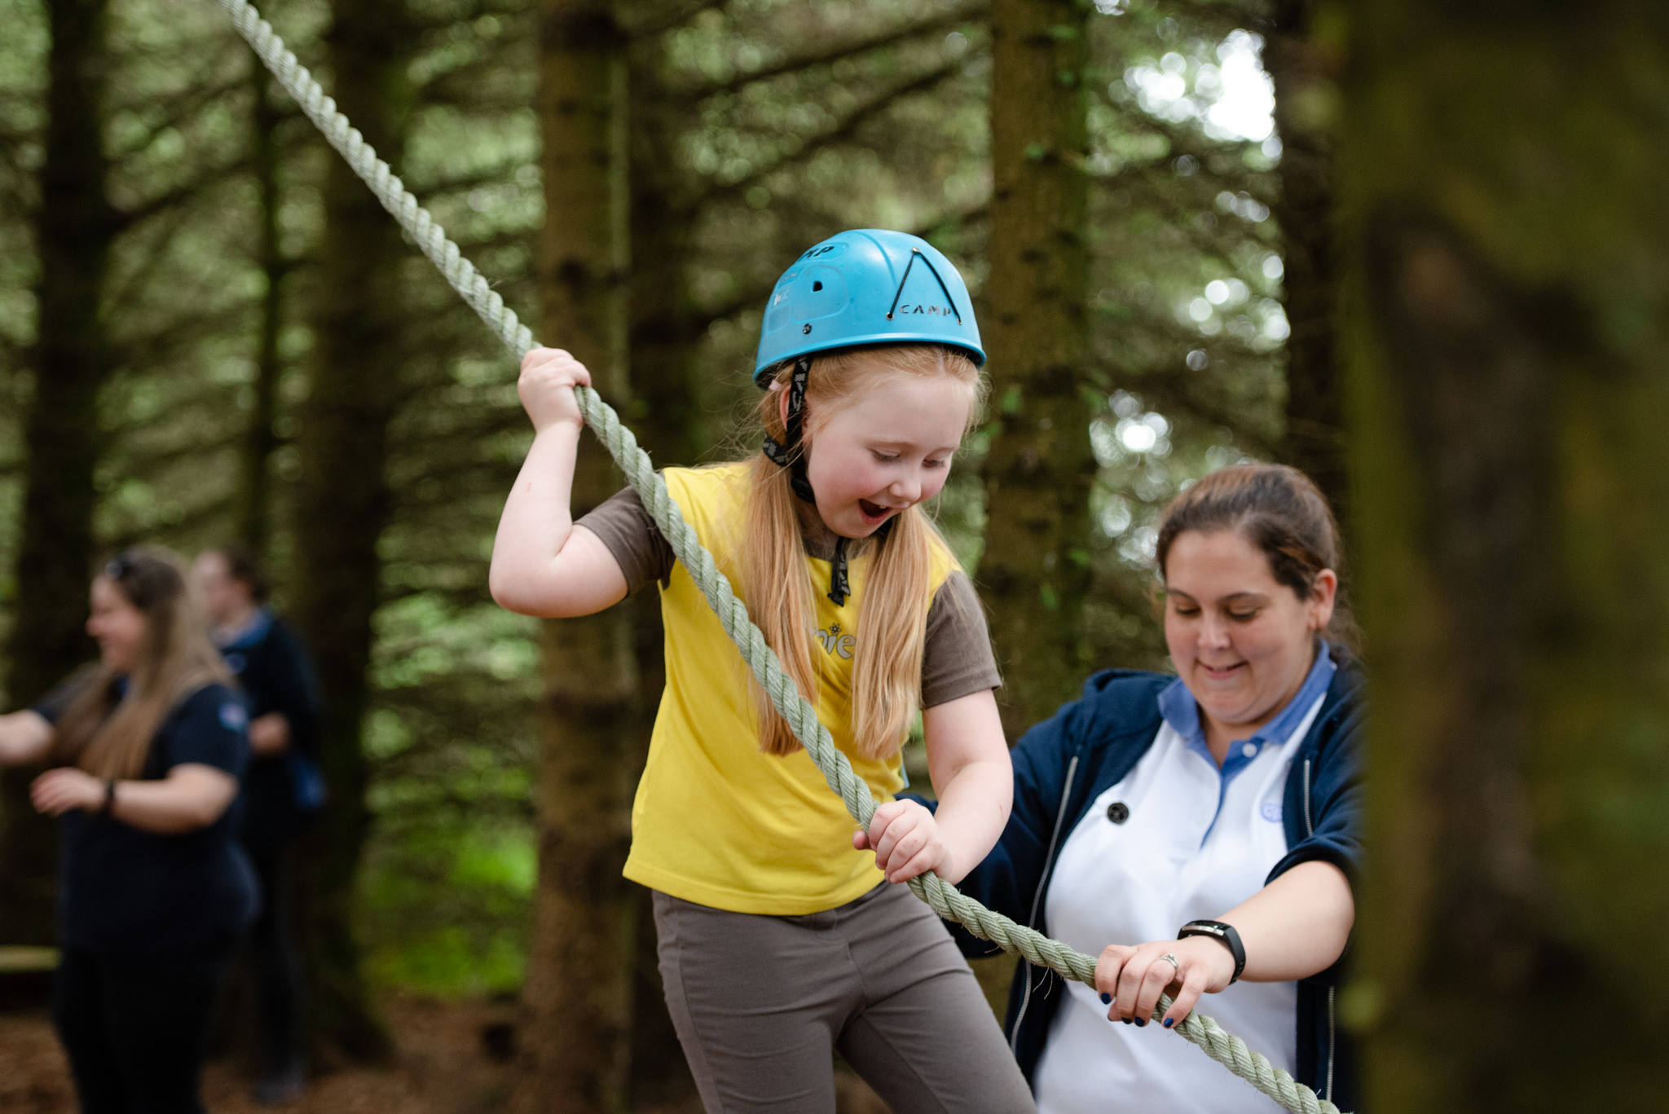
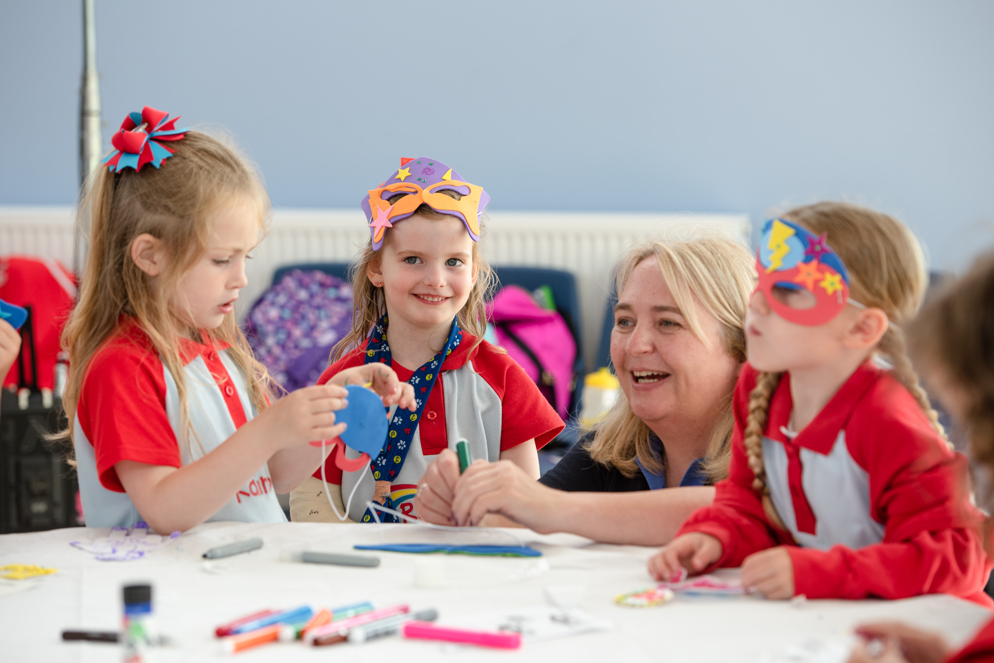
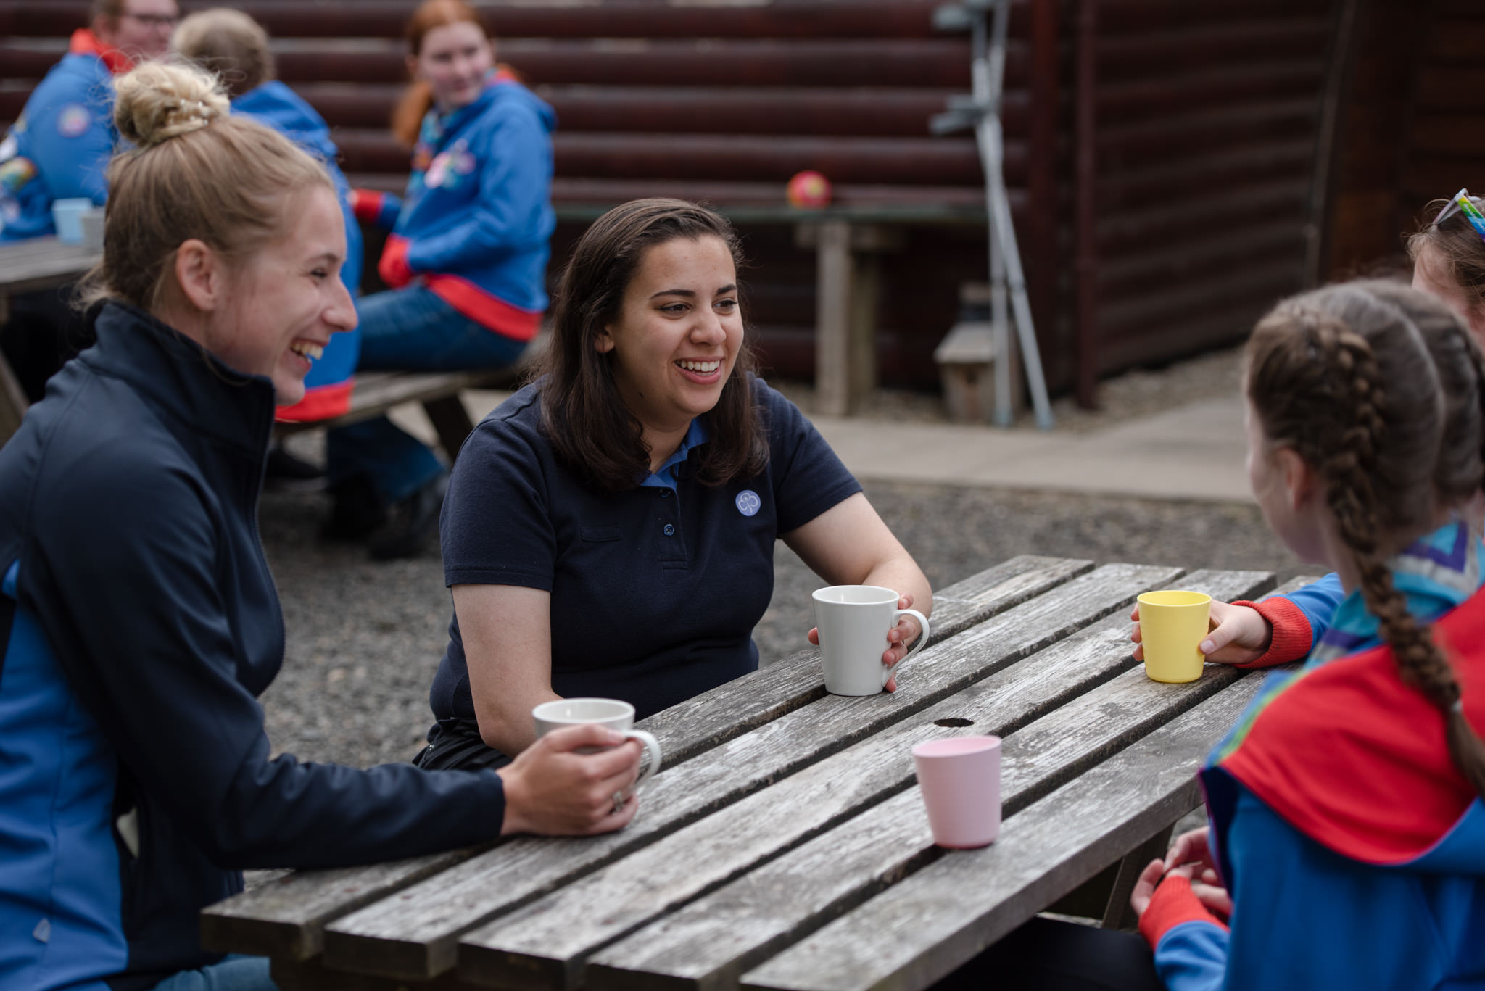
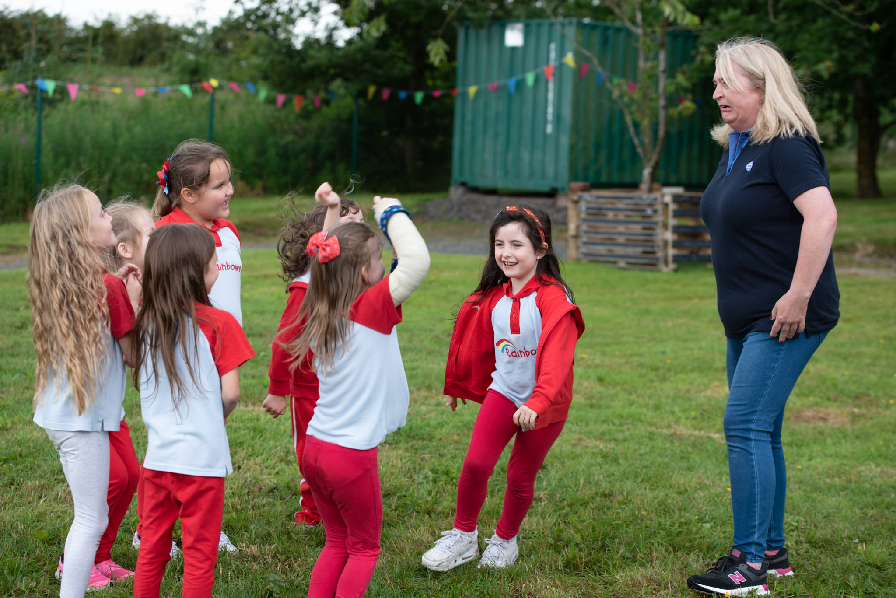
Skills you can gain from volunteering
Organisation
Cooperation
Leadership
Creativity
Administration
Flexibility

Slide 10
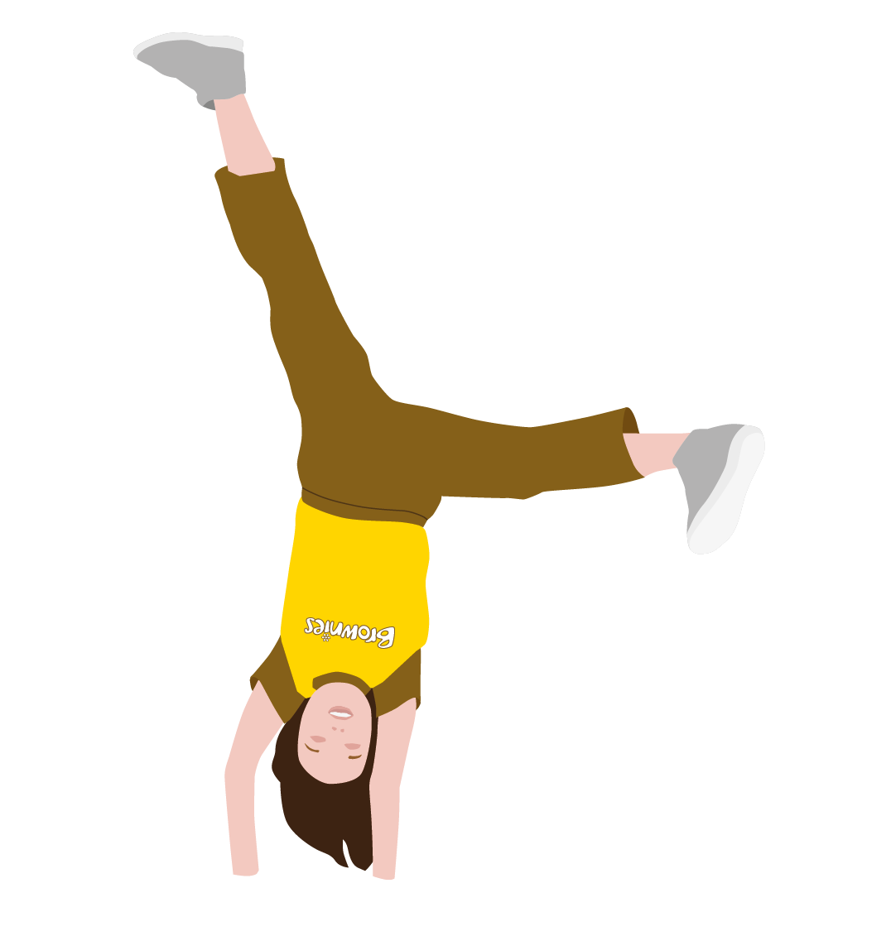
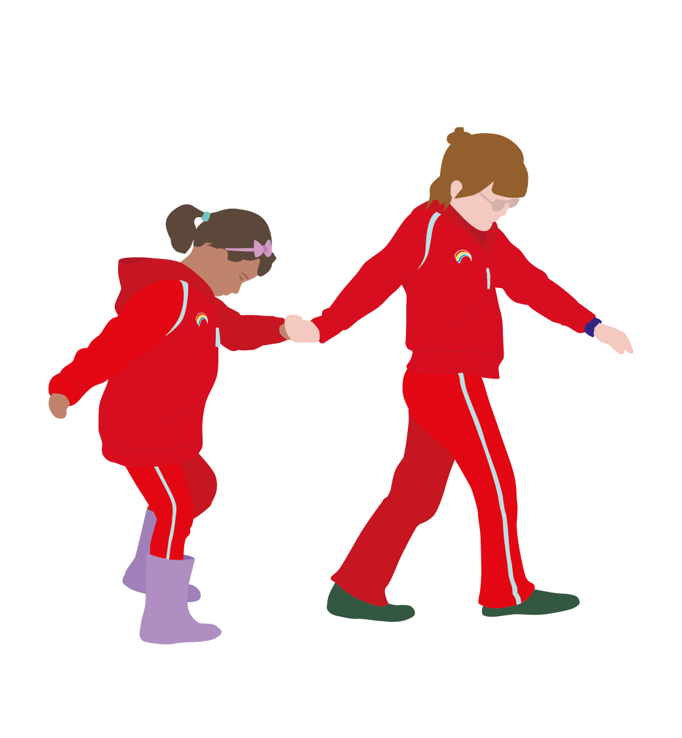
Timeline
4
10
14
18
7

Slide 11
The learning platform
The learning platform holds a variety of courses both e-learning and webinars. Some of which you need to complete, others are optional extras to boost your knowledge and confidence.
A Safe Space
The Programme training
Accounts management
Including all
And much more!

Slide 12
Jargon Busting! We’ve picked some words and phrases that might trip you up as a new volunteer. Test your knowledge, or just have a guess!

Slide 13
Commissioner

Slide 14
The Programme

Slide 15
GO

Slide 16
Subs

Slide 17
The Promise

Slide 18
FOG

Slide 19
REN

Slide 20
LQ/LDP

Slide 21
Any Questions?

Slide 22
Next Steps…
Complete A Safe Space 1 and 2
Recruitment checks:
ID Check
PVG
References
Join a unit!

Slide 23
Quote from local volunteer about why they love volunteering with Girlguiding/what they enjoy most.
Volunteer role, location.

Slide 24
Thank you! If you want any support after this session, you can email: X district commissioner

