Slide 1
Volunteering with Girlguiding Scotland
Your name

Slide 2
Hello!
A little bit about me…
xx
xx
xx

Slide 3
Girlguiding Scotland Who are we?

Slide 4
We help all girls know they can do anything.
We’re Girlguiding Scotland.

Slide 6
If this is the answer, what is the question?
9,036
After some girls gate-crashed a Boy Scout meeting in 1909 and demanded ‘something for girls too’
We help all girls know they can do anything
Notes:
Current number of volunteers
How Girlguiding started
Our purpose

Slide 8
Skills for employability What can we do for you?

Slide 9
How can volunteering address a skills or career gap?
What volunteering says about your character!
Proactive
Compassionate
Interesting
Resourceful
Friendly
Someone they want to work with!
What volunteering adds to your CV!
Specific skills e.g. admin or youth work
Soft skills e.g. leadership or communication
Experiences to talk about in an interview
A referee
Qualifications e.g. first aid, PVG
Make it work for you!
Short or long-term
As little as 30 minutes a week
Work from home
Totally flexible
You’re volunteering your time, so no pressure or expected outcomes
Also, it’s fun!

Slide 10
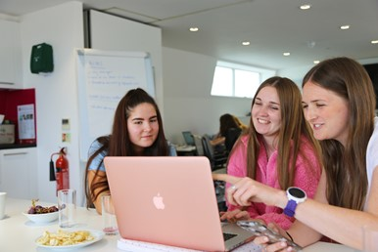
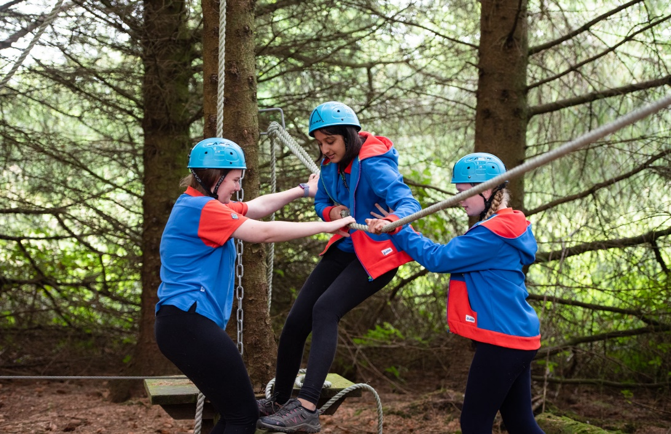
Skills you can gain from volunteering
Organisation and events planning
Cooperation and communication
Leadership
Creativity
Administration
Initiative and resourcefulness

Slide 11
Volunteering roles
Helping children and young women at unit meetings
Roles available include:
Unit helper
Assistant leader
Unit leader

Slide 13
Volunteering roles
Supporting units in your area
Additional roles available include:
Administrator
Secretary
Treasurer
Retail
Photographer
Events planning
Fundraising
Social media
Be a unit helper once a fortnight, and every other week keep the accounts up to date!
The list goes on!

Slide 14
What do our volunteers think?
Volunteering with Girlguiding makes you more employable!
67% of volunteers say Girlguiding has improved their employment prospects
86% of volunteers say Girlguiding has helped them learn new skills that can be used outside of Girlguiding
90% of volunteers say Girlguiding has helped them try things they’ve never done before
90% of volunteers say Girlguiding helps them develop new ideas

Slide 15
Want to work in childcare?
Become a unit helper to get experience working with children and planning a term of activities and resources.
Want to build confidence and community?
You get to be part of a team, you have a mentor, and will empower the next generation of girls and young women!
Want to level up your conversational English skills?
It’s a relaxed fun environment to practice. Take additional trainings to go even further!

Slide 16
I have experience in HR but I want to get a degree in primary education.
Choose any role to build up soft skills, and get training in first aid, safeguarding and more via our online sessions.
I don’t have much admin experience but I want to find a career in that area
Become a unit helper to get experience working with children and planning a term of activities and resources.
I want to build up my CV with skills as I search for jobs
As well as unit helper, become an administrator and get training to work with our extensive member database

Slide 17
Becoming a volunteer. What comes next?

Slide 18
Registering your interest
Become a volunteer - Girlguiding Scotland
A local volunteer will reach out to see what you’re interested in, and invite you to say hello to the team!
You will always have a mentor to support you every step of the way.

Slide 19
Navigating the website

Slide 20
Navigating the website
Scrolling down on this page will give you info on the benefits of volunteering, types of roles, and FAQs

Slide 21
Navigating the website
You’ll fill in contact details, what role(s) you’re interested in, and location so we can find a local volunteer local to reach out and say hello.
It takes just a few minutes to register your interest.

Slide 22
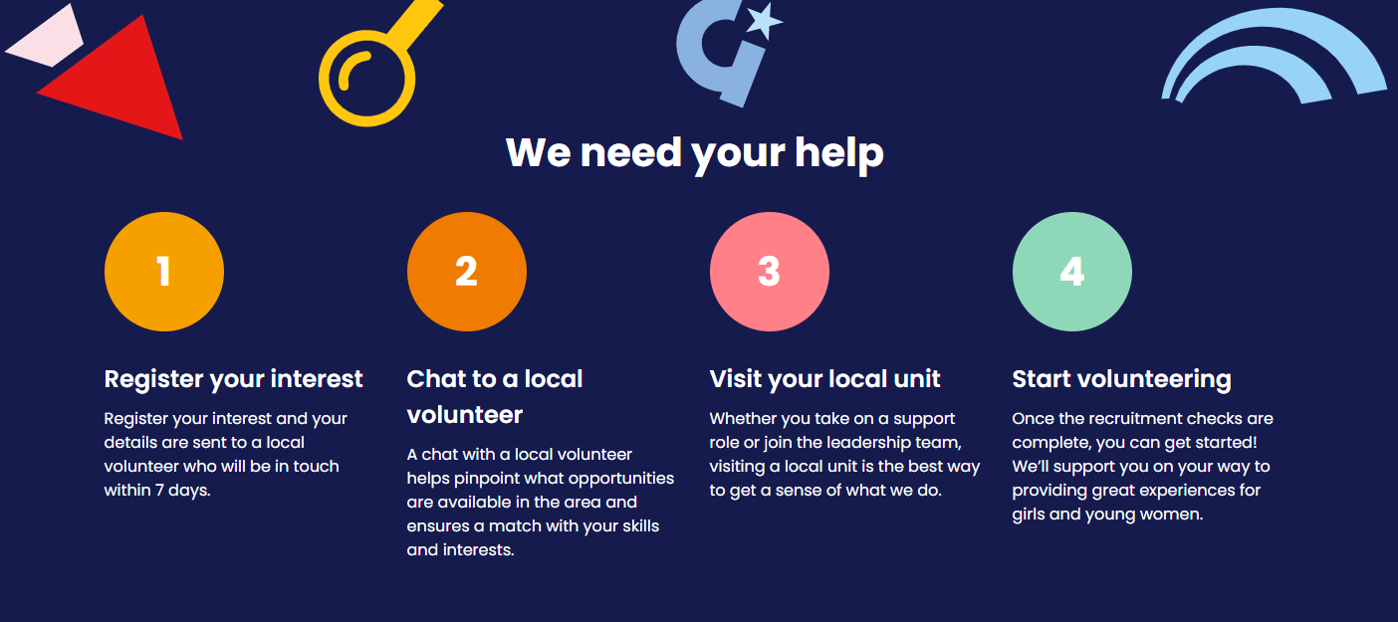

Slide 23
I wouldn’t be at my current level without Girlguiding, which offered a pathway into team management.

Slide 24
Every single job interview I’ve had Girlguiding has been mentioned at some point.

Slide 25
By giving me the space and opportunity to go along to events where often most of the participants are unknown to me, it’s helped me to be more confident and improved my ability to network.

Slide 26
I remember one particular interview where they said they didn’t particularly like the layout of my CV but they called me for an interview because it said I’d done a drug awareness certificate at Guides and I actually got the job, it was one of my first jobs.

Slide 27
I was asked to be a first aider at work because I had my qualification with Girlguiding. Its opportunities have given me the edge in the job market.

Slide 28
It’s given me examples to use in interviews and skills to put on my CV and I’m confident that it is a major factor in my progression in my professional life.

Slide 29
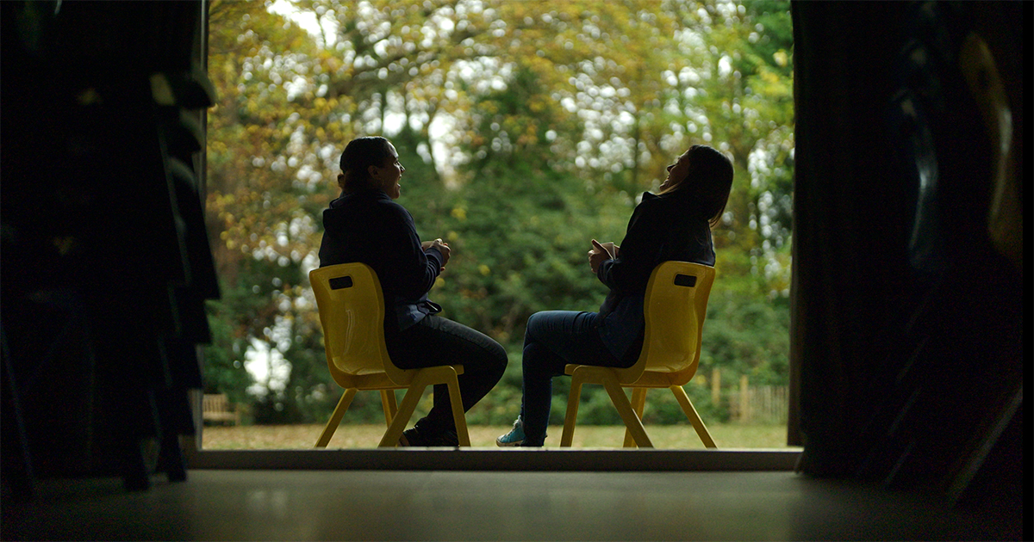
Develop leadership, boost your CV, and help young women thrive

Slide 30
Thank you!
Any questions?
If you’d like to know more, please get in touch:
Email: xx@xx
Tel: xxx
Social media: xx

