Slide 1
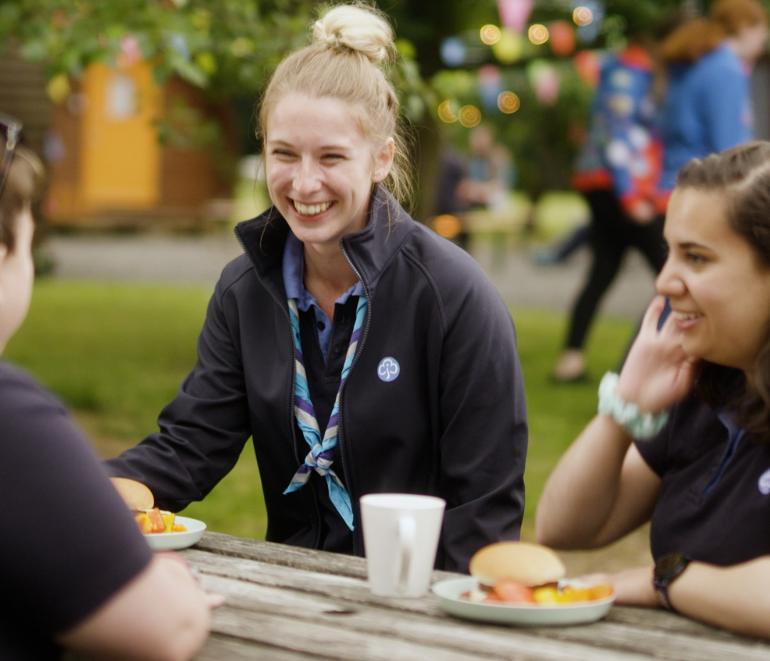

Welcoming new volunteers
Girlguiding Scotland’s role in welcoming new adult members
(Updated May 2022)

Slide 2
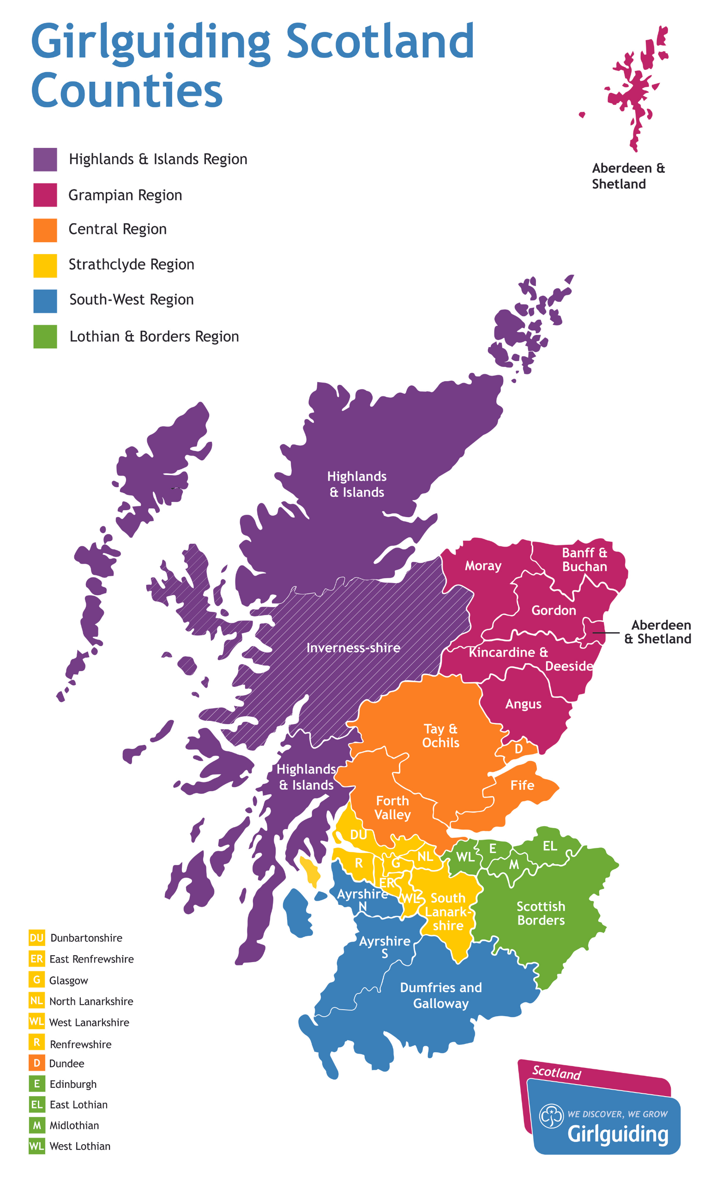
Warm Welcome From Girlguiding Scotland
Aim:
Introduce Girlguiding Scotland as a source of support for new enquirers
Ensure new enquirers receive a consistent warm welcome, wherever they are in Scotland
Important:
Adds to but does not replace local warm welcome!
Notes:
Girlguiding Scotland is supporting new volunteers in the following ways.

Slide 3
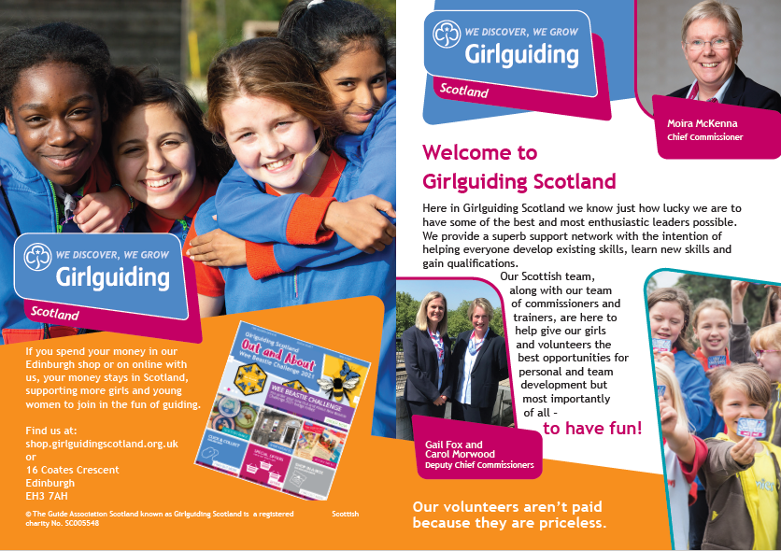
Warm Welcome What’s new?
In 2022 all new volunteer enquirers receive…
Welcome email from GGS team
A PDF Scottish welcome booklet
Note, we’re no longer offering Girlguiding Scotland Welcome sessions. Instead we’re sharing training materials to help counties run these locally if they wish
Notes:
Girlguiding Scotland is supporting new volunteers in the following ways.

Slide 4
Warm Welcome 1. Welcome email
How it works…
Girlguiding provides Girlguiding Scotland with list of every new volunteer enquirer added to go in last 7 days (whatever stage of the joining process they are at)
Girlguiding Scotland’s Membership Development & Growth Administrator sends a welcome email
The welcome email is a first ‘hello’ from the Scottish team and ensures every new enquirer can get in touch with Scottish HQ if they don’t receive a local response to their enquiry
Also includes a pdf version of our Scottish welcome booklet
Notes:
1. Welcome emails to anyone that registers interest
The membership team will send a welcome email to anyone that registers interest. This will be a warm, friendly, light touch “hello” from the Scottish team. Everyone registering will get the same email and will encourage them to explore our social media while they wait to hear from a local volunteer. They’ll use details sent by Girlguiding so emails will go out once per week to anyone that’s registered in the last 7 days. It may get quicker if the pilot proves successful.
2. A re-designed welcome booklet
The welcome email will also include a pdf Scotland welcome booklet. This Scotland-level welcome booklet will take the place of the county –level booklets that some of you may already be familiar with. Girlguiding have recently updated the booklet to ensure it complies with GDPR – the work involved in updating these for every county to make them compliant and then updating them each time the commissioners change or the map needs updated following a merger is too great. If we issue the booklets centrally, it’s one less thing to ask commissioners to do.

Slide 5
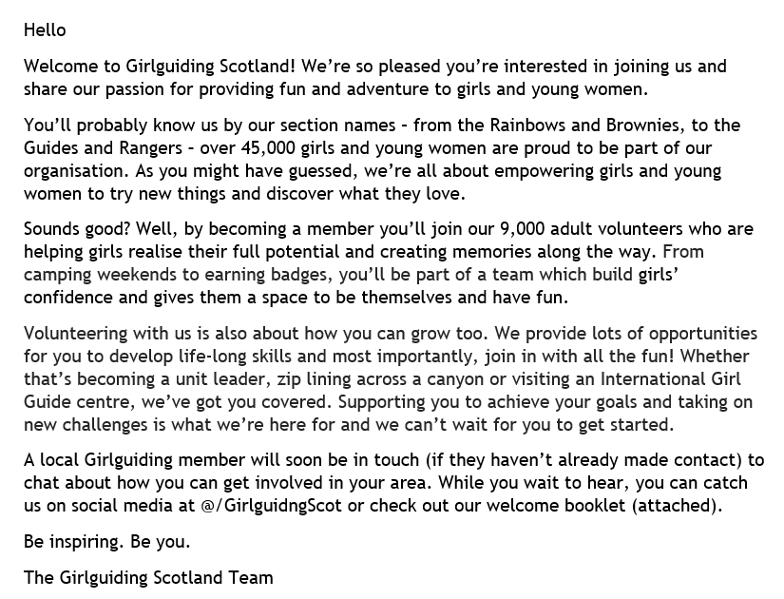
Warm Welcome 1. Welcome email
What is says…
Notes:
1. Welcome emails to anyone that registers interest
The membership team will send a welcome email to anyone that registers interest. This will be a warm, friendly, light touch “hello” from the Scottish team. Everyone registering will get the same email and will encourage them to explore our social media while they wait to hear from a local volunteer. They’ll use details sent by Girlguiding so emails will go out once per week to anyone that’s registered in the last 7 days. It may get quicker if the pilot proves successful.
2. A re-designed welcome booklet
The welcome email will also include a pdf Scotland welcome booklet. This Scotland-level welcome booklet will take the place of the county –level booklets that some of you may already be familiar with. Girlguiding have recently updated the booklet to ensure it complies with GDPR – the work involved in updating these for every county to make them compliant and then updating them each time the commissioners change or the map needs updated following a merger is too great. If we issue the booklets centrally, it’s one less thing to ask commissioners to do.

Slide 6
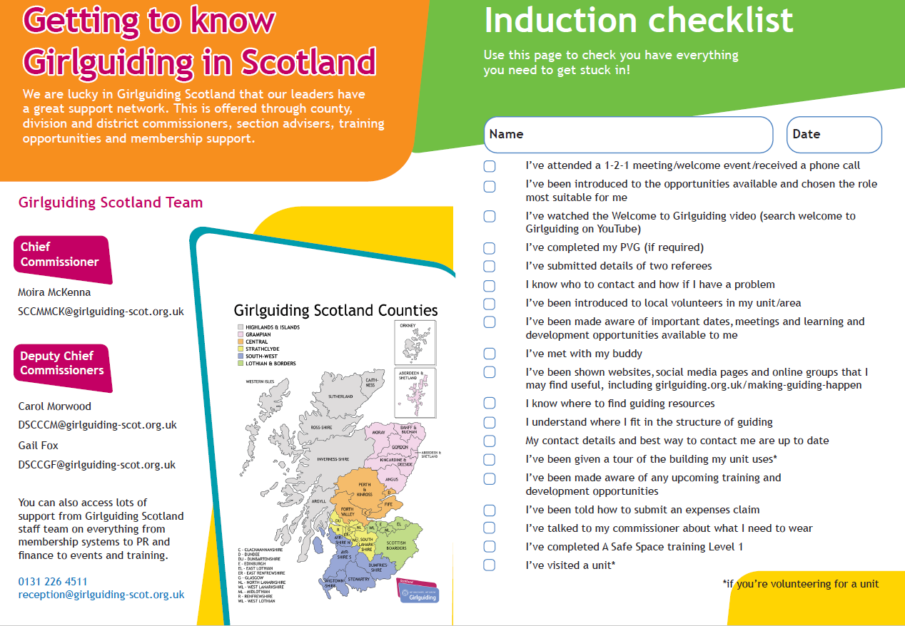
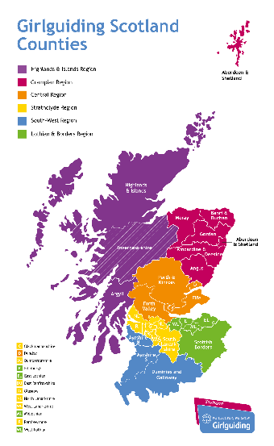
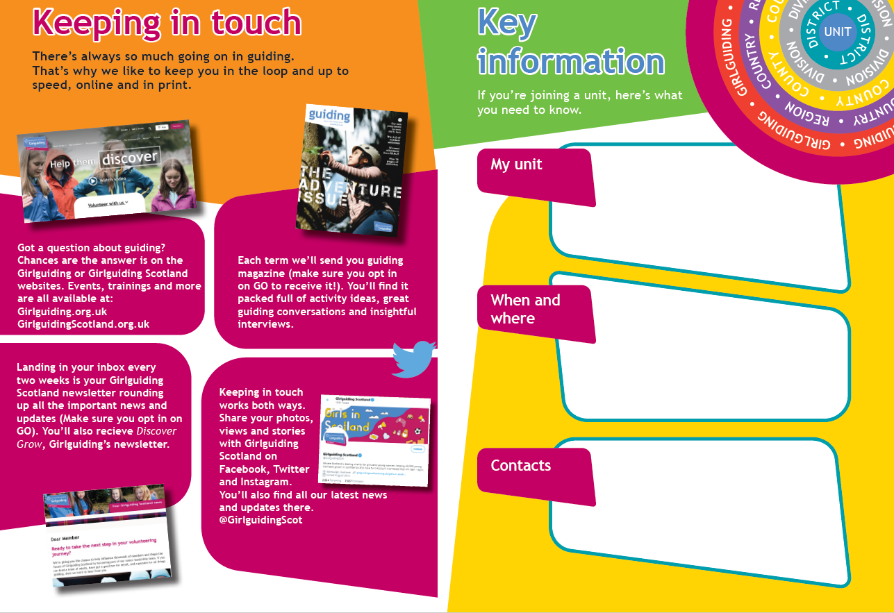
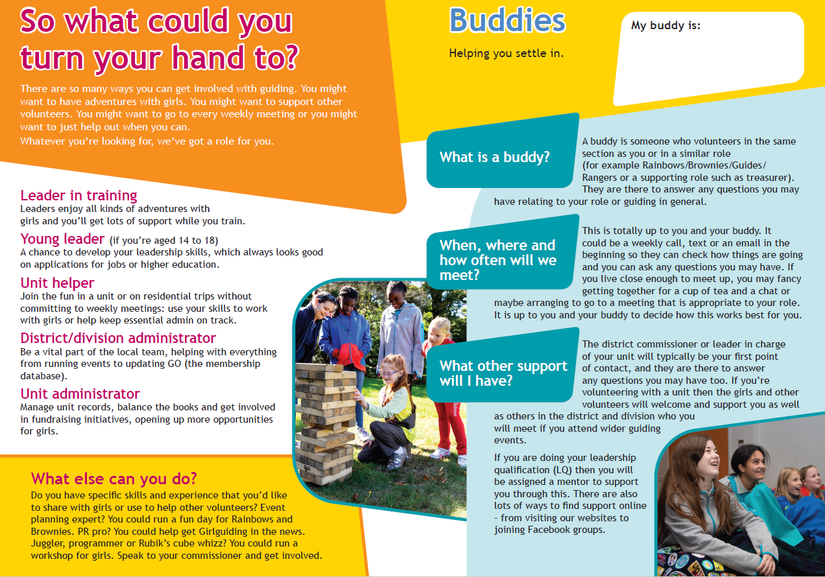
Warm Welcome 2. Welcome booklet
PDF containing…
GGS HQ contacts
Intro to guiding in Scotland
Induction checklist
Communications info
Roles available
Support available
Notes:
1. Welcome emails to anyone that registers interest
The membership team will send a welcome email to anyone that registers interest. This will be a warm, friendly, light touch “hello” from the Scottish team. Everyone registering will get the same email and will encourage them to explore our social media while they wait to hear from a local volunteer. They’ll use details sent by Girlguiding so emails will go out once per week to anyone that’s registered in the last 7 days. It may get quicker if the pilot proves successful.
2. A re-designed welcome booklet
The welcome email will also include a pdf Scotland welcome booklet. This Scotland-level welcome booklet will take the place of the county –level booklets that some of you may already be familiar with. Girlguiding have recently updated the booklet to ensure it complies with GDPR – the work involved in updating these for every county to make them compliant and then updating them each time the commissioners change or the map needs updated following a merger is too great. If we issue the booklets centrally, it’s one less thing to ask commissioners to do.

Slide 7
Warm Welcome Important things to note…
Girlguiding Scotland’s admin will not move enquirers on GO: new enquirers won’t be moved to ‘contacted’ after a GGS welcome email is sent
These Girlguiding Scotland warm welcome activities don’t replace local welcome
Counties running their own welcome sessions are welcome to use training materials provided by Girlguiding Scotland but don’t need to do so
If you’d like a copy of the available training material or help to develop your own local welcome or induction sessions please contact membershipadmin@girlguiding-scot.org.uk

