Slide 1
Flexible Guiding Conversation Starters
Notes:
Using these slides
These slides should be used alongside the Flexible Guiding Conversation Starter card deck and training pack – contact Louise Henderson (louise@girlguiding-scot.org.uk) for more information or to request a printed version of the card deck for training purposes.

Slide 2
What is flexible guiding?
Doing things differently to meet the needs of our current adults and young members
Being flexible on venues, meeting times and frequencies, the roles we offer and how we run our leadership teams
Breaking down barriers which prevent members from joining and/or getting the best out of guiding
Notes:
It’s possible to work flexibly and still follow Girlguiding’s policies and procedures.
If you’re not sure what’s allowed, contact Scottish Headquarters for advice.

Slide 3
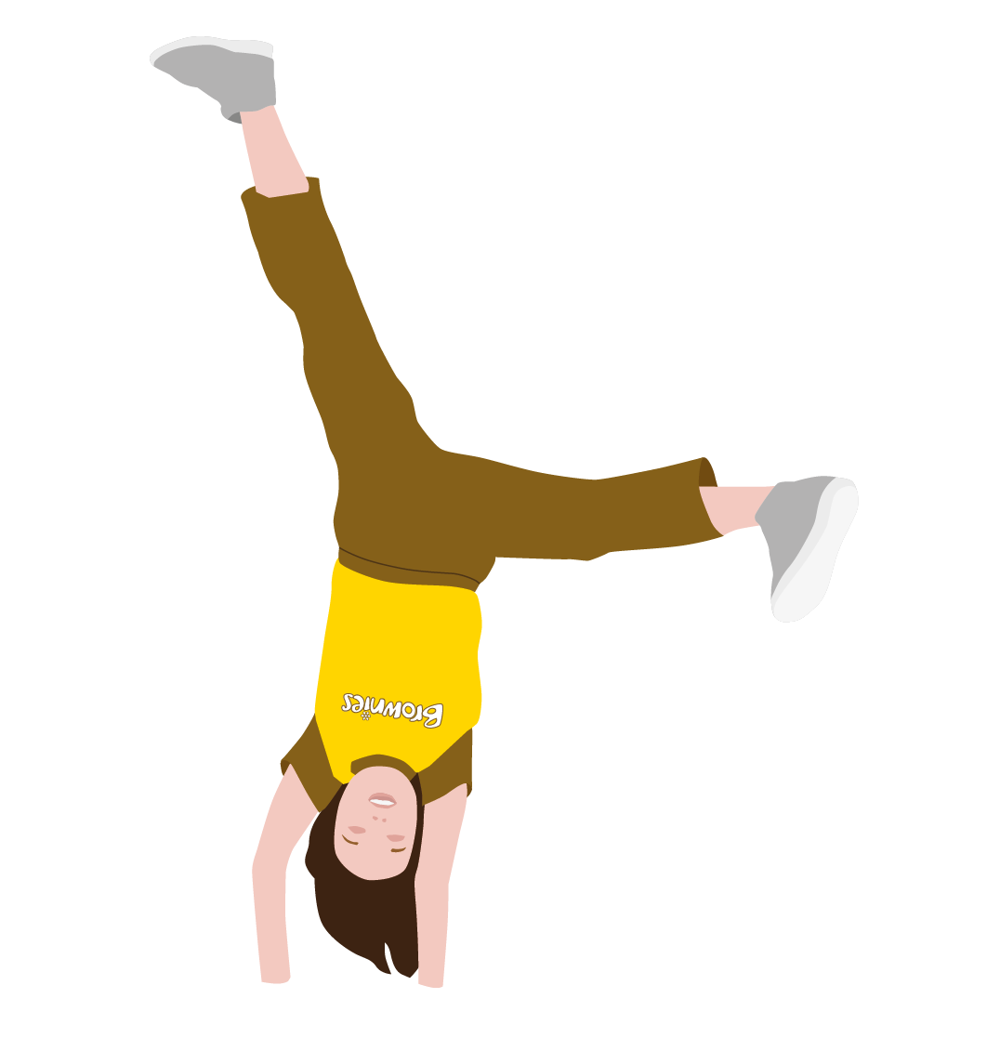
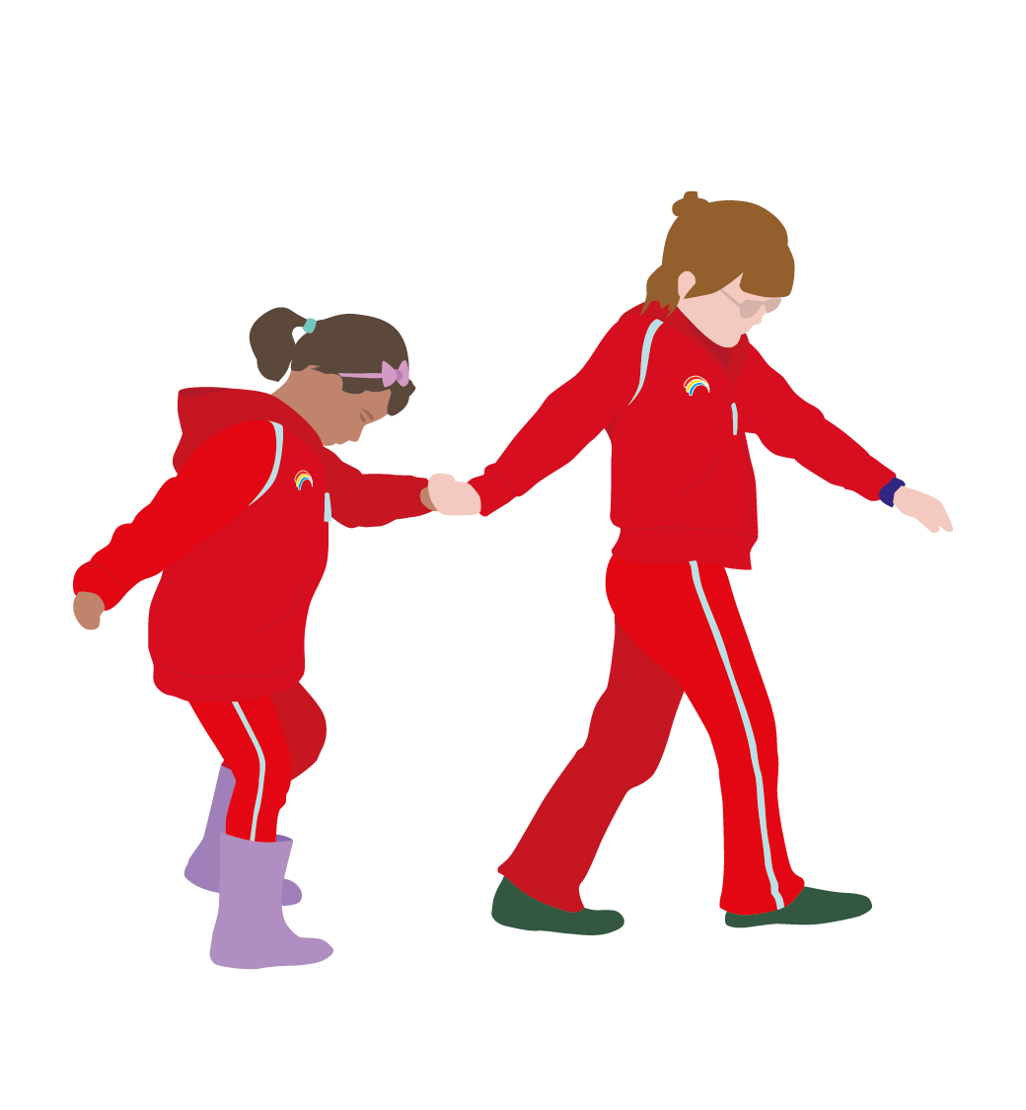
Why do we need flexible approaches ?
ACCESS is one of 4 themes within Girlguiding Scotland’s strategic plan:
Our ACCESS objectives:
Every girl and young woman who wants to join guiding in Scotland will have the opportunity to do so
Girls and adults from diverse backgrounds and communities across Scotland will want to join guiding
Every adult volunteer will receive a warm welcome and an induction specific to their role
Thinking differently will bring new members into guiding and make the experience of existing members more rewarding.
Notes:
Widening access to guiding is a strategic priority for Girlguiding Scotland because…
Our girl membership is going down even though more than 12,000 girls join each year
We’re losing girls before they’ve been in guiding for 3+ years so they’re missing out on lifelong benefits
Girls are missing out in areas without any or not enough guiding
Lives are changing and we need to make sure our offer meets the needs of today’s girls and today’s volunteers
We need more adults to help run existing units and take the pressure off our current volunteers

Slide 6
Key points…
There are lots of opportunities out there for girls and
adults
To stand out from the crowd, we need to make sure parents and girls understand what guiding offers now and in the longer term
Research shows that girls who spend 3+ years in guiding will have lifelong benefits – that’s why we want girls to stay as long as possible!
We also need to move with the times – busy lifestyles can make it difficult for both girls and adults to maintain a weekly commitment
Being rigid about what it means to volunteer or take part as a young member can stop members joining or staying in guiding
Notes:
This unit could stay attractive by…
Trying different meeting times
Trying different frequencies: fortnightly, monthly, holidays, weekends, etc
Making sure parents know what skills and values guiding offers now and in the longer term
Ensuring girls are taking the lead in the unit

Slide 8
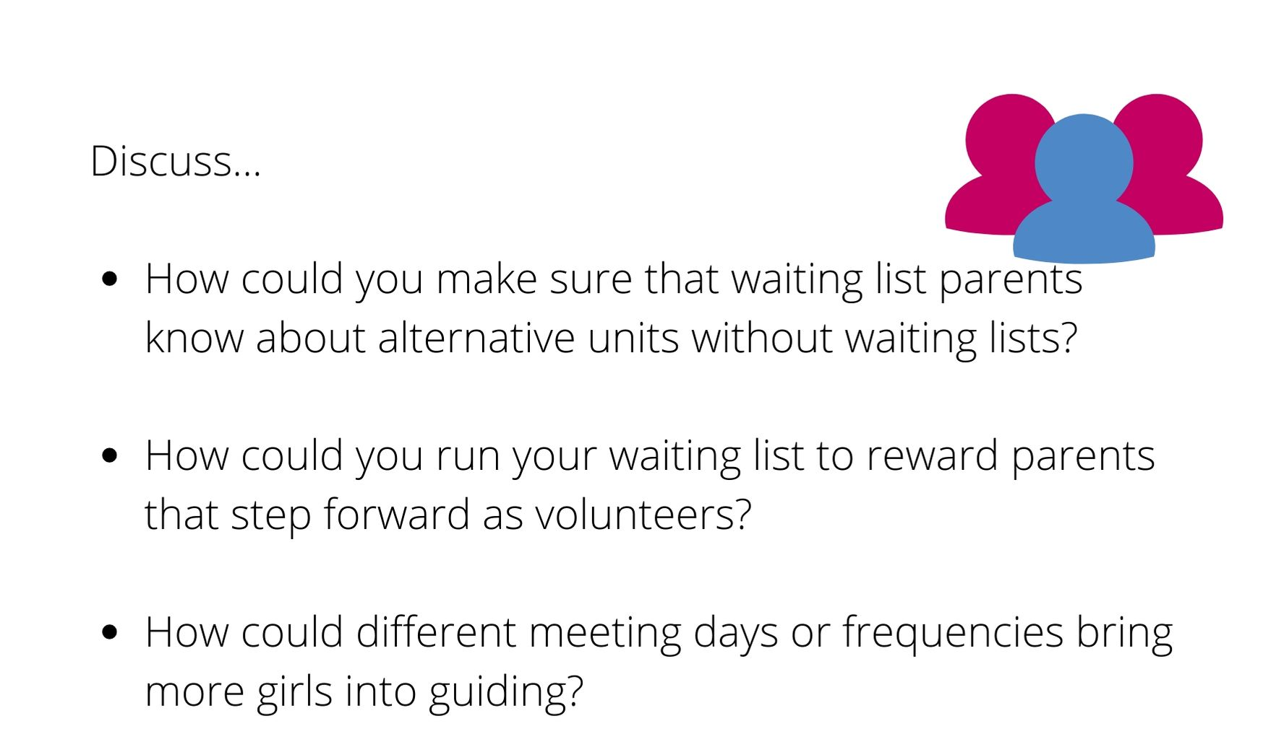

Slide 9
Key points…
Being flexible in this example is all about being open
and honest about what is and isn’t possible
Offer a choice of units where available even if it means a different night, time, location or frequency
Offer holiday guiding if it’s available in your area or the chance to join in district or division events while they wait
If you could offer a space if you had an extra adult, invite the parent to volunteer – explain the girl will be able to come along as long as the adult is there too
Crucially, don’t ignore parents because you can’t offer a space. This creates a poor impression of Girlguiding.

Slide 12
Key points…
Girlguiding suggests minimum unit sizes for each age
group:
Rainbows: 5 Brownies: 12 Guides: 12 Rangers: 5
You don’t have to wait until you reach these numbers before getting started if you’re confident you can grow the unit over time
Tasters are a great way to test the water
Joint units can be a good first step where numbers are limited – the programme lends itself to this way of working
Once you’re up and running, bring a friend activities can help to build the unit up. Free recruitment materials are available from Scottish Headquarters to help spread the word.
Notes:
Small units might be needed where there’s a low girl population or where you’re introducing guiding for the first time
Don’t be afraid to start small. It’s important to have enough girls to be able to run a good programme though – joint units are a good solution initially
If the thought of running a taster event or bring a friend night is daunting, contact Scottish Headquarters for help.
They’ll share templates that can be adapted and/or put you in touch with other volunteers who have already run successful events.

Slide 15
Key points…
Society is changing - We need more volunteers to deliver
the same number of volunteering hours
Being flexible about the type of roles we offer and the time
commitment we expect will allow us to attract more adult members
Try to put yourself in a parent’s shoes – what might they imagine volunteering involves?
An open-ended commitment will put many people off. Why not ask parents to try volunteering for 4-6 weeks to see whether they like it?
Offer a range of ways to get involved, in and out of the meeting place
We often forget to mention that we’re a membership organisation when talking about volunteering. Share what you get out of volunteering in terms of fun, friendship and wider membership benefits.
Notes:
Parents will have built up an idea of what it is to volunteer based on what they see and hear about the unit
Challenge their perceptions by offering a range of ways to get involved and offer a short-term trial initially.
Emphasise that it’s ok not to want to volunteer in the meeting place every week.
Many will assume that being a leader is the only option.
Or that only women can volunteer.
If you need a template letter to send to parents about volunteering options, contact Scottish Headquarters.

Slide 16
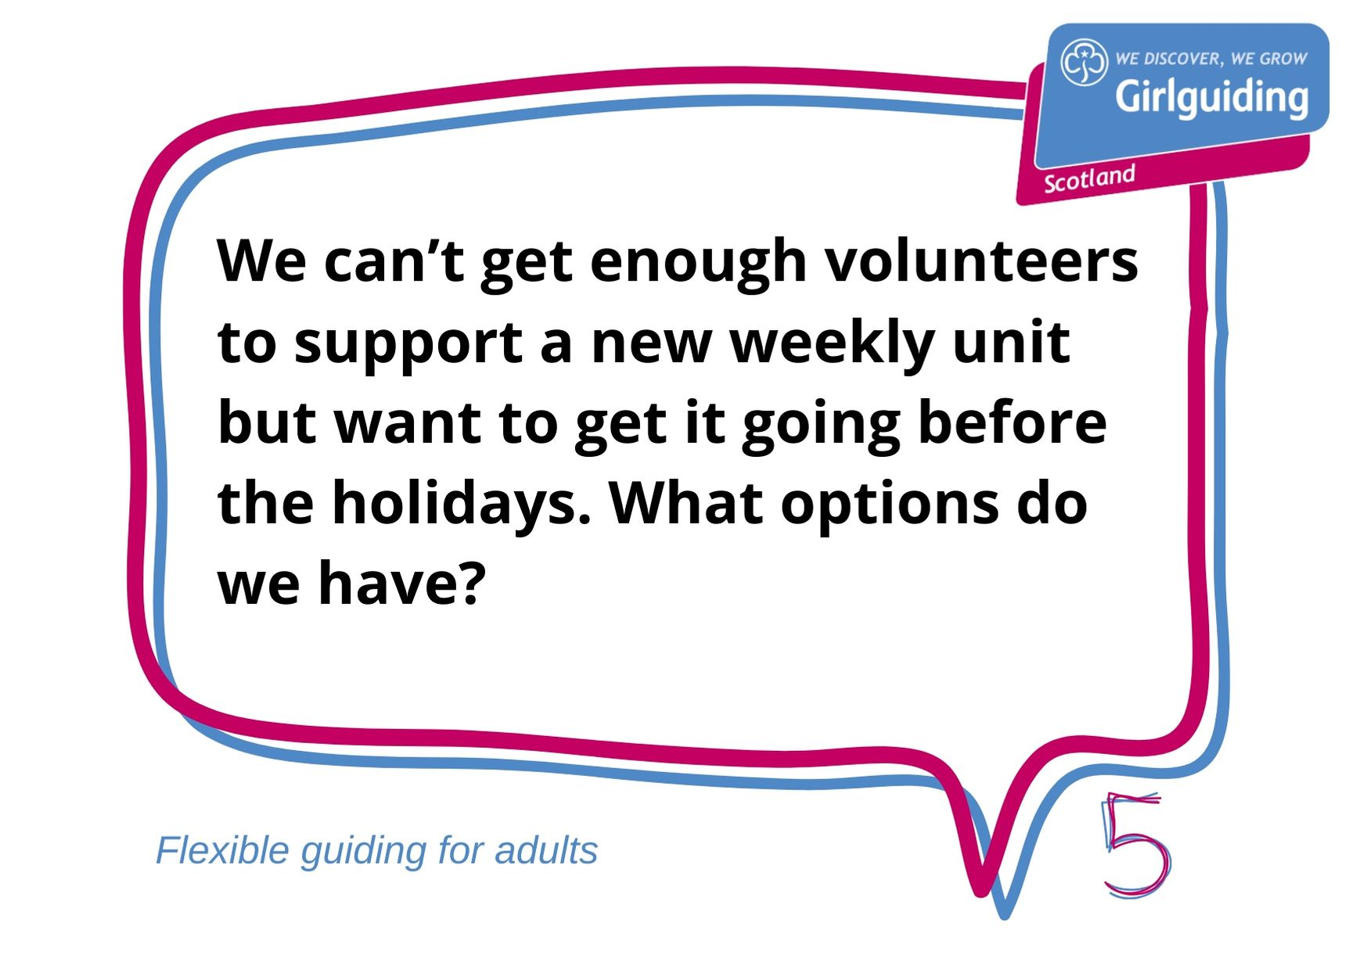

Slide 18
Key points…
Without adult support, guiding can’t happen. Being flexible
will make our volunteering offer more attractive
Adults with work and family commitments might find a weekly commitment daunting. Monthly volunteering could feel like a more manageable prospect.
Weekend units can also be attractive to those who work during the week
If you can get adults to help less frequently, you could create a leader rota or the unit could meet less frequently, for longer sessions
You could also invite leaders in training or Trefoil members in your area to support the unit for a short time while you try to recruit new volunteers

Slide 21
Key points…
There are lots of reasons why the night might need to change
including venue availability or a lack of volunteers or girls
Being open and honest about why the night night needs to change is key
Give advance notice that this might need to happen unless parents can offer an alternative solution – give a deadline for them to make suggestions
Practical things to consider include volunteer and girl numbers, venues and other activities going on in the community
If some girls or adults can’t make the new night work with your local commissioner to find alternative units for them
Accept that some might have to miss out in order to benefit the majority – it’s better to keep the unit open than have everyone miss out
Notes:
There are practical things to consider when deciding which night to meet
You need to have enough girls and adults to run – whether they are already in the unit or coming off the waiting list
You need to find an affordable and safe venue
You need to think about what else is on in the community – what will you be competing with?
If your current night isn’t working, frequent and honest communication with parents is key – involve them in making decisions rather than presenting them as a done deal

Slide 24
Key points…
Students have loads to offer you and the girls!
They’ll bring creativity and energy and give the girls younger role models to look up to
They’ll be glad of the break from the pressures of studying and grateful for the opportunity to add to their CV
Make it work by sharing your expectations about the notice they need to give if they can’t make a meeting due to a deadline, exam or holiday
Guiding can offer a welcome connection to home. If you’re sending girls off to university or college, give them the chance to join your residentials and involve them in planning calls
Notes:
How often do we hear that students are unreliable or will ‘only’ commit for 4 years?
Guiding has loads to gain from involving students. They will often bring invaluable experience and enthusiasm.
Guiding has loads to offer them too. This can be a challenging period with lots of change and guiding can offer stability and a connection to home.

Slide 26
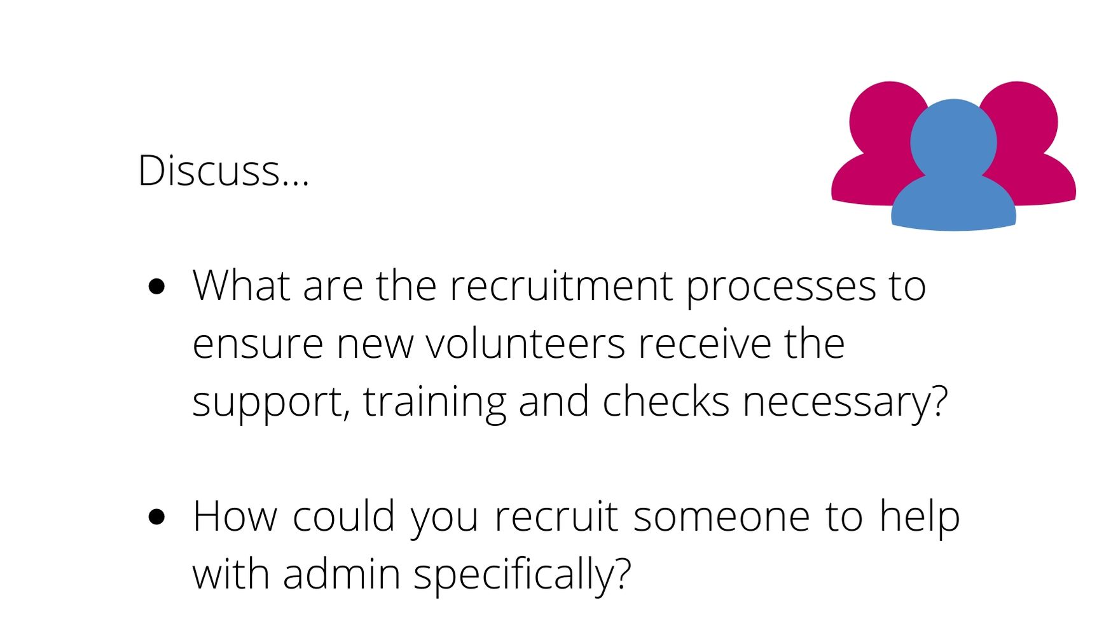

Slide 27
Key points…
All units can recruit a unit administrator to help
manage admin.
The role can be held by any adult age 18+
They should be a member of Girlguiding or be willing to join us
If joining, they will be required to complete the recruitment process and provide 2 references
Tasks the unit administrator might do include:
Responding to joining enquiries
Responding to enquiries from parents of existing members
Managing admin for trips or other activities
Helping maintain financial records
Notes:
Girlguiding have produced a role description for a unit administrator. Contact Scottish Headquarters for an electronic copy or search the Girlguiding website.
Scottish Headquarters can also help place online adverts to help you recruit to this role.
Administrators don’t need to be PVG-checked and can be men or women. Remember that everyone is new at some point.
There are lots of people who work in admin who could lend their skills to guiding.

Slide 30
Key points…
Every contribution to guiding is valuable.
Whether involving unit guiding or a support function
Whether short-term or long-term
Whether regular or occasional
If we have a fixed idea of what being a ‘valuable’ volunteer means we will miss out on useful skills and experience that will benefit both adults and girls already in guiding
People volunteer for lots of different reasons and all are valid. We can help people boost their CVs, learn new skills, have fun and make friends in exchange for their time, skills and enthusiasm
Talk to current and potential volunteers about what they can offer and what they want to get out of guiding – it’s a two way exchange!
Notes:
When we recruit, we’re often focused on filling a gap. Urgently.
Taking time to find out what someone wants to get out of guiding and what their skills are will help us match people to the right roles.
This is a useful analogy to describe how we sometimes approach recruitment:
You attend a speed dating event. You meet someone with similar values. There’s an instant spark. You’re excited to getting to know them more.
From nowhere they propose marriage and insist they won’t see you again if you’re not ready to set the wedding date.

Slide 33
Key points…
A change in circumstances is one of the most common
reasons for giving up a volunteering role
Being flexible could be the difference between someone staying connected to guiding or walking away altogether
Change becomes easier to manage over time – by being flexible we leave the door open for people to return in future
Ways to keep people involved could include:
Offering a less regular commitment – a rota place for example
Suggesting they support one-off events or residentials
Inviting them to join a skills pool
Regular check-ins are key – people should be able to take a step back without feeling guilty or that their only choice is to leave completely
Notes:
Not sure what a skills pool is or how to set one up? There’s a handy guide on the Girlguiding website.

Slide 36
Key points…
There’s flexibility in the number and length of sessions
offered as well as the shape of the leadership team
The practical stuff: girls can become full members, wear uniform, pay census and stay active during term time, working independently on badges with parental support
There are benefits for girls, parents, new and experienced volunteers:
A great way to get a taste of volunteering or try out a new role
A fast track to completing the Leadership Qualification
A way to get waiting list girls into guiding or set up guiding in a new area
A route into the next section for girls unsure about moving up
An alternative to taking on another weekly term-time commitment
Notes:
Holiday guiding can be an amazing experience for both adults and girls!
It doesn’t mean giving up your whole holiday to guiding. Most holiday projects involve a rota so that leaders swap in and out
Holiday units can be added to GO and parents can sign up girls in the usual way
Girls can cover a terms worth of guiding over a week. They can become full members, making the promise, wearing uniform and paying census
The Flexible Guiding in Action Case Study pack includes Scottish examples of holiday guiding projects

Slide 37
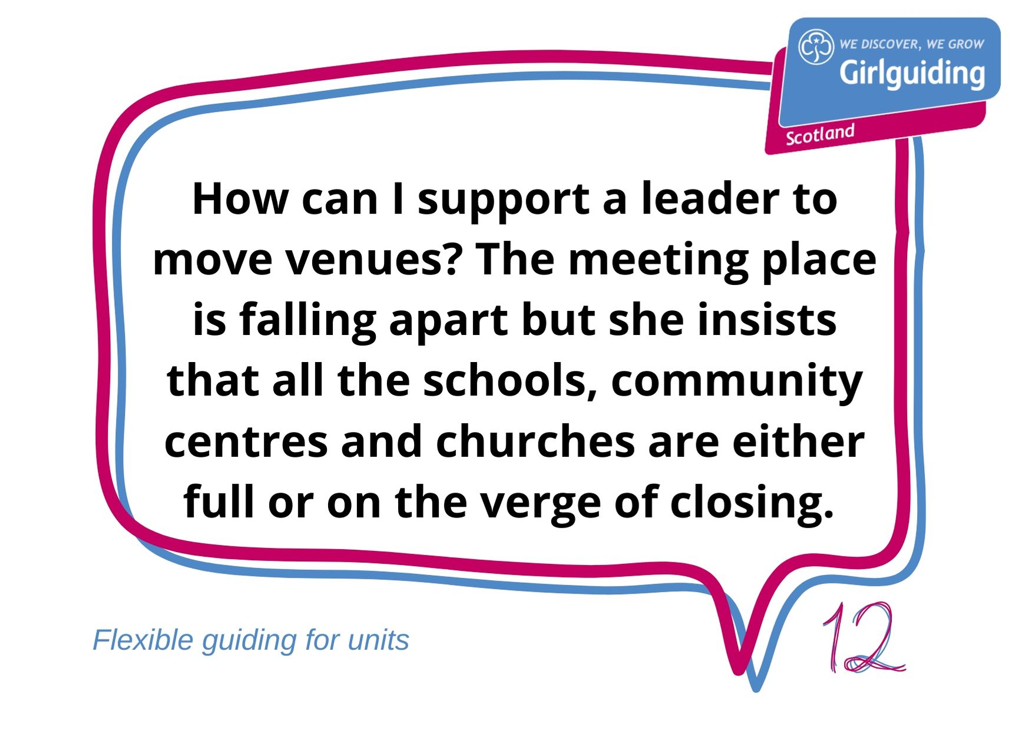

Slide 39
Key points…
Being flexible about venues could enable at risk units
to stay open
If a space has been risk assessed and deemed safe, you can hold a unit there
Ask friends, colleagues and parents to recommend venues they know of – you might be surprised about the connections they have
Venues to consider include supermarkets, cafes, gyms, sports centres, hotels, conference centres, libraries, museums and galleries, other charities, office buildings, medical centres, hospitals and many more!
Don’t rule out venues because they’re usually closed in the evenings

Slide 40
So we’ve talked a lot about flexible guiding…
What will you take away from this session?
Next steps

Slide 41
The Membership Development Team at Scottish Headquarters can signpost you to useful resources and connect you to other volunteers with experience of flexible guiding.
Get in touch: membershipadmin@girlguiding-scot.org.uk
0131 226 4511
Need more help?

